Slide 1
A new approach to reduce infant mortality and achieve equity: Presentation to Commission on Infant Mortality
Amy Bush Stevens, MSW, MPH
March 7, 2018
Copyright © 2018 Health Policy Institute of Ohio. All rights reserved.

Slide 2
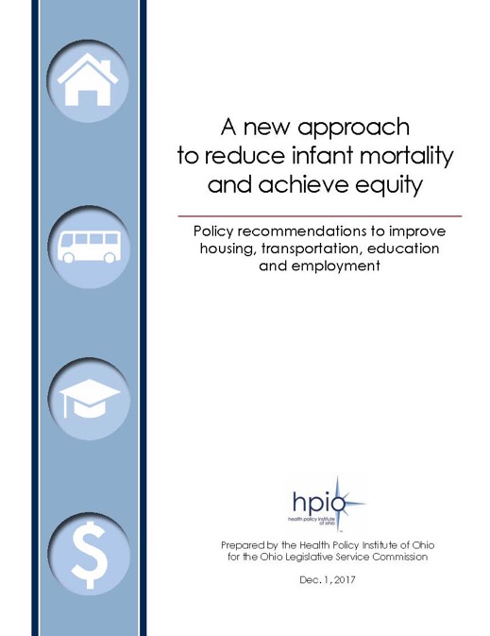

Slide 3
Who can use this report?
Copyright © 2018 Health Policy Institute of Ohio. All rights reserved.

Slide 4
Policy change starting points Recommendation examples
Community service in lieu of driver’s license reinstatement fee (SB 160) and other changes to maintain driver’s licenses
Occupational licensing reform (SB 129)
Delay criminal background checks and other changes to help families get rental housing
Copyright © 2018 Health Policy Institute of Ohio. All rights reserved.

Slide 5
Today
Why is this important?
Background and purpose
Key findings
Recommendations and next steps
Copyright © 2018 Health Policy Institute of Ohio. All rights reserved.
5

Slide 6
Improvement is possible.
Copyright © 2018 Health Policy Institute of Ohio. All rights reserved.
6

Slide 7
Infant mortality
Pre-term birth
Low birth weight
Birth defects
Child accidents and injuries

Slide 8
Infant mortality
Pre-term birth
Chronic health problems
Low birth weight
Poor nutrition
Lack of physical activity
Birth defects
Child accidents and injuries
Short birth spacing
Lack of access to care
Substance use disorders
Smoking and secondhand smoke exposure
Homelessness and housing instability
Intimate partner violence
Residential segregation
Poverty
Air and water pollution
Mass incarceration
Income inequality
Harmful working conditions
Racism
Violence
Toxic stress
Unemployment

Slide 9
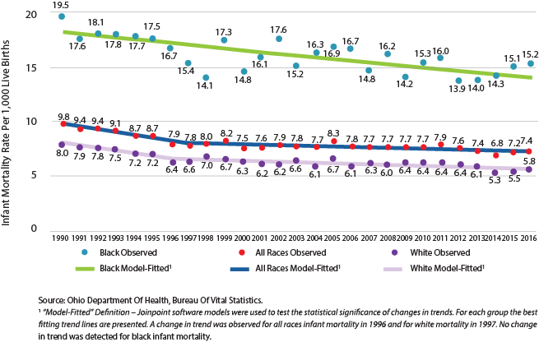
Trends in Ohio infant mortality rates, by race (1990-2016)
Copyright © 2018 Health Policy Institute of Ohio. All rights reserved.

Slide 10
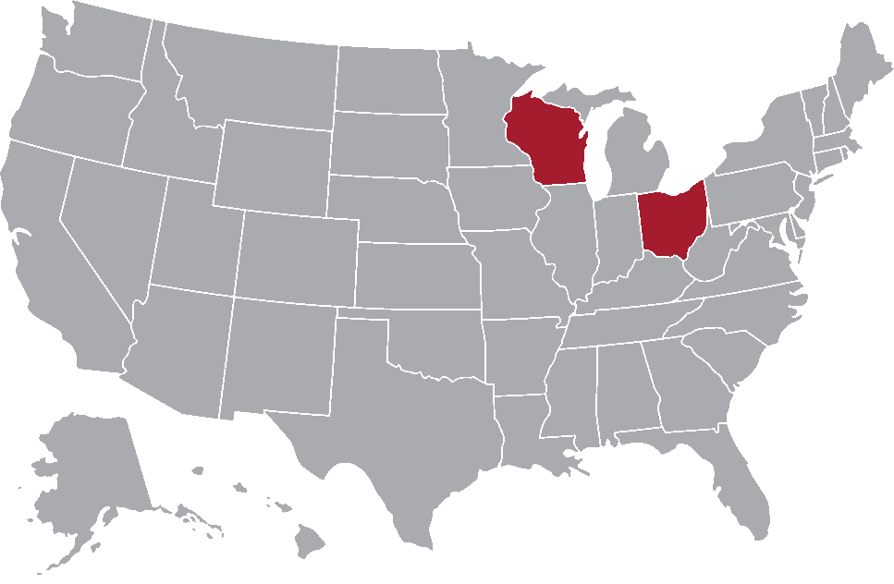
States with highest Non-Hispanic black infant mortality rate, 2013-2015 (pooled)
Source: CDC, NCHS Data Brief, No. 295, January 2018
Copyright © 2018 Health Policy Institute of Ohio. All rights reserved.

Slide 11
Ohio infant mortality average five-year rate, by county (2012-2016)
Copyright © 2018 Health Policy Institute of Ohio. All rights reserved.

Slide 12
Modifiable factors that influence health
Source: County Health Rankings and Roadmaps
Copyright © 2018 Health Policy Institute of Ohio. All rights reserved.
Notes:
Now, I’m sure you are all wondering why it is that Ohio performs poorly. The answer is complicated. The Health Value Dashboard shows us is that Ohio performs well on access to care but poorly on population health. This indicates that access to health care is necessary, in fact it is critical if you are sick, injured or have a chronic condition, but good performance on access to care alone is not sufficient to improving our overall health.
In addition, the Dashboard indicates that Ohio continues to perform poorly on the other factors that impact health value. Research estimates that of the modifiable factors that influence our overall health outcomes, 80 percent is attributed to non-clinical factors (including our social and economic environment, physical environment and health behaviors) and only 20% is attributed to clinical care (so things like access to care and healthcare system performance). And we are just not doing well in many of those areas.

Slide 13
Health equity is critical to health value.
Copyright © 2018 Health Policy Institute of Ohio. All rights reserved.

Slide 14
2017 Health Value Dashboard: Ohio’s rank
Copyright © 2018 Health Policy Institute of Ohio. All rights reserved.

Slide 15
Priority populations
Groups of Ohioans most at risk for infant mortality:
African American/black Ohioans
People with low levels of educational attainment
People with low incomes
Residents of infant mortality “hot spot” communities (mostly urban neighborhoods and rural counties with higher rates of infant death)
It is important to note that racism and inequities in the social, economic and physical environment drive the increased risk for African Americans.
Copyright © 2018 Health Policy Institute of Ohio. All rights reserved.

Slide 16
Background and purpose

Slide 17
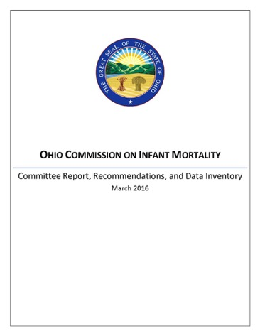
Senate Bill 332
Copyright © 2018 Health Policy Institute of Ohio. All rights reserved.

Slide 18
SB 332 requirements
Review of policies and programs: housing, transportation, education, employment
Identify opportunities to improve policies and programs
Study impact of state-funded rental assistance program
Evaluate best practices from other states
Make policy recommendations
Copyright © 2018 Health Policy Institute of Ohio. All rights reserved.
18

Slide 19
Copyright © 2018 Health Policy Institute of Ohio. All rights reserved.

Slide 20
Copyright © 2018 Health Policy Institute of Ohio. All rights reserved.

Slide 21
Key findings

Slide 22
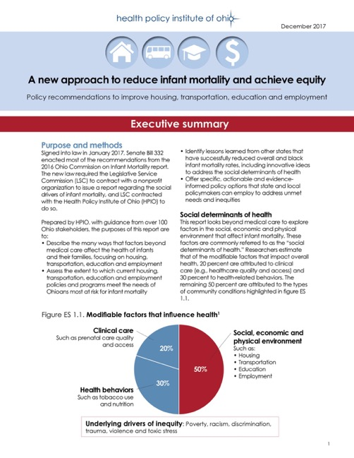

Slide 23
Key findings
Troubling trends
Troubling disparities
Access to care is necessary, but not sufficient
Community conditions are challenging for risk groups
Policymakers have many options
Copyright © 2018 Health Policy Institute of Ohio. All rights reserved.

Slide 24
Key themes for improving community conditions
Prioritize housing and employment
Connect the disconnected
Ensure all children have the opportunity to thrive
Acknowledge and address the roles of racism, discrimination, violence and toxic stress
Innovate, leverage public-private partnerships and join forces across sectors
Coordinate, collaborate, monitor and evaluate
Balance short-term fixes with longer-term change
Copyright © 2018 Health Policy Institute of Ohio. All rights reserved.

Slide 25
Case study states
Copyright © 2018 Health Policy Institute of Ohio. All rights reserved.

Slide 26
Most frequently mentioned drivers of improvement
Home visiting (Nurse-Family Partnership or other models)
Safe sleep campaigns and programs
Centering Pregnancy (or other group prenatal care models)
Medicaid policy changes (including coverage expansions in 2014 or earlier and reimbursement changes)
Policies and education to reduce early elective deliveries and C-sections
Tobacco prevention policies and/or smoking cessation programs
Copyright © 2018 Health Policy Institute of Ohio. All rights reserved.

Slide 27
Case study examples
New York
South Carolina
Copyright © 2018 Health Policy Institute of Ohio. All rights reserved.

Slide 28
Selected examples of New York State tax credits for families
Copyright © 2018 Health Policy Institute of Ohio. All rights reserved.

Slide 29
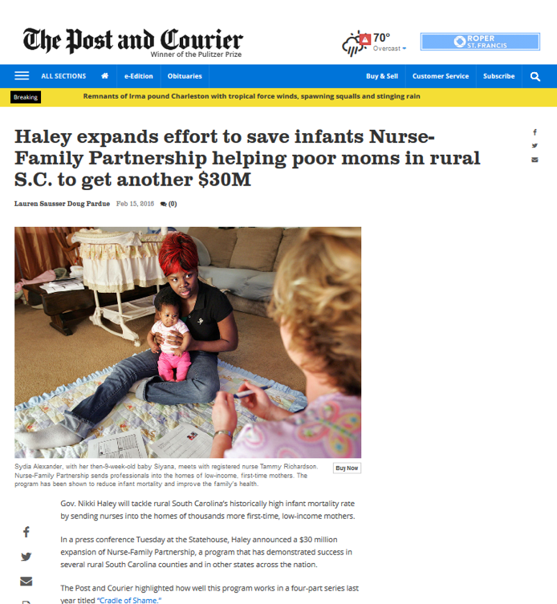

Slide 30
Recommendations and next steps

Slide 31
Copyright © 2018 Health Policy Institute of Ohio. All rights reserved.

Slide 32
Housing policy goals
Copyright © 2018 Health Policy Institute of Ohio. All rights reserved.

Slide 33
Recommendation examples: Housing
Recommendation 2.1. Delay criminal background checks and other changes to help families get rental housing
Recommendation 6.1. Rapid access to legal representation, landlord-tenant mediation, etc. to prevent evictions
Copyright © 2018 Health Policy Institute of Ohio. All rights reserved.

Slide 34
Transportation policy goals
Copyright © 2018 Health Policy Institute of Ohio. All rights reserved.

Slide 35
Recommendation examples: Transportation
Recommendation 1.4. Monitor and enforce managed care plan compliance with Non-Emergency Medical Transportation (NEMT) requirements
Recommendation 5.1. Community service in lieu of driver’s license reinstatement fee (SB 160)
Recommendation 5.2. Authorize courts to allow people with suspended licenses to continue driving to work and healthcare appointments
Copyright © 2018 Health Policy Institute of Ohio. All rights reserved.

Slide 36
Education policy goals
Copyright © 2018 Health Policy Institute of Ohio. All rights reserved.

Slide 37
Recommendation examples: Education
Recommendation 1.2. Increase number of children served by high-quality early childhood education
Recommendation 3.1. Increase capacity for secondary and postsecondary career-technical education (vocational training)
Recommendation 3.2. Increase participation of high school students in career-technical education, such as by allowing students attend Ohio Technical Centers through College Credit Plus
Copyright © 2018 Health Policy Institute of Ohio. All rights reserved.

Slide 38
Employment policy goals
Copyright © 2018 Health Policy Institute of Ohio. All rights reserved.

Slide 39
Recommendation examples: Employment
Recommendation 1.1. Expand Earned Income Tax Credit (EITC)
Recommendation 2.1. Occupational licensing reform (SB 129)
Recommendation 5.2. Consider employer’s record with Ohio Civil Rights Commission (OCRC) when determining tax incentives and assess fees on employers with regular complaints to OCRC
Copyright © 2018 Health Policy Institute of Ohio. All rights reserved.

Slide 40
Recommendation examples:
Cross-cutting
Recommendation 1. Monitor and evaluate implementation of the recommendations in this report
Recommendation 5. Coordinate, collaborate and evaluate, including data to track disparities and inequities
Copyright © 2018 Health Policy Institute of Ohio. All rights reserved.

Slide 41
Key themes for improving community conditions
Prioritize housing and employment
Connect the disconnected
Ensure all children have the opportunity to thrive
Acknowledge and address the roles of racism, discrimination, violence and toxic stress
Innovate, leverage public-private partnerships and join forces across sectors
Coordinate, collaborate, monitor and evaluate
Balance short-term fixes with longer-term change
Copyright © 2018 Health Policy Institute of Ohio. All rights reserved.

Slide 42
Key findings
Troubling trends
Troubling disparities
Access to care is necessary, but not sufficient
Community conditions are challenging for risk groups
Policymakers have many options
Copyright © 2018 Health Policy Institute of Ohio. All rights reserved.

Slide 43
How local communities can use the recommendations
Which topic(s) have the most unmet need for infant mortality priority populations in your community?
Select small number of goals within relevant topic(s)
Select relevant state-level recommendations and partner with others to advocate for them
Select relevant local-level recommendations and partner with others to enact and implement
Copyright © 2018 Health Policy Institute of Ohio. All rights reserved.

Slide 44
Next steps
OCPIM SDOH workgroup
ODH COIIN SDOH workgroup
Examples from Columbus and Akron
Copyright © 2018 Health Policy Institute of Ohio. All rights reserved.

Slide 45
Ways to get the word out and motivate action
Support or introduce legislation that aligns with recommendations
Reach out to colleagues with interest in improving housing, transportation, education and employment to find common interests
Encourage state agencies to incorporate recommendations into RFPs for state-funded programs
Gather and disseminate real-life stories from your district
Write an op ed or letter to the editor in your local newspaper
Copyright © 2018 Health Policy Institute of Ohio. All rights reserved.

Slide 46
Improvement is possible.
Copyright © 2018 Health Policy Institute of Ohio. All rights reserved.
46

Slide 47
Contact
Amy Bush Stevens, MSW, MPH
Health Policy Institute of Ohio
astevens@hpio.net
Copyright © 2018 Health Policy Institute of Ohio. All rights reserved.

Slide 48
Connect with us
Visit www.hpio.net
Subscribe to
HPIO mailing list (link on our homepage)
Ohio Health Policy News (healthpolicynews.org)
Follow us
Twitter: @HealthPolicyOH
Facebook: facebook.com/healthpolicyOH
Copyright © 2018 Health Policy Institute of Ohio. All rights reserved.

Slide 49
How to prioritize manageable set of goals and recommendations
Copyright © 2018 Health Policy Institute of Ohio. All rights reserved.

Slide 50
Advisory Group Sectors
Copyright © 2018 Health Policy Institute of Ohio. All rights reserved.

Slide 51
Policy recommendations informed by…
Inventory of evidence-based policies and programs
(from evidence registries and systematic review)
Literature reviews
Most-improved state analysis
Suggestions and priorities from Advisory Group
Copyright © 2018 Health Policy Institute of Ohio. All rights reserved.

Slide 52
Policy recommendation development
Copyright © 2018 Health Policy Institute of Ohio. All rights reserved.

