Slide 1
Place, Policy and the Social Determinants of Health
July 27, 2017
Case Studies from The Kirwan Institute’s Health Equity Portfolio
David Norris
Senior Researcher
The Kirwan Institute for the
Study of Race and Ethnicity
The Ohio State University

Slide 2
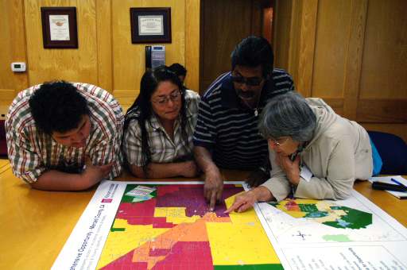
Our time together:
Mapping the social determinants of health (SDoH)
SDoH and health outcomes: Examples from Kirwan’s work
Implications for policy and practice

Slide 3
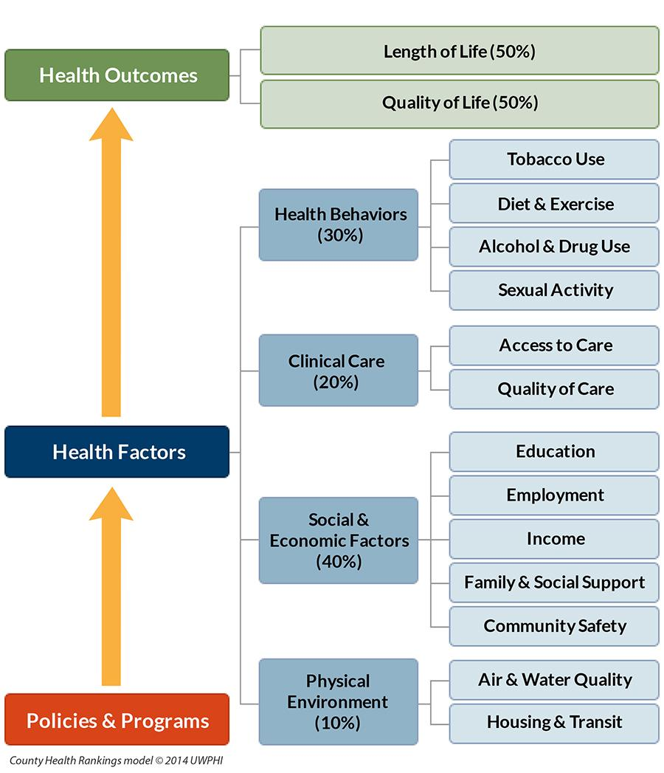
Notes:
In some neighborhoods, this might include access to high performing schools, robust job centers, a rich public transit system, well-funded police services, a well-resourced library system, and more.
In others, it sometimes means the opposite: failing schools, limited employment opportunities, inadequate public transportation, unsafe streets, deteriorating infrastructure and more.
At the Kirwan Institute, we refer to these communities as “opportunity rich” and “opportunity poor.”
Problematically, the housing one has access to, is significantly impacted by income and wealth, and the housing that many low-income families can afford in our metropolitan regions is often disconnected from opportunity.
Much of the Kirwan Institute’s housing research and advocacy, therefore, focuses on providing fair access to communities of opportunity through affordable housing development and fair housing policy.

Slide 4
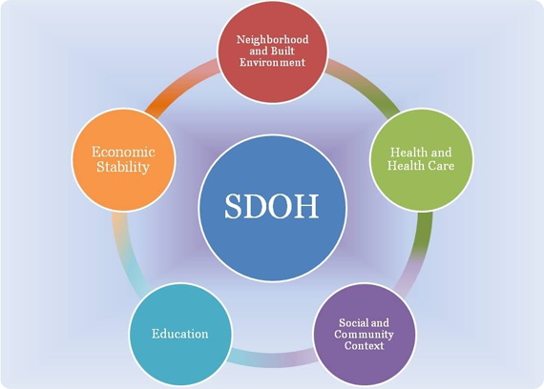

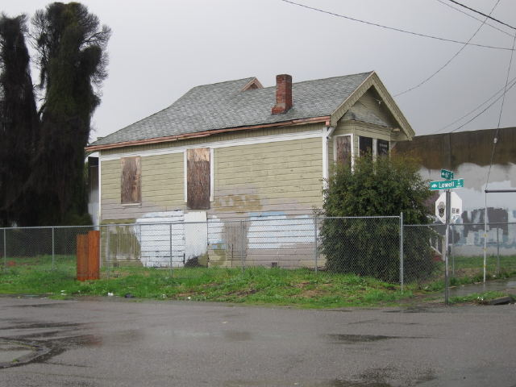
Good health extends beyond
the individual choices we make
  Place-based determinants of health:
  High-quality education
  Stable housing
  Sustainable employment
  Healthy and safe
  environment
  Access to healthy food
  Positive social networks
  Political empowerment
“Opportunity Rich”
“Opportunity Poor”
Notes:
In some neighborhoods, this might include access to high performing schools, robust job centers, a rich public transit system, well-funded police services, a well-resourced library system, and more.
In others, it sometimes means the opposite: failing schools, limited employment opportunities, inadequate public transportation, unsafe streets, deteriorating infrastructure and more.
At the Kirwan Institute, we refer to these communities as “opportunity rich” and “opportunity poor.”
Problematically, the housing one has access to, is significantly impacted by income and wealth, and the housing that many low-income families can afford in our metropolitan regions is often disconnected from opportunity.
Much of the Kirwan Institute’s housing research and advocacy, therefore, focuses on providing fair access to communities of opportunity through affordable housing development and fair housing policy.

Slide 5
Neighborhood Effects: Anchoring Vulnerabilities to Place
Many vulnerabilities
Residents of some areas experience multiple vulnerabilities; others, few
Assumption: Effects are additive
Identifying areas that experience the greatest number of vulnerabilities

Slide 6
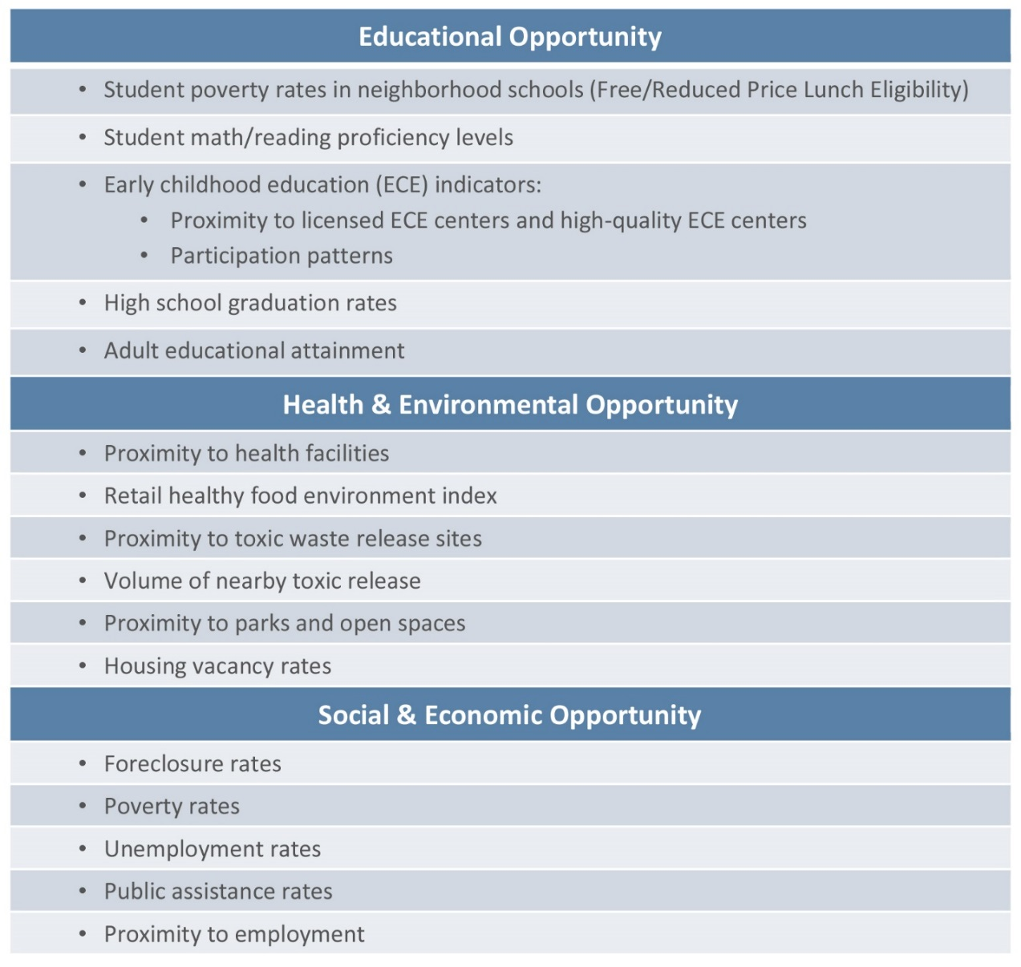
Typical Indicators in Kirwan’s Opportunity Index
ALL Reflect Social Determinants of Health

Slide 7
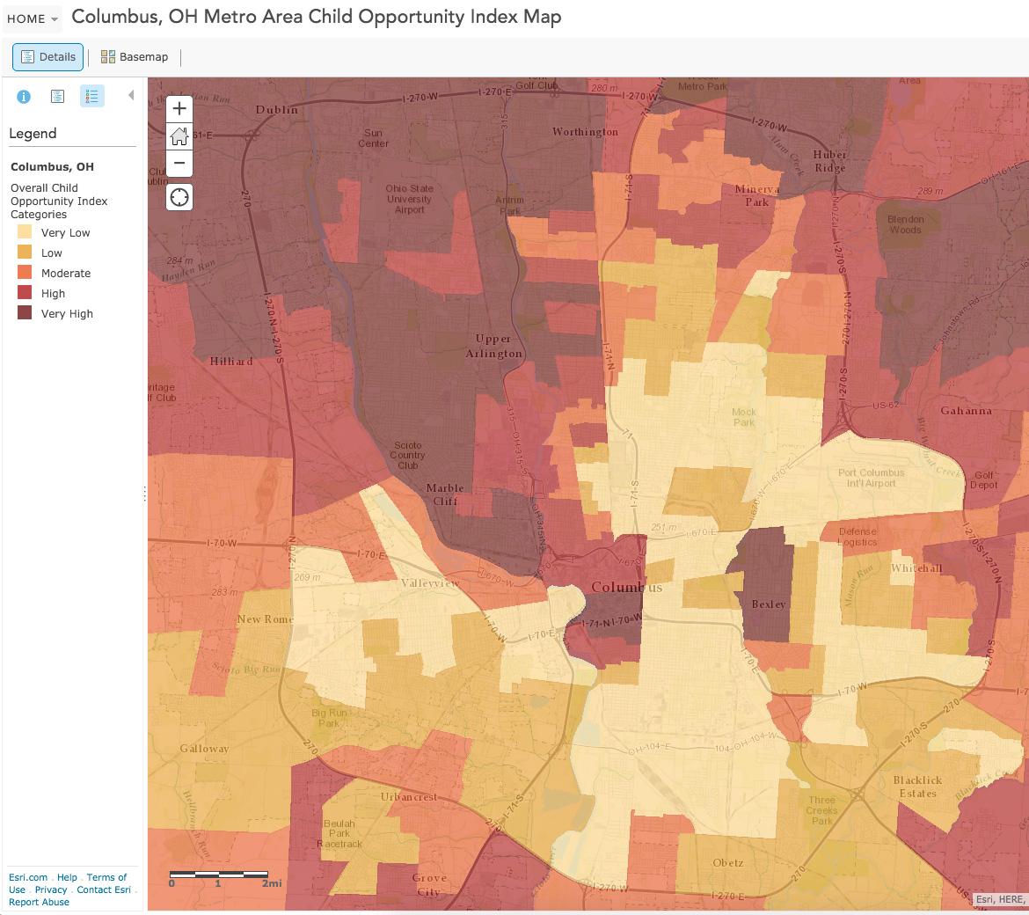
Kirwan’s Opportunity Index*
Additive Neighborhood Influences on Well-Being (+ and —)
*Child Opportunity Index developed for DiversityDataKids.org

Slide 8
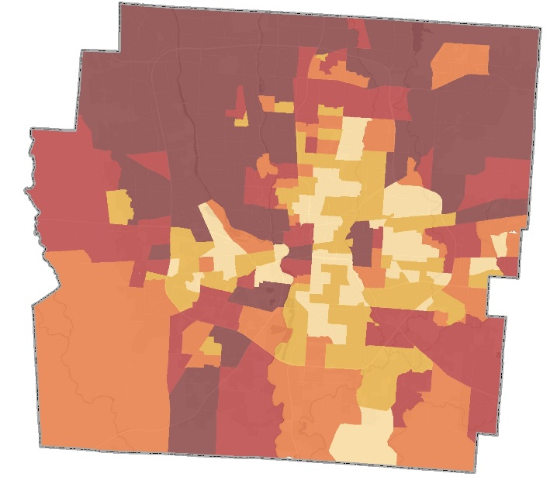
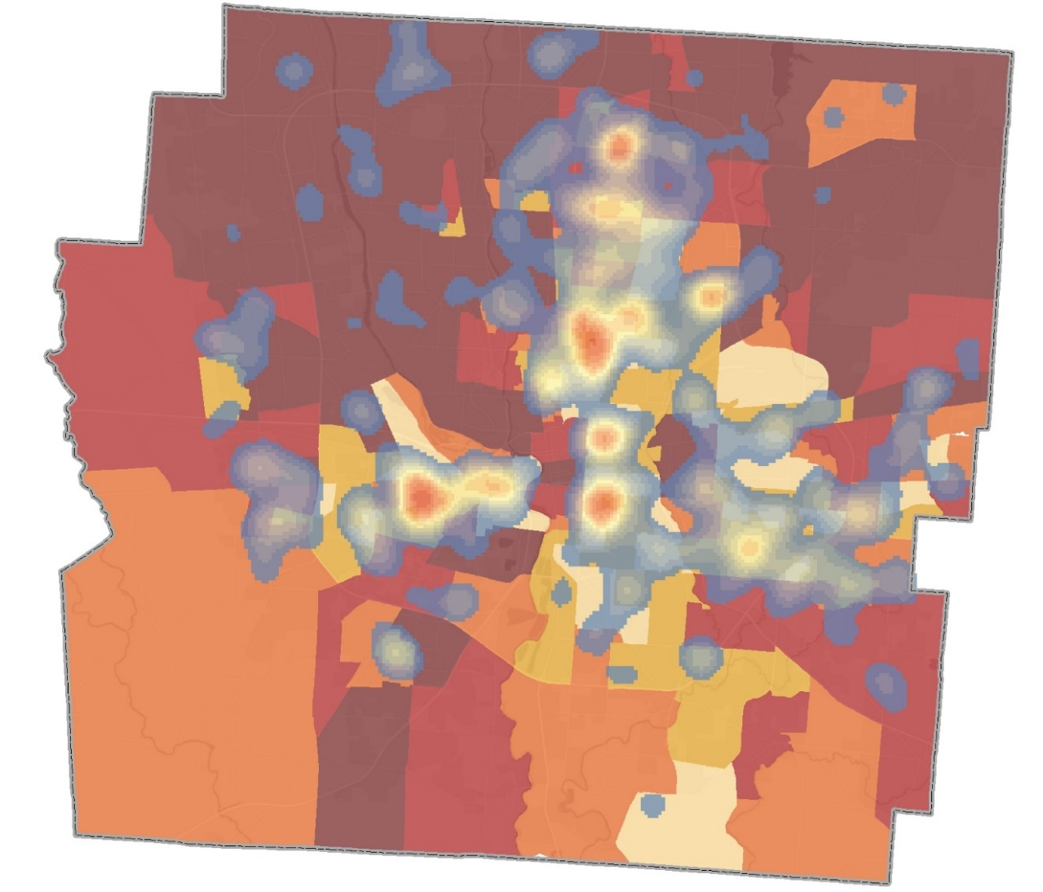
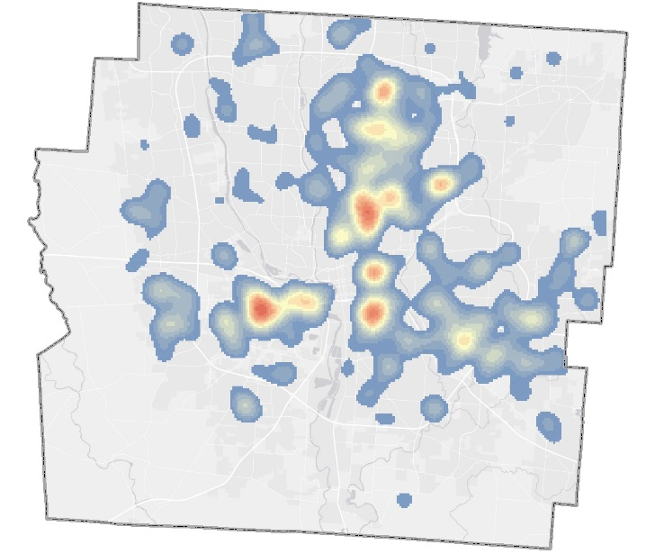
Infant Mortality: The Worst Birth Outcome

Slide 9
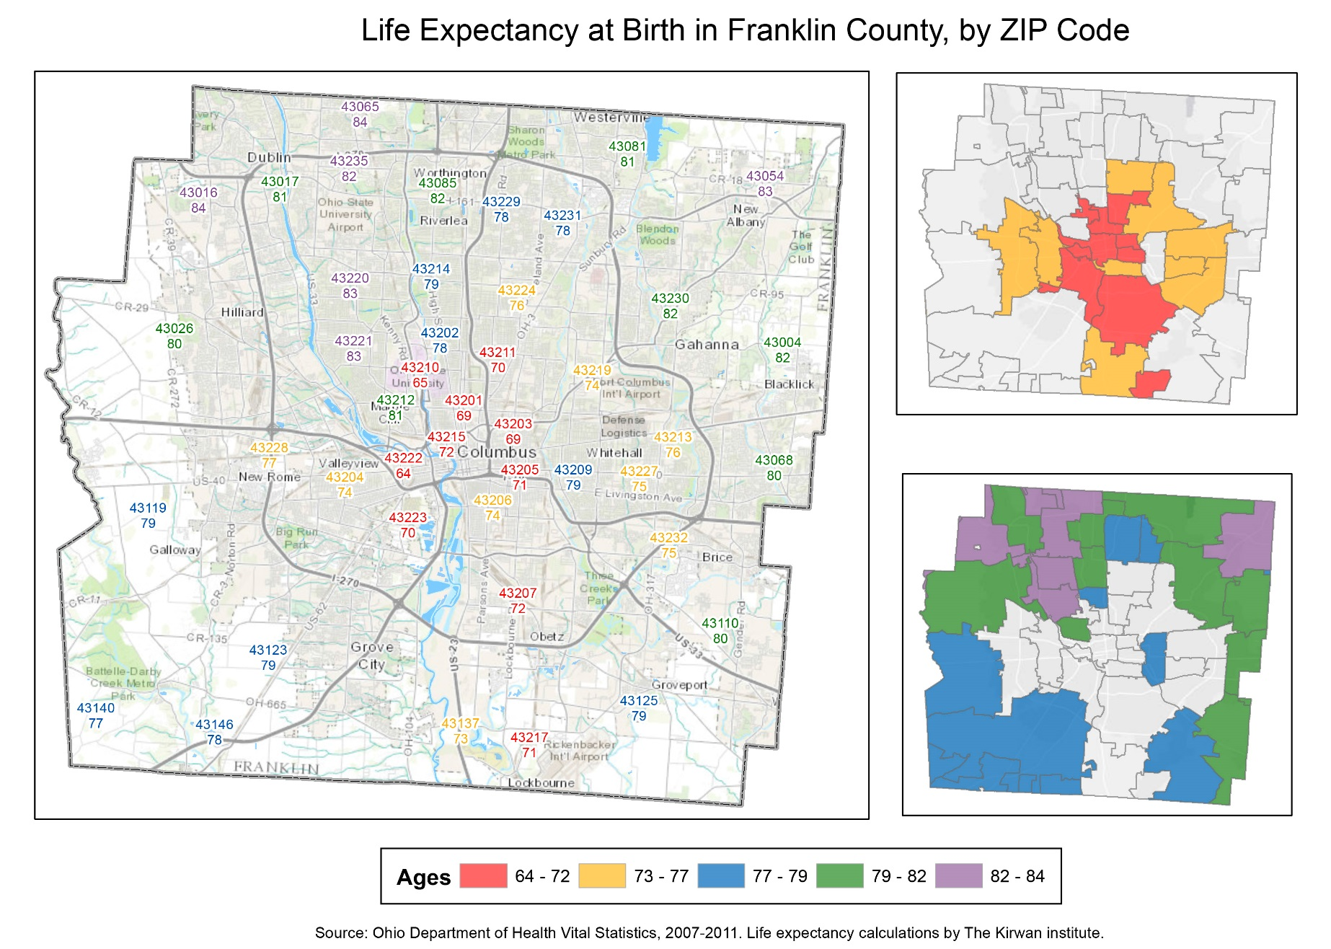
Life Expectancy: The Other End of the Life Course

Slide 10

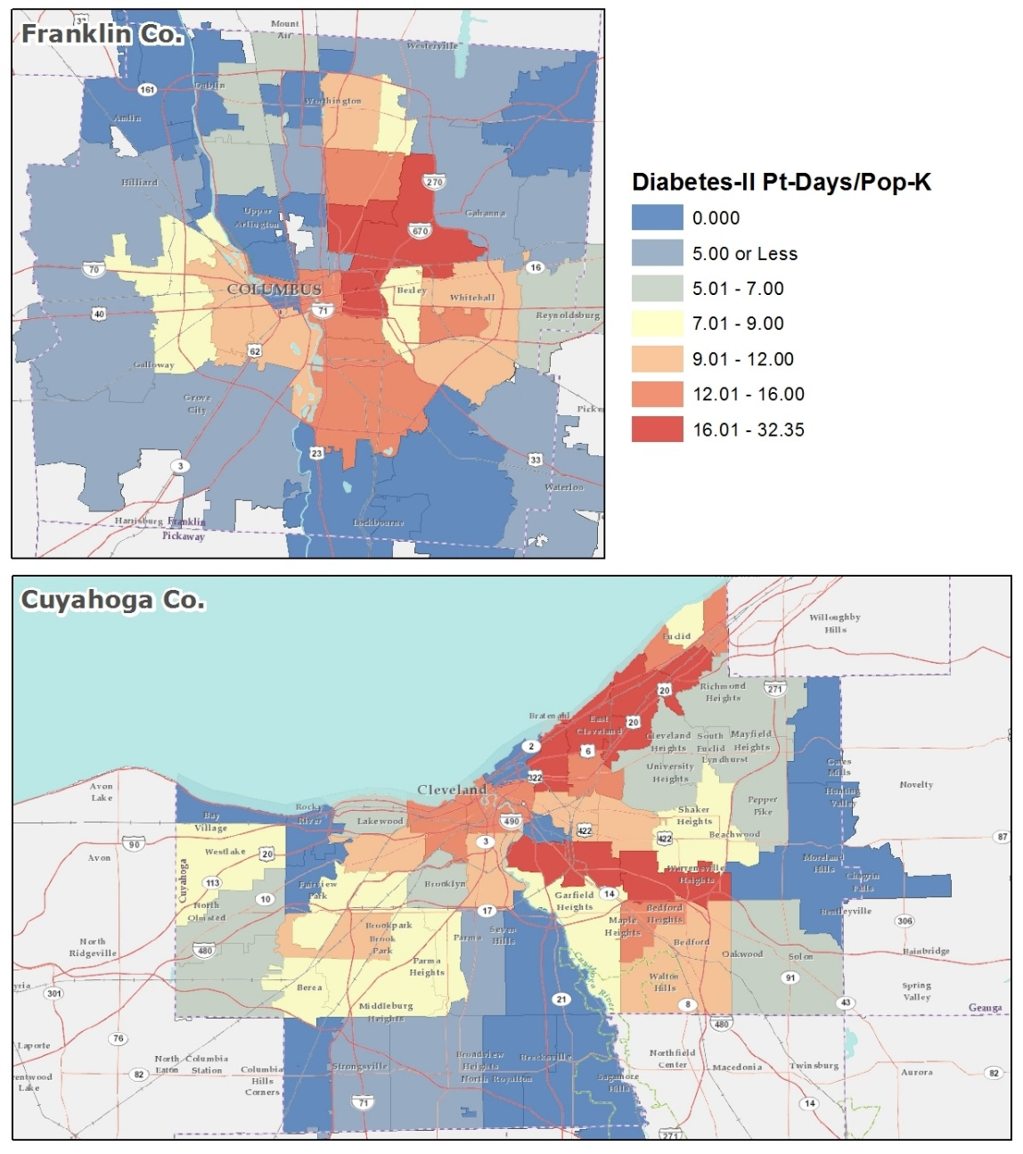
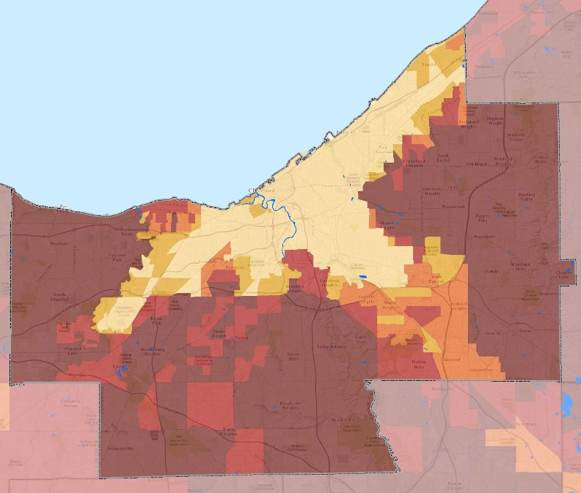
Hospital Admissions for Type II Diabetes

Slide 11
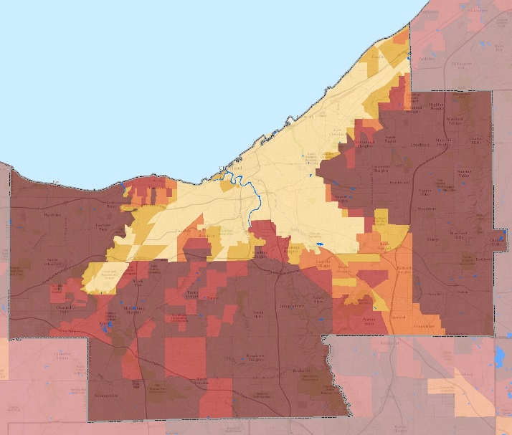
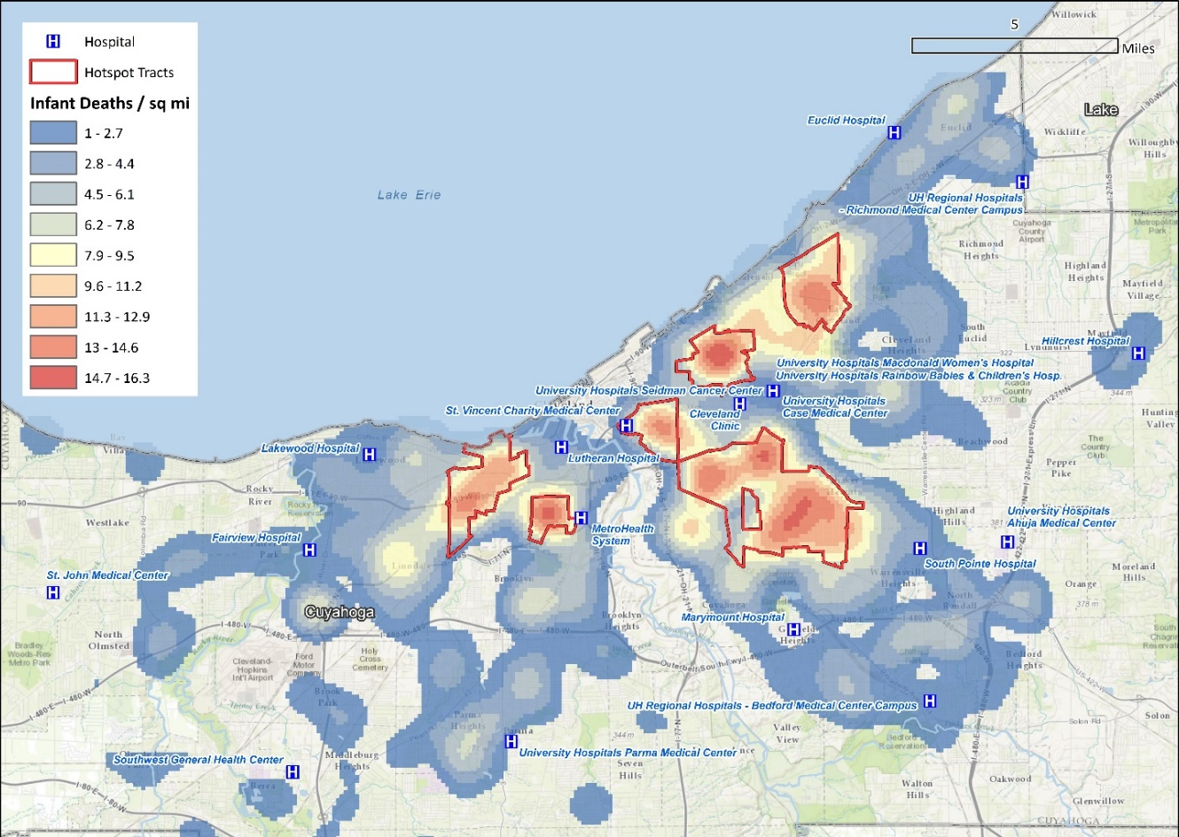
Cleveland - Areas Lacking in Measures of Social
Determinants Also Exhibit:
Higher infant mortality
rates
Higher rates of lead
exposure
Higher exposure to toxic
waste release
Higher poverty rates
Higher vacant property
rates
Higher residential
subprime loan rates
Lower life expectancy
Higher percentages of
African Americans

Slide 12
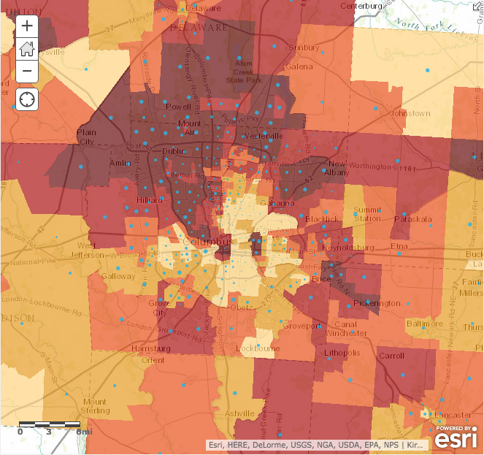
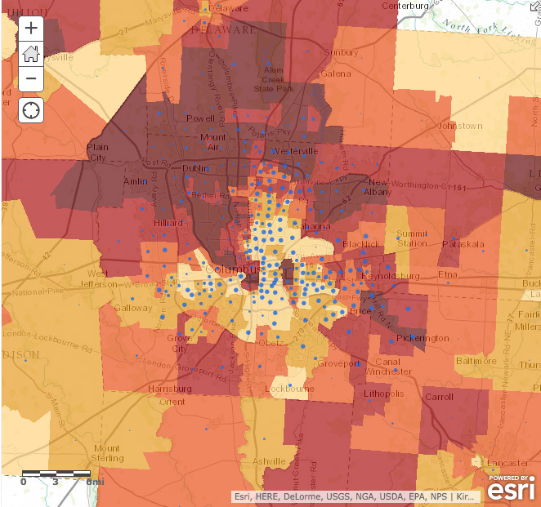
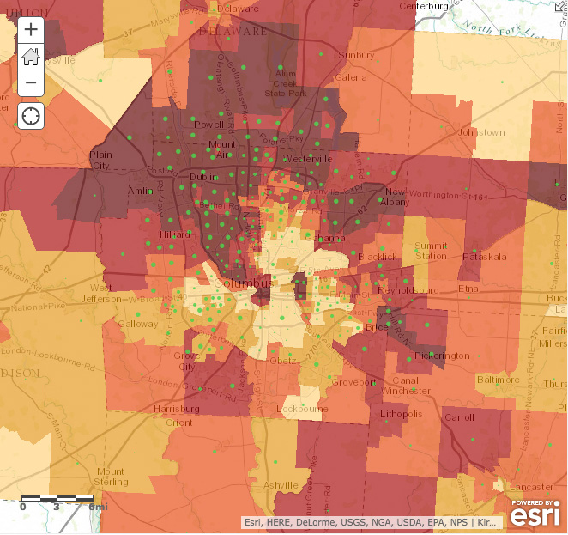
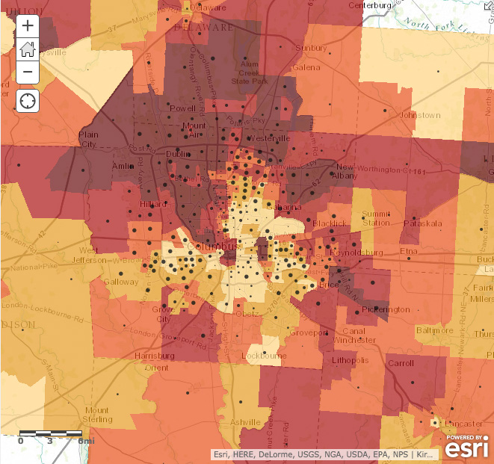
White
Black
Asian
Hispanic

Slide 13
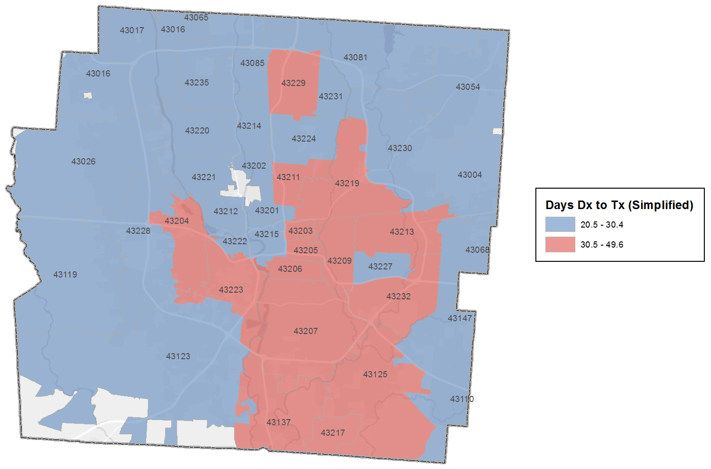
Breast Cancer: Days from Diagnosis to Treatment
Source: Susan G. Komen - Columbus

Slide 14
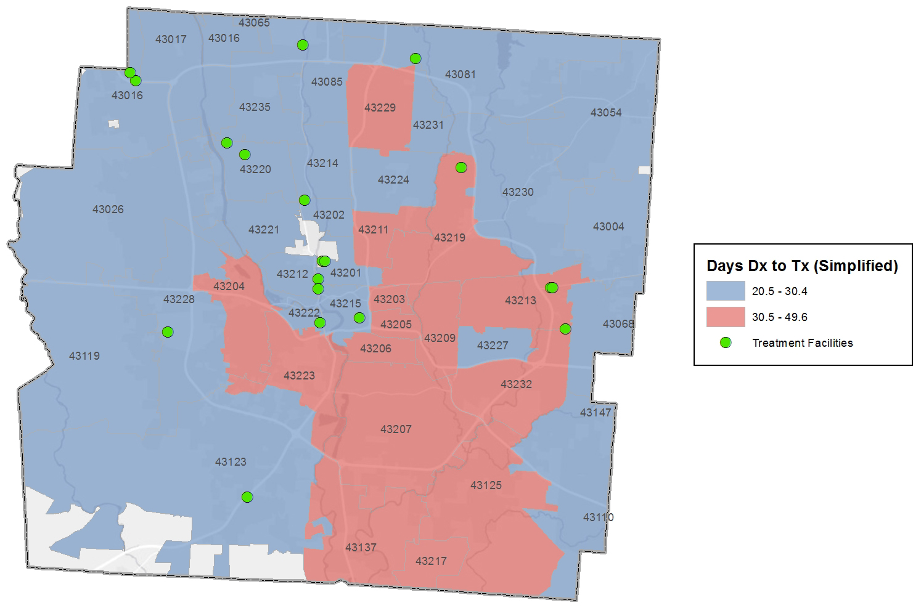
Breast Cancer: Days from Diagnosis to Treatment
Source: Susan G. Komen - Columbus

Slide 15
Breast Cancer: Days from Diagnosis to Treatment
What questions does this raise?
  Treatment centers
    Capacity?
    Medicaid?
  Physical access to Tx centers
    Access to vehicle
    Public transit
  Screening: where?
  Follow-up
    Home visits, CHWs
    Prescriptions
  Other community assets & supports?

Slide 16
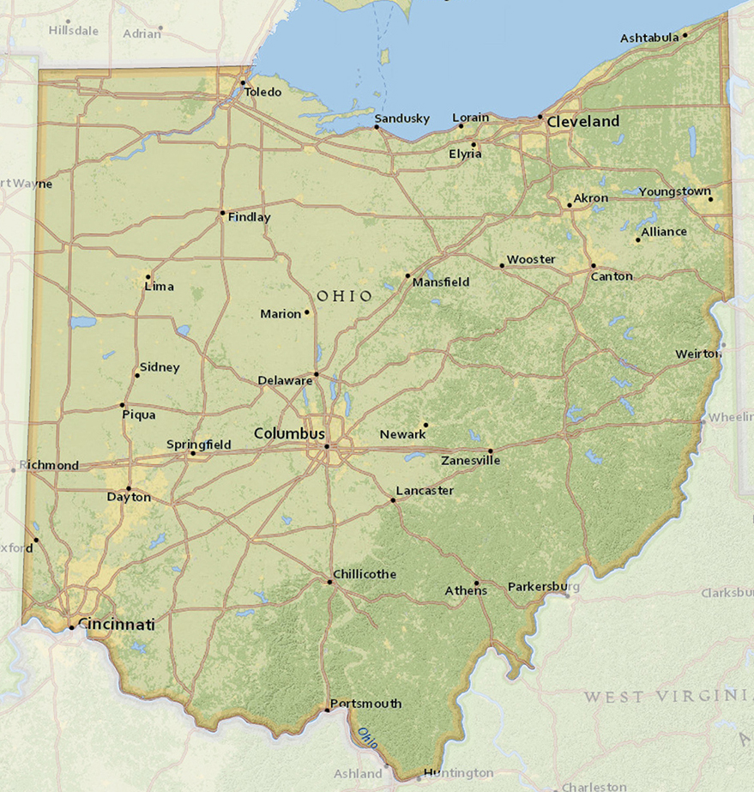
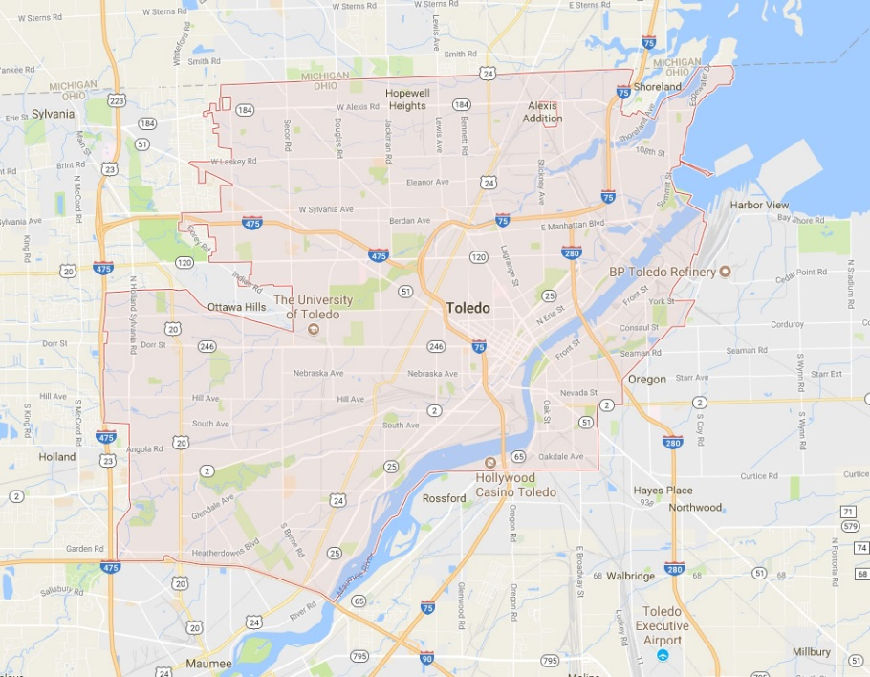
Toledo: A Case Study in Environmental Justice Mapping
Where is Lucas County?
West end of Lake Erie
Toledo – County Seat

Slide 17
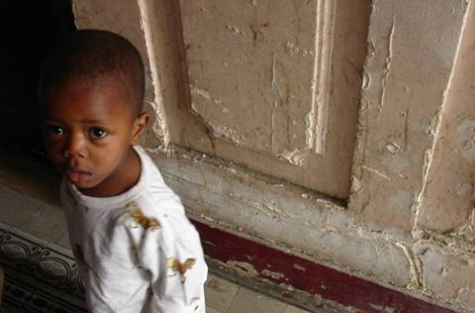
Toledo: A Case Study in Environmental Justice Mapping
Signs of lead poisoning
  Irritability or behavioral problems
  Difficulty concentrating; headaches
  Loss of appetite, weight loss, sluggishness, fatigue
  Abdominal pain, constipation, vomiting, nausea
  Pallor (from anemia)
  Metallic taste in mouth
  Muscle and joint weakness or pain
  Seizures
Signs may be mild; may be taken for some
other illness
Very important to have children tested!

Slide 18
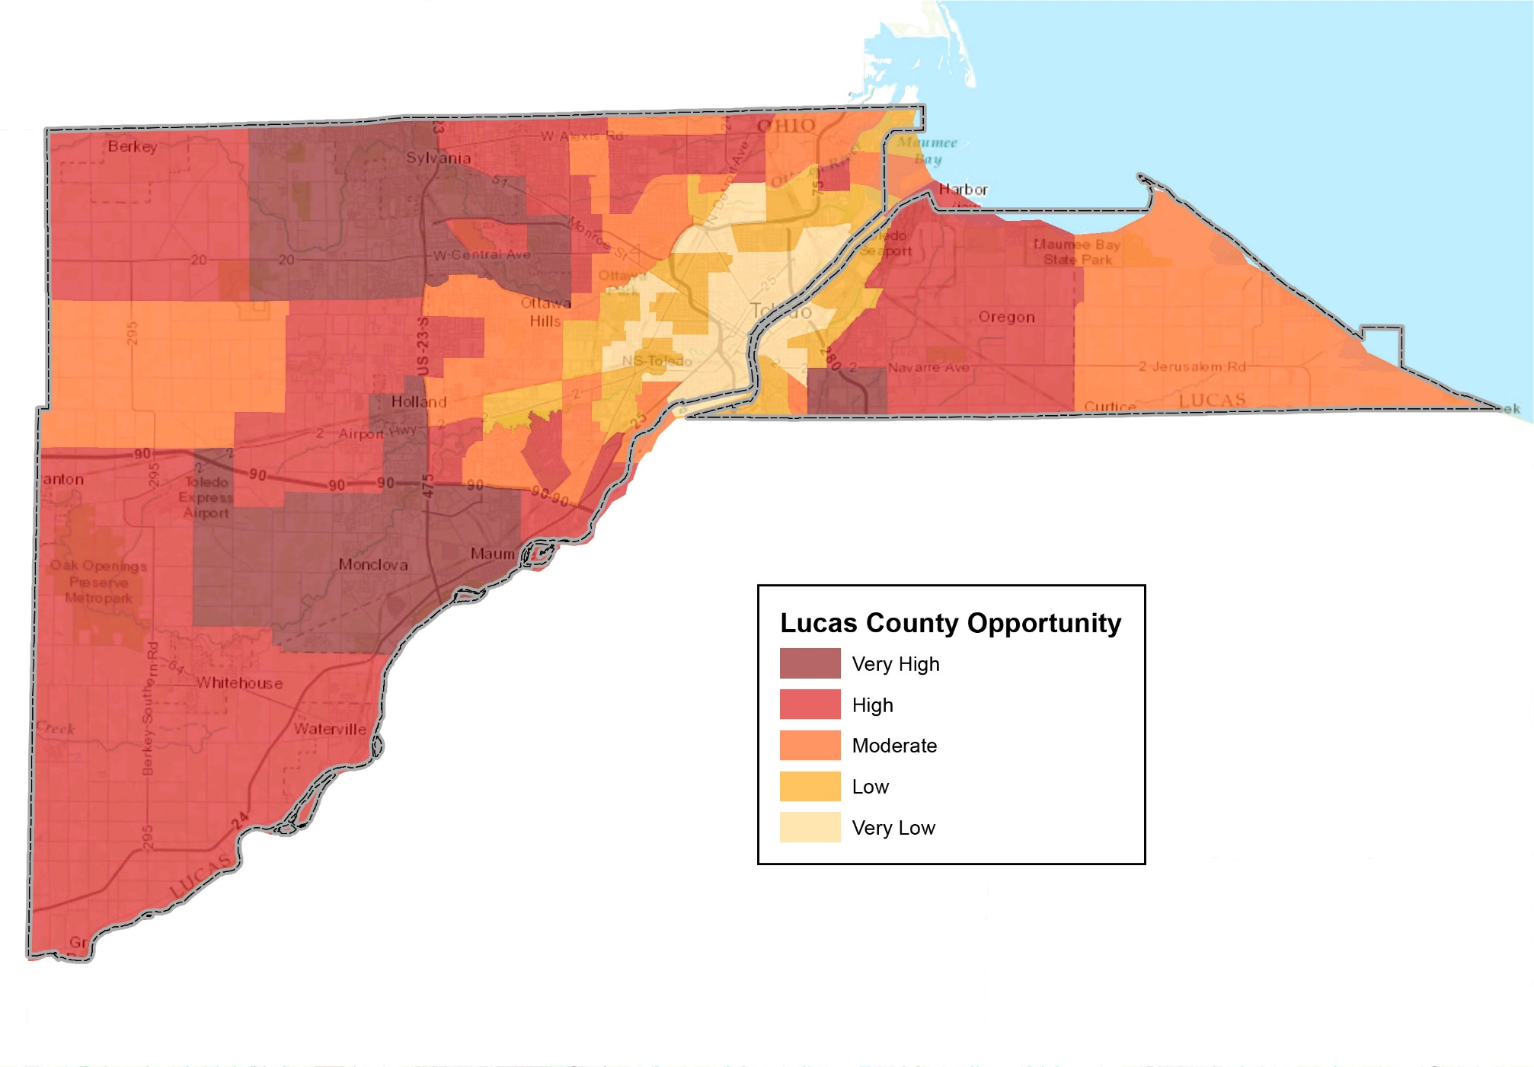
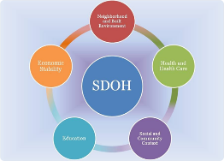
Lucas County Opportunity* Map
* Opportunity metrics are also SDoH metrics

Slide 19
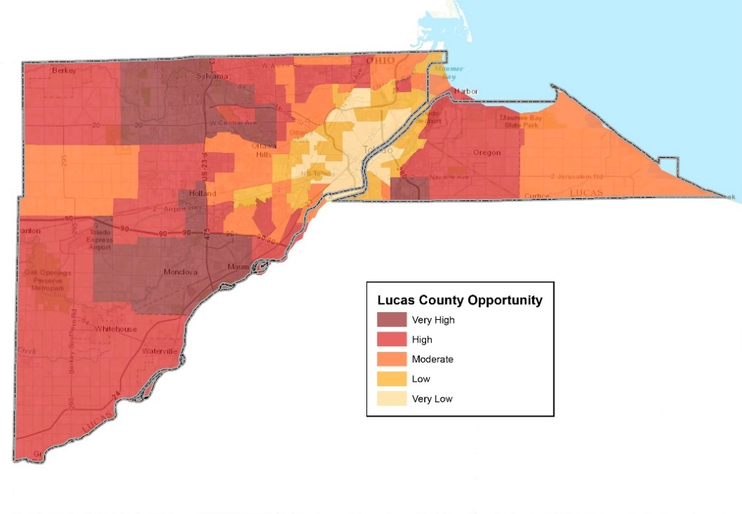
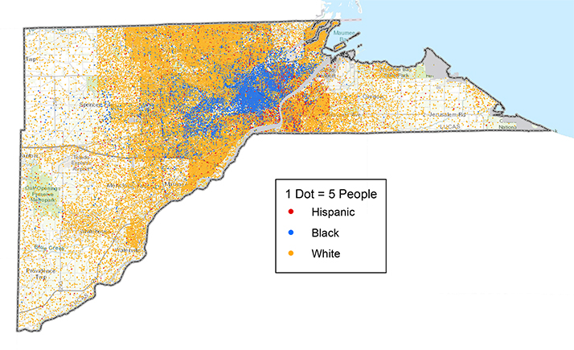
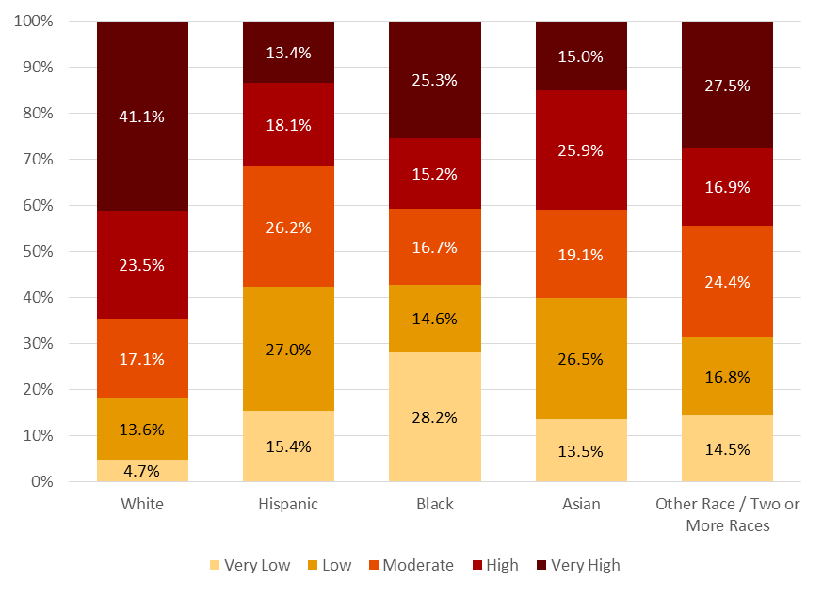
Who Lives in Lucas County’s High-and Low-Opportunity Areas?

Slide 20
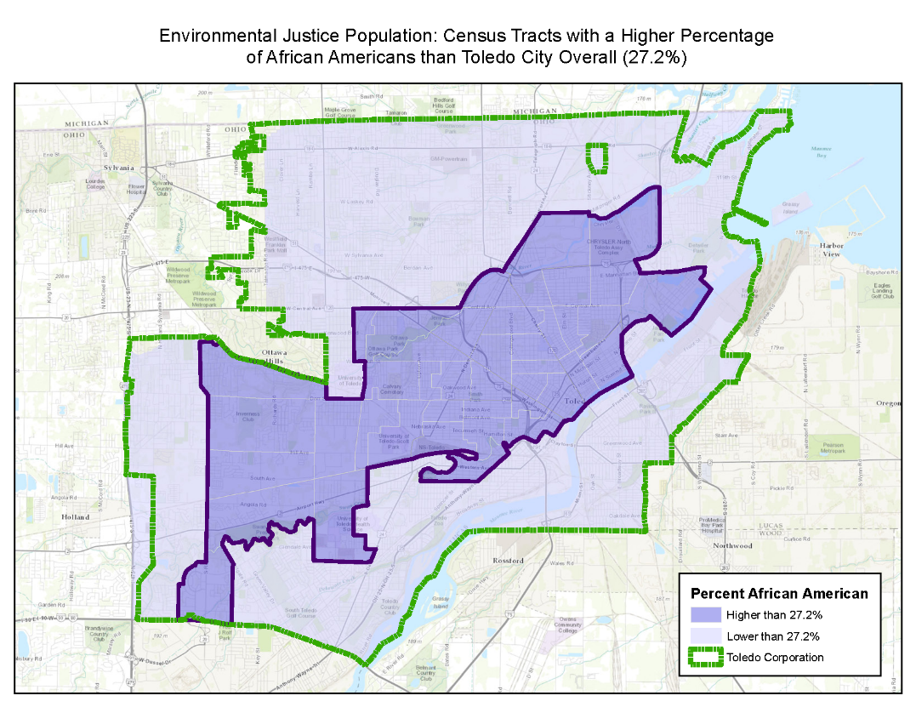
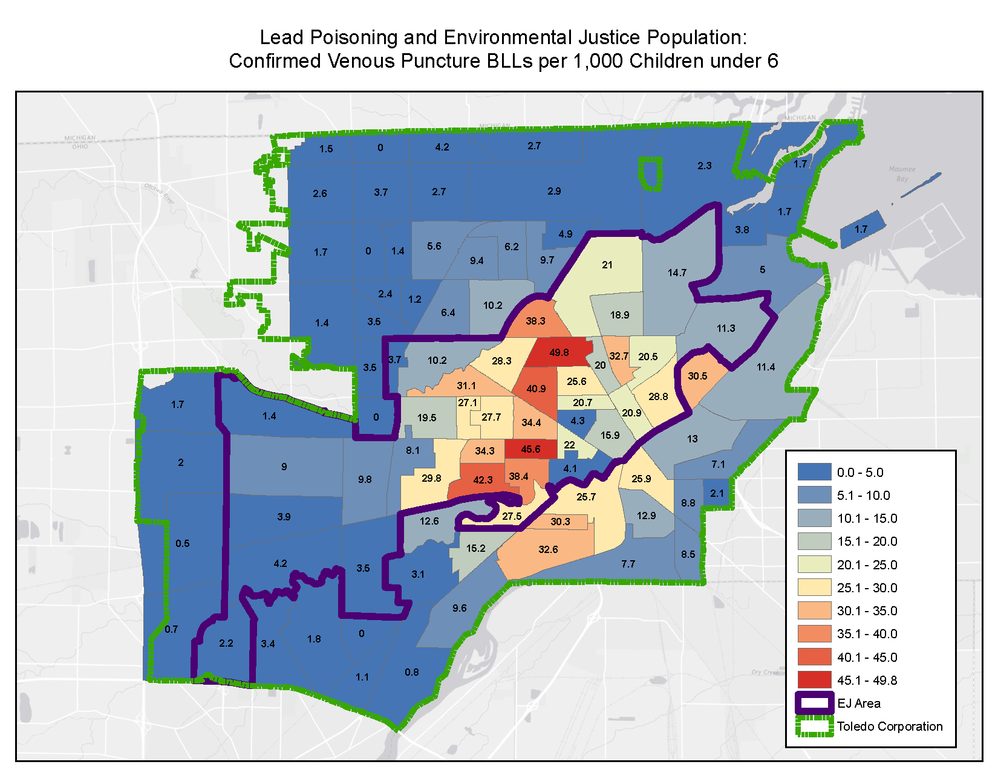
Toledo: A Case Study in Environmental Justice Mapping

Slide 21
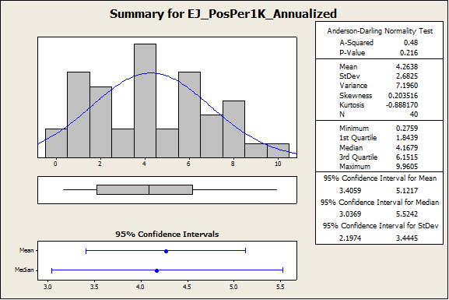
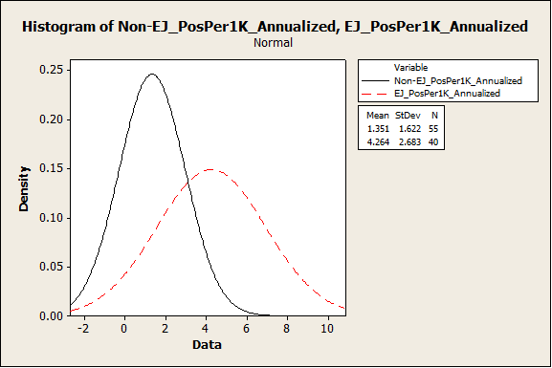
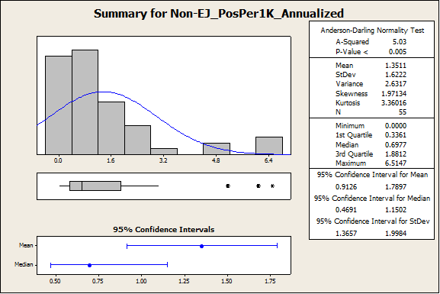
Toledo: A Case Study in Environmental Justice Mapping

Slide 22
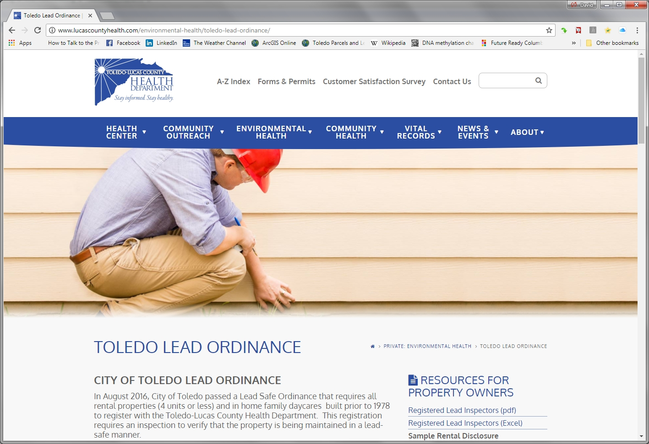

Slide 23
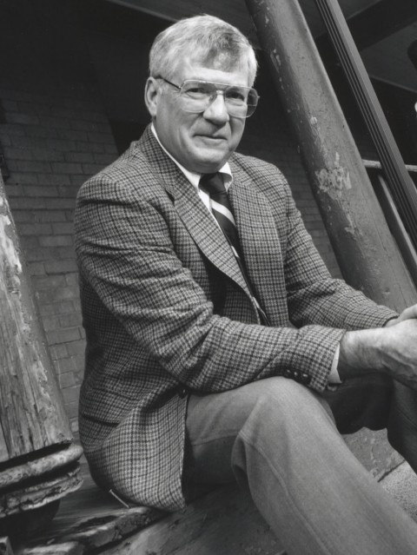

Herbert Needleman, MD – 1927—2017
“It wasn’t enough to make a diagnosis and prescribe medication. I’d treated her for lead poisoning, but that was not the disease — the disease was much bigger and caused by forces embedded in the child’s life. Her disease was where she lived and why she was allowed to live there.”
-Dr. Needleman, speaking of his “index” lead-poisoning patient in the
infant ward of a Philadelphia hospital

Slide 24
Historical Drivers of Racial Segregation and Isolation of Communities of Color
Racial Segregation & Opportunity Isolation
Zoning & Land Use Practices
Redlining & Investment Practices
Urban Renewal, Public Housing & Federal Highway Policies
Explicit Racial Discrimination & Intimidation Practices

Slide 25
Neighborhood disinvestment shaped the communities of today

Slide 26
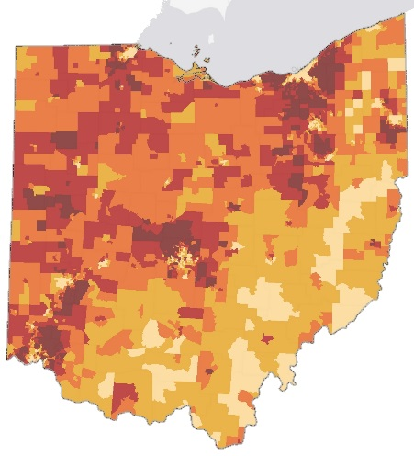
Why Is the Geography of
Social Determinants
Relevant?
Patient choices are constrained by their community’s resources
  Particularly true of patients in poorly resourced communities
Rx: Connect patients to the resources they need
“Connection” should go beyond referral for medical services,
to facilitating access to:
  Transportation
  Child care
  Home visits

Slide 27

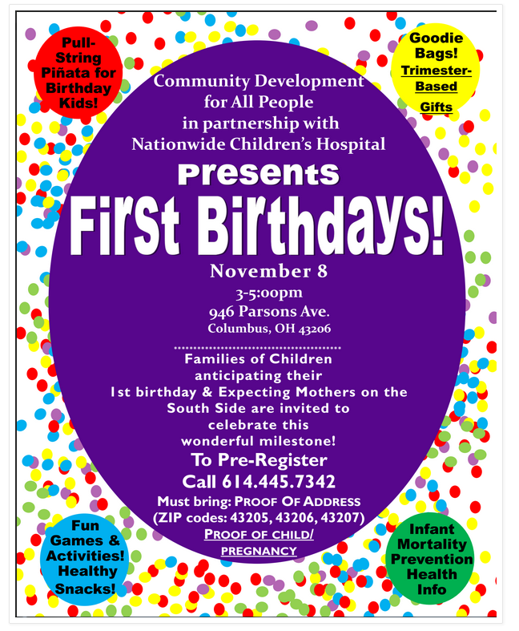
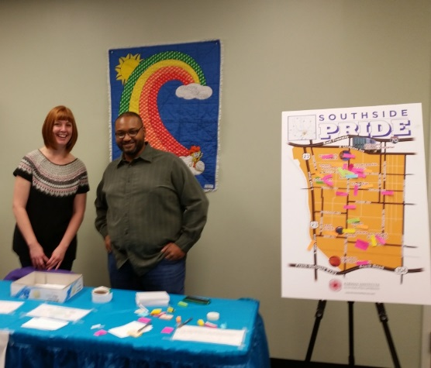
Final thoughts: Things we haven’t discussed
Internalizing the external
  The body’s response to chronic/toxic stress: HPA axis
  Physiological markers of stress: hormonal and cellular changes
Mapping covers “hard” stressors in the environment
  More difficult to quantify, map
  social/behavioral stressors
    Racial/ethnic discrimination
    Microaggressions
    Social exclusion
    Perception of safety
Community assets

Slide 28
Implications for Addressing Health Equity
Clinical interventions are only part of the solution
Need for restorative investment in communities
Tailoring interventions to a community’s unique needs and culture
Recognize policy’s explicit role in shaping community health inequities
  Policy must be a tool to revitalize communities
Relationship between values, biases and policy
  Whose values are reflected in our policies (past and present) in relation to health equity?
Context for the longevity of the health-equity challenges
  Neighborhood change does not happen quickly

