Slide 1
Working in Ohio
Hannah Halbert
hhalbert@policymattersohio.org
@HannahHalbert
July 27, 2017

Slide 2
Policy Matters Ohio is a nonprofit policy research institute that creates a more vibrant, equitable, sustainable and inclusive Ohio through research, strategic communications, coalition building and policy advocacy.
Follow us on Twitter
@PolicyMattersOH
Like us on Facebook
facebook.com/policymattersohio
Sign Up for our eNews
policymattersohio.org

Slide 4
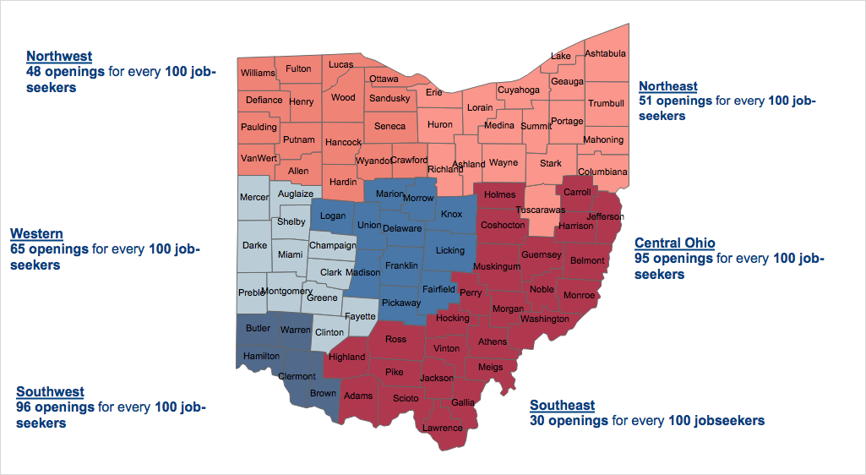
Source: Policy Matters Ohio calculation comparing number of job postings on OMJ.com in May 2017, by region, available at http://omj.ohio.gov/omjresources/jobpostingstrends.stm, to the number of unemployed (LAUS) in May 2017, by region.

Slide 5
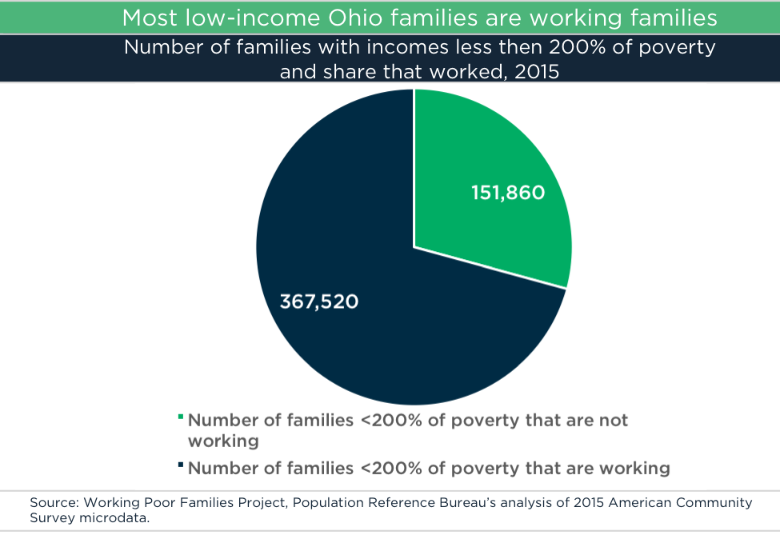

Slide 7
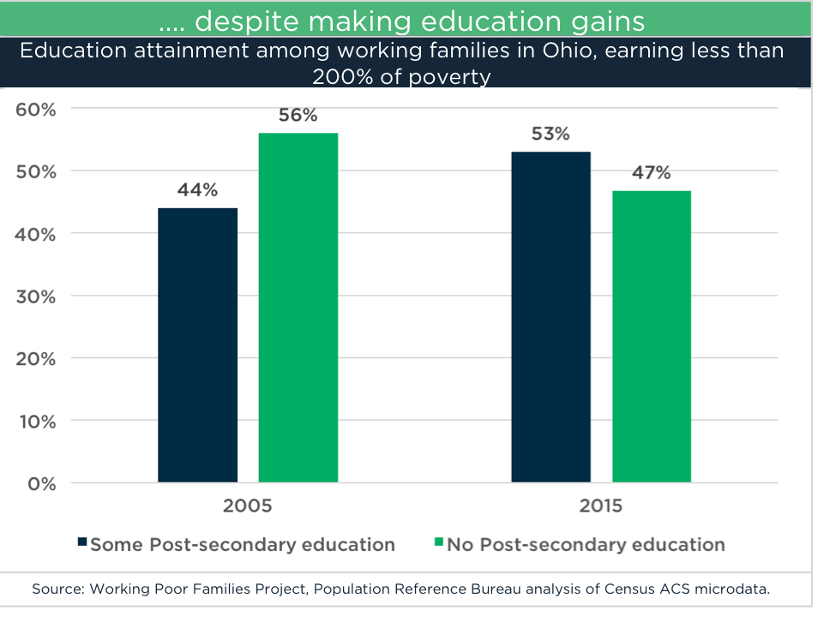

Slide 8
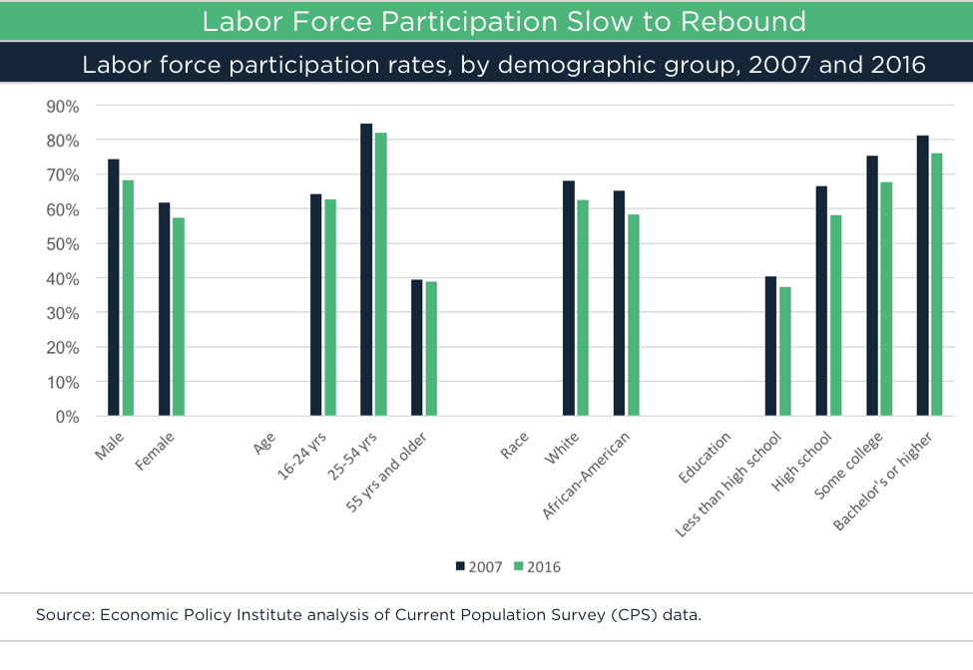

Slide 9
Challenges
Slow growth economy. Too many jobs pay too little.
Job Quality
Increasing the minimum wage, increased collective bargaining for pink-collar work, scheduling balance, high-road workforce development
Work Supports
Refundable EITC, SNAP employment and training, affordable and accessible childcare and transportation, health care.
@PolicyMattersOH • policymattersohio.org

Slide 10
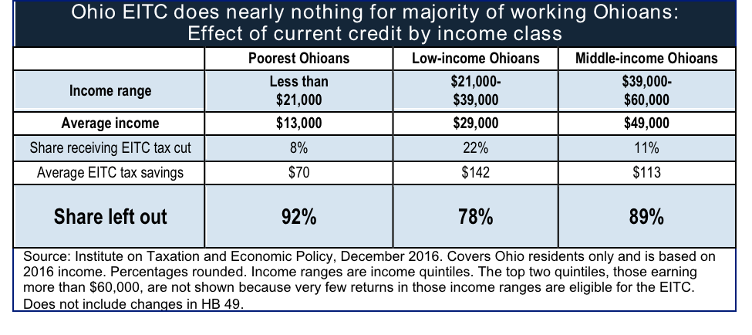
Earned Income Tax Credit: Refundability matters

Slide 11
SNAP Employment and Training
Work Experience Program – 35,059 participants
Typical placements include janitorial work, grounds maintenance, office work, or warehouse packing.
Washington Model (BFET)
Voluntary
28,000 served annually
Community colleges, 30+ community partners
$30 million budget
Supports students in career and tech ed., basic adult ed., GED, and ESL.
Employment and Training -- 16,400 participants
Literacy skills, vocational training, post-secondary credentials.
@PolicyMattersOH • policymattersohio.org

Slide 12
THANK YOU

