Slide 1
The Health & wealth connection
OPPORTUNITIES FOR INVESTMENT ACROSS THE LIFE COURSE
Anjum Hajat, PhD, MPH
Assistant Professor of Epidemiology
University of Washington
July 27, 2017

Slide 2
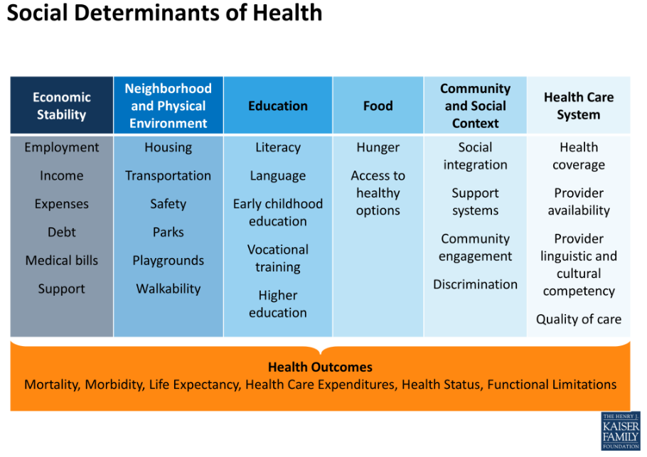
Social determinants of health
Notes:
Robert Wood Johnson Foundation has a simpler shorthand: “Health happens where we live, learn, work, and play.” Both descriptions of the social determinants of health highlight the idea that what determines health for individuals and communities goes beyond the more familiar discussion of healthcare. Health is about much more than what happens in hospitals and doctors’ offices.
As you can see from this graphic developed by the Kaiser Family Foundation, the social determinants of health cross sectors and systems that one may not immediately associate with health. But in public health, we know that economic opportunities, the quality of neighborhoods and communities, the level and quality of education, access to healthy food, social and community support and engagement, and accessibility of health care systems all drive health outcomes like mortality (or death), morbidity (or disease and disability) as well as the length and quality of life. Many of the determinants to the left of health care on this graphic have a considerable impact health outcomes, but our public and private investments often do not reflect this strong relationship between health and social factors.

Slide 3
Socioeconomic Status (SES)
Used interchangeably with terms such as socioeconomic position, social class, social status
Includes both resource and prestige-based assets
Measured by
Education
Income
Occupation
Wealth
Determines economic stability

Slide 4
SES and Health Across the Life Course
Adler et al., 2007, Reaching for a Healthier Life: Facts on socioeconomic status and health in the US.
Notes:
Not only is the relationship between social and economic factors and health strong; it is also complex. We tried in the brief to simplify some of this complexity by noting that socioeconomic status—and in particular wealth as one indicator of SES—impacts health and that health impacts socioeconomic status across the life course. This graphic from a report on SES and health by Adler and colleagues shows that beginning even before birth, socioeconomic status in one phase of life impacts both health and later SES in later phases. Health early in life also exerts an effect on SES and later health. This complexity can make it difficult for researchers to tease apart which factor is contributing to which outcome, and more research is needed, but we are learning more every day about this critical link between SES and health. We’re also learning more about how wealth in particular is implicated in health. This life course perspective introduces a number of key opportunities to invest in the health and well-being of children, families, and communities.

Slide 5
Wealth vs Income
Income is flow of resources in the household at any give point in time
Wealth is financial assets minus debt
Assets accumulate over the life course and provide financial stability. They include:
Home ownership
Business ownership
Stocks and bonds
Retirement accounts

Slide 6
INEQUITIES IN WEALTH AND HEALTH
Inequality in Wealth

Slide 8
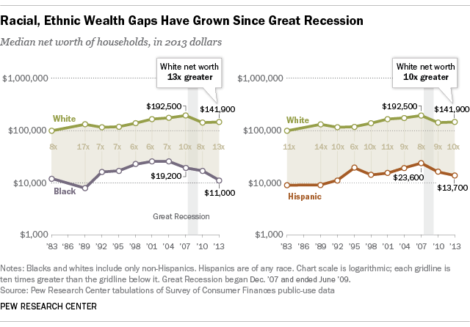
Racial, ethnic wealth gap
Notes:
The Institute for Policy Studies estimates that if current rates of growth remain the same, it would take 228 years for the average Black family and 84 years for the average Hispanic family to accumulate the same amount of wealth currently held by White families.

Slide 9
INEQUITIES IN WEALTH AND HEALTH
Inequality in Health by Wealth
Notes:
Getting back to discussion of health, what is the relationship between health and wealth?

Slide 12
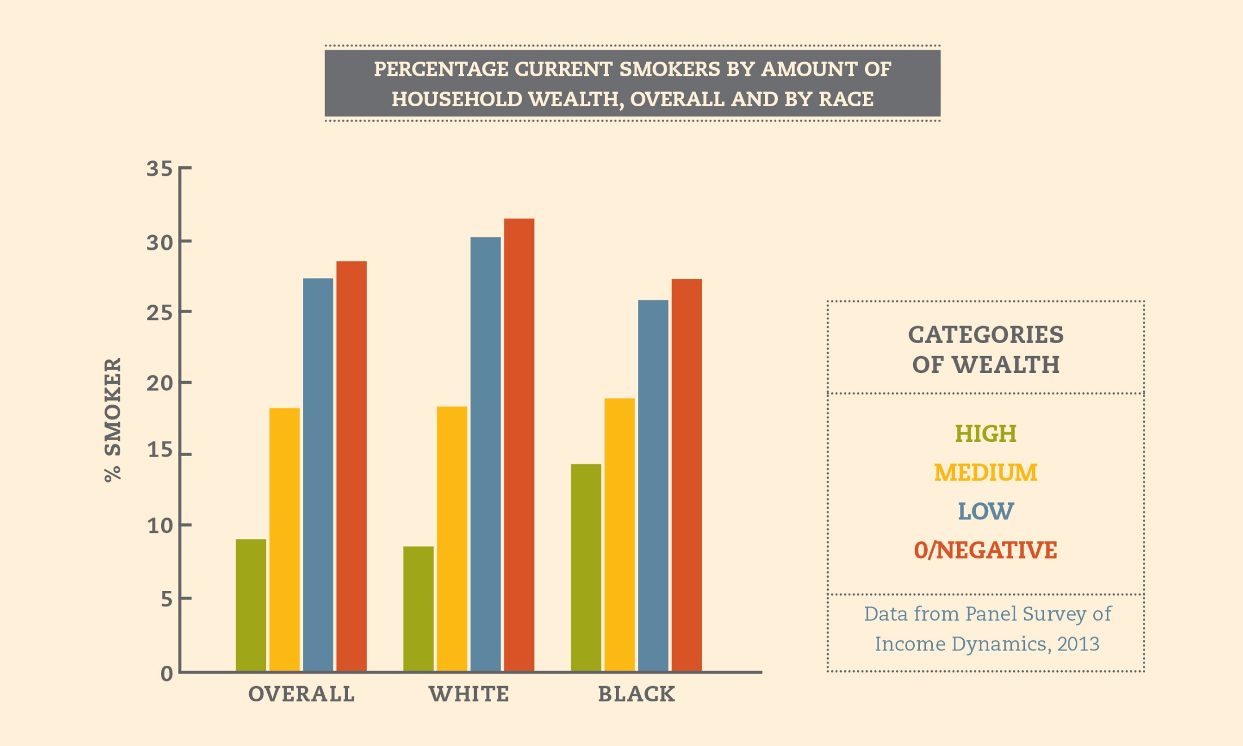

Slide 13
Debt and Health
Alternative financial services (AFS) or fringe banking is a source of debt
Very amenable to policy intervention
Ohio has 28% cap on payday loans (but there are loopholes), prohibition on car title loans, no regulation on pawn shops

Slide 14
D
Characteristics of AFS users nationwide
Notes:
Overall prevalence 4.2

Slide 15
dA
AFS use and poor health

Slide 16
How does wealth impact health?
Three explanations:
Biological: Stress pathway
Education
Greater future orientation
Notes:
I will now discuss the mechanisms of the relationship between wealth and health and some data to illustrate this relationship. How does wealth impact health? Why is this important?

Slide 17
Biological consequences
Stress Pathway
Inflammatory response
Persistent
Stressors e.g. financial instability
Immune suppression
Disease
Unhealthy behaviors
(drinking, smoking, poor diet and lack of exercise)
Release of stress hormones
Notes:
This is an oversimplified diagram. I am trying to summarize the pathways by which chronic stress gets under the skin.
Stress hormones couples with other responses may lead to hippocampal atrophy which result in memory impairment and cognitive dysfunction. Recent work scarcity.
Stress hormones are involved in immune response, which leads to the release of inflammatory cytokines, And
Stress hormones impact the Autonomic Nervous system leading to htn and headaches
The physiological pathway is one mechanism by which chronic stress can lead to disease, but the other pathway is through unhealthy behaviors.

Slide 18
Education leads to…
Better access to and understanding of health information
Changes in norms and behaviors (e.g. lower rates of smoking)
Notes:
Education is another mechanism by which wealth impacts health. Those who are more educated have better access to and understanding of health information. The more educated also have different norms and behaviors around health, things like lower rates of smoking, more exercise. Education an area for intervention and something that links health and wealth.

Slide 19
Greater Future Orientation
Savings allows one to envision the future
Evidence to support savings in childhood associated with college attendance and completion
Notes:
The 3rd way in which we believe health impact wealth is through a greater future orientation. Least well supported in terms of evidence. Savings allows one to envision the future. And there is evidence to support savings in childhood is associated with higher rates of college attendance and completion. However, some research suggests that the same underlying orientation toward the future predicts both wealth-building and health-promoting behavior. Do savings cause future orientation? Or does a future oriented disposition cause savings?

Slide 20
Life Course Intervention Opportunities
Notes:
We have seen some evidence for disparities in wealth and inequities in health because of wealth and have discussed a few reasons for this, we will now move on to discuss how we can take action to improve health. Here the big thing to keep in mind is incorporating asset building/wealth into health related programs and practices.
Over the next several slides, I will present some of opportunities that consider possible asset building strategies with health prevention and promotion activities. This has the benefit of enhancing both economic and health outcomes.

Slide 21
Home visitation with financial coaching
Example: Alemeda, CA Public Health Department
Child Development Accounts (CDA) with preventive health and early childhood development
Family friendly community development
Interventions should be:
Multi-generational
Dual language & culturally appropriate
Notes:
In the critical early years of development when the resources of parents, the health of the mother, and the health of the child influence outcomes well into adulthood. Potential investment opportunities include combining evidence-based home visitation programs for mothers and other caregivers with financial coaching; child development accounts that are increasingly popular might be combined with preventive health and early childhood development interventions; across interventions, taking a multi-generational approach is likely to be more effective than a focus on children to the exclusion of parents and others in their lives; and in all of our programming being sensitive to the language and cultural needs of families will enhance program effectiveness.

Slide 22
CDA deposits at key milestones
Financial education for entire families
For older teens, hands-on financial skills tied to first job
Example: MyPath Savings Initaitive
Notes:
Later in a child’s development when health influences the opportunity to learn and savings influence the likelihood of attending and graduating from college, child development accounts, particularly for the neediest children, should receive additional deposits. These should be tied to milestones like grade level or age rather than behavioral outcomes like school attendance or grades in order to be fair and administratively efficient.
Financial education for entire family focuses on developing postivie financial habits and norms.
For older children hands-on financial skills development specifically helpful when tied to first job. Partnership with schools required.

Slide 23
Individual Development Accounts tied to preventive health behaviors
Workplace wellness programs that encourage employer contributions linked to health behaviors
Paid family and sick leave
Example: Small Business Majority
Financial coaching
Homeownership and retirement preparation
Notes:
Individual Development Accounts that are for low-to-moderate income individuals to save for things like home purchases or business start up could be tied to preventive health behaviors, with incentives for quitting smoking or exercise.
Contributions to retirement or health savings accounts could also be linked to health behaviors, as they are in many workplaces.
At the policy level, more support for paid family and sick leave would make a significant difference for adult workers, and financial coaching with a focus on managing credit and debt, homeownership, and retirement would be important in this phase.

Slide 24
Financial counseling and support for those with new chronic disease diagnosis
Tax deferred savings for care of elderly parents
Homeownership support and protection that help this key asset grow
Notes:
In the middle adult years, we begin to see the onset of several chronic diseases like diabetes and heart disease, disproportionately for those at lower levels of SES. These chronic diseases come with significant healthcare-related costs that must be managed effectively in addition to managing the disease. Wealth can help to buffer the shocks.
The stresses of the so-called sandwich generation also appear in this phase of life. Helping families to save in anticipation of care for older parents may alleviate some of this burden.
And while many in this phase may have already purchased homes, there is a need to help protect this vital asset in terms of both maintenance and financing.

Slide 25
Financial advice to preserve assets and plan for increased health care costs
Coordination of health and housing services to allow older adults to “age in place”
Example: Fahe, Appalachia
Community health workers with focus on preventative health and financial security
Example: Project Puente, San Antonio, TX
Notes:
Finally, in older adulthood, when health problems can lead to permanent disability and earlier than expected retirement, there is a need for financial advising that preserves accumulated assets even as health care spending reaches its highest level of any phase of life.
Older adults are also in need of coordination of services that can help them to stay in their homes as long as possible. Example of this in Appalachia where there is a fragmented system of aging services. Multi-sector approach that brought together many stakeholders (providers, hospitals, housing sector) to help seniors stay in homes longer. Home improvements to improve livability. Keeping home means keeping asset and not having to spend down to qualify for medicaid
Community health workers can be crucial connectors to resources, information and support for older adults.
As you can see from these recommendations, a multifaceted approach across the life course is needed in order to ensure optimal health and financial stability—both of which are interconnected outcomes.
https://www.marketplace.org/2014/02/10/health-care/delivering-better-medical-care-15-hour

Slide 26
Recommendations
Actively pursue and develop opportunities to invest in health and economic well-being across the life course
Encourage a focus on health and asset building in multiple settings and systems, meeting individuals and families where they are
Support community infrastructure
Build awareness and provide resources to educate and inform key decision-makers and the public
Support asset-building and health research
Increase opportunities for multisector collaboration

