Slide 1
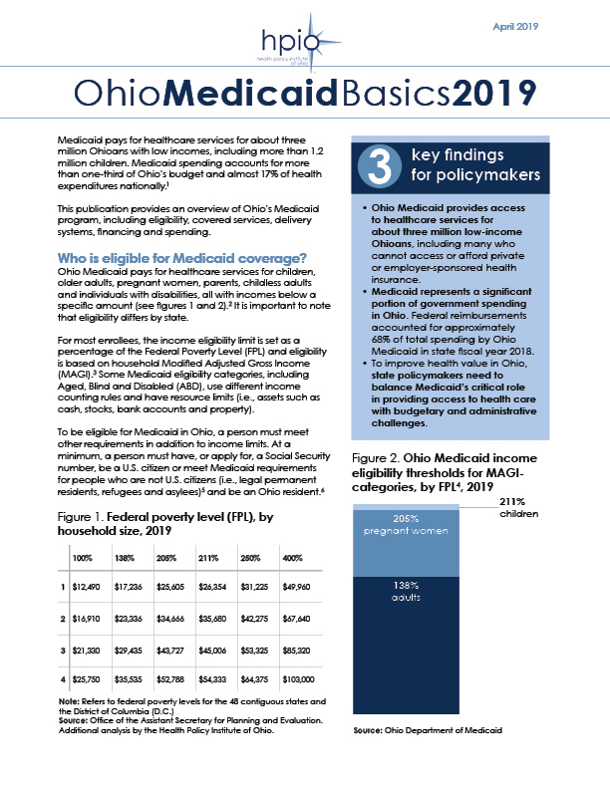
Graphics from
Ohio Medicaid Basics 2019
Copyright © 2019 Health Policy Institute of Ohio. All rights reserved.

Slide 2
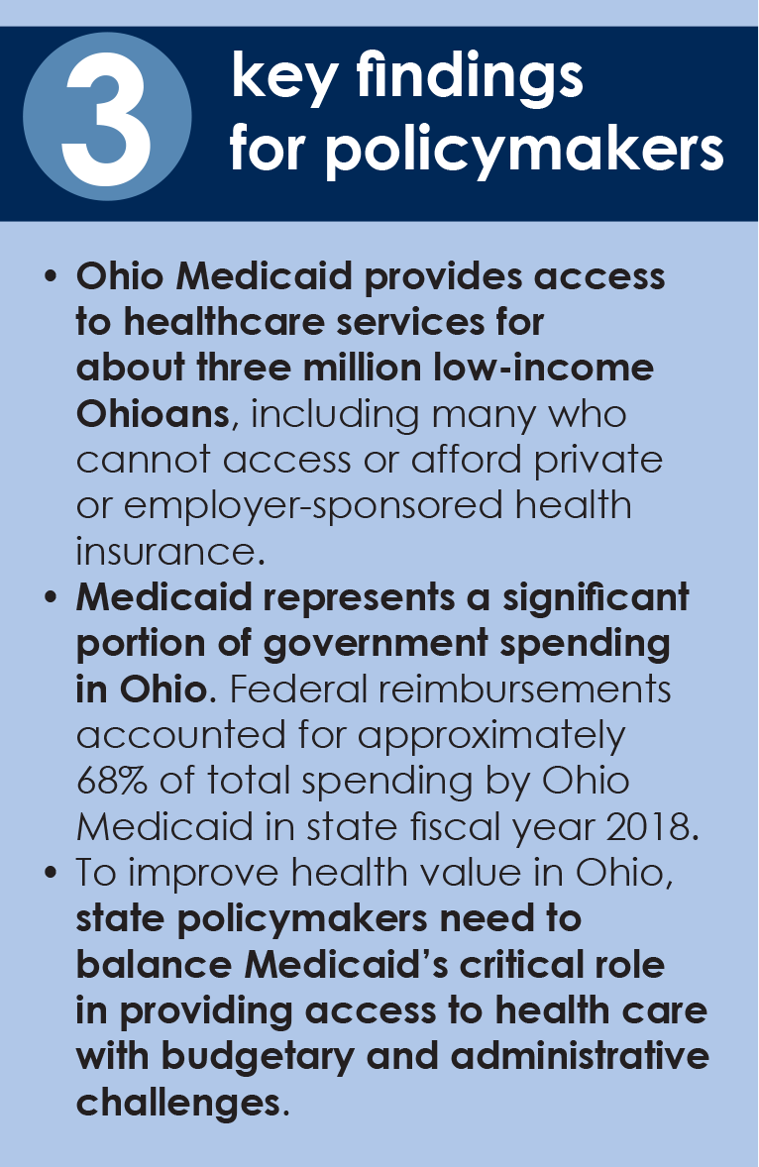
Copyright © 2019 Health Policy Institute of Ohio. All rights reserved.

Slide 3
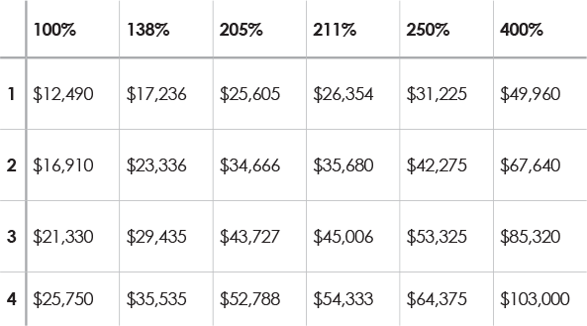
Federal poverty level (FPL),
by household size, 2019
Note: Refers to federal poverty levels for the 48 contiguous states and the District of Columbia (D.C.)
Source: Office of the Assistant Secretary for Planning and Evaluation. Additional analysis by the Health Policy Institute of Ohio.
Copyright © 2019 Health Policy Institute of Ohio. All rights reserved.

Slide 4
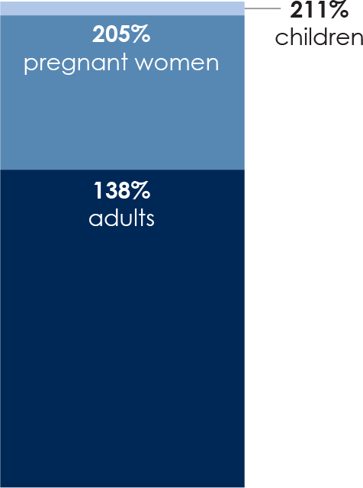
Ohio Medicaid income eligibility thresholds for MAGI-categories, by FPL4, 2019
Source: Ohio Department of Medicaid.
Copyright © 2019 Health Policy Institute of Ohio. All rights reserved.

Slide 5
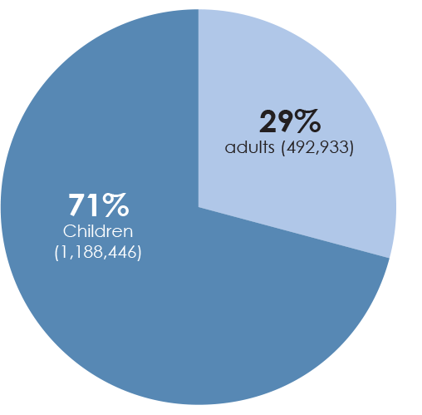
Ohio Medicaid Covered Families and Children enrollment for adults and children, SFY 2018
Source: Ohio Department of Medicaid. Additional analysis by HPIO.
Copyright © 2019 Health Policy Institute of Ohio. All rights reserved.

Slide 6
Differences between Medicaid and Medicare
Copyright © 2019 Health Policy Institute of Ohio. All rights reserved.

Slide 7
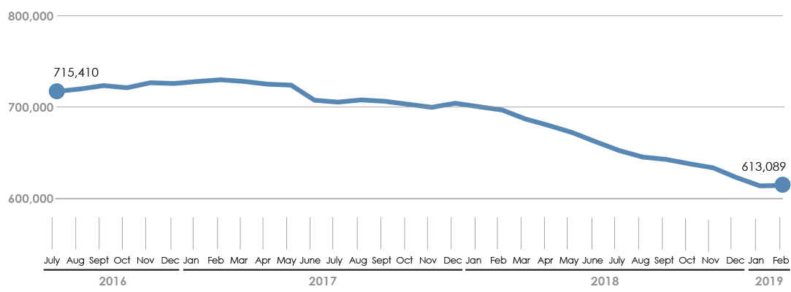
Group VIII enrollment by month,
July 2016-January 2019
Note: Enrollment numbers between March 2018 and February 2019 are preliminary and subject to change.
Source: Ohio Department of Medicaid caseload reports. July 2016 – June 2017 from report published June 2018; July 2017 – February 2019 from report published February 2019.
Copyright © 2019 Health Policy Institute of Ohio. All rights reserved.

Slide 8
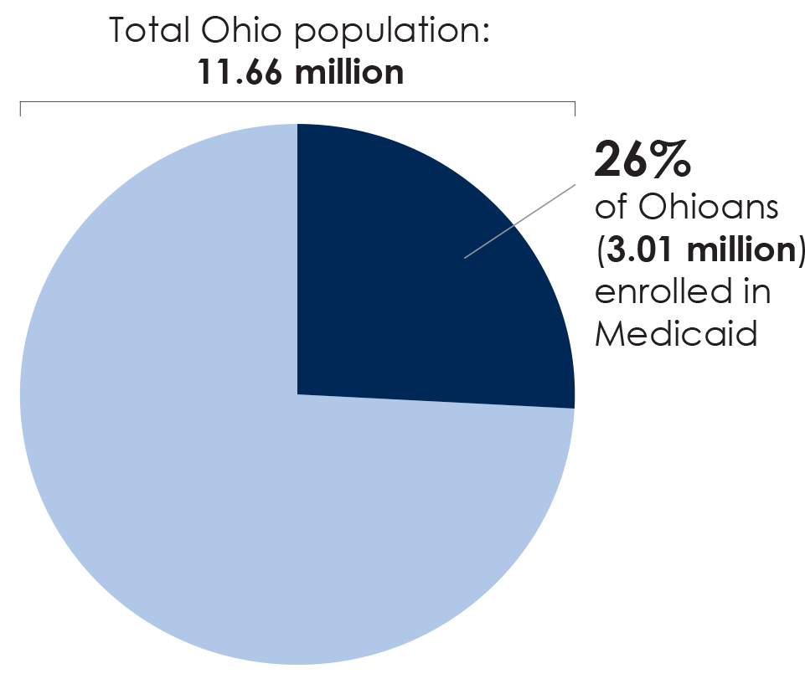
Estimated percent of Ohioans enrolled in Medicaid, SFY 2018
Sources: Ohio Department of Medicaid and U.S. Census Bureau, American Community Survey
Copyright © 2019 Health Policy Institute of Ohio. All rights reserved.

Slide 9
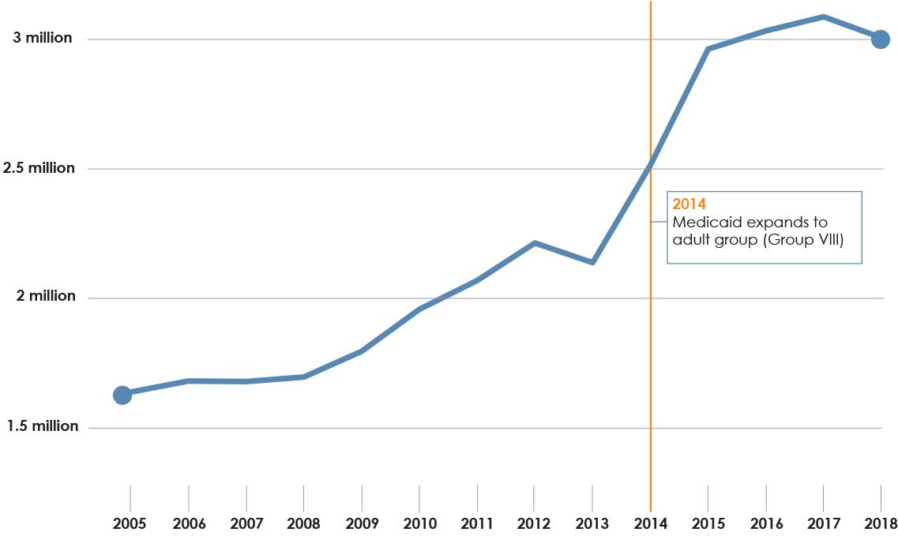
Ohio Medicaid enrollment trend,
SFY 2005-2018
Sources: SFY 2005-2011 Ohio Department of Job and Family Services, Public Assistance Monthly Statistics reports; SFY 2012-2018 Ohio Department of Medicaid
Copyright © 2019 Health Policy Institute of Ohio. All rights reserved.

Slide 10
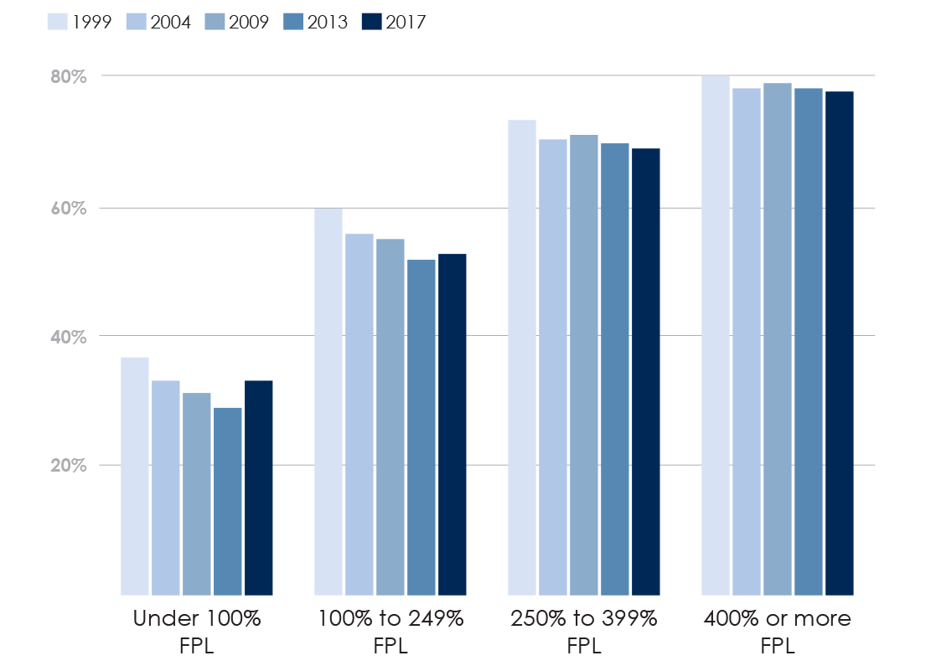
Percent of non-elderly population enrolled
in ESI by FPL, by year, 1999, 2004, 2009,
2013 and 2017
Source: Kaiser Family Foundation analysis of the National Health Interview Survey. 1999-2017
Copyright © 2019 Health Policy Institute of Ohio. All rights reserved.

Slide 11
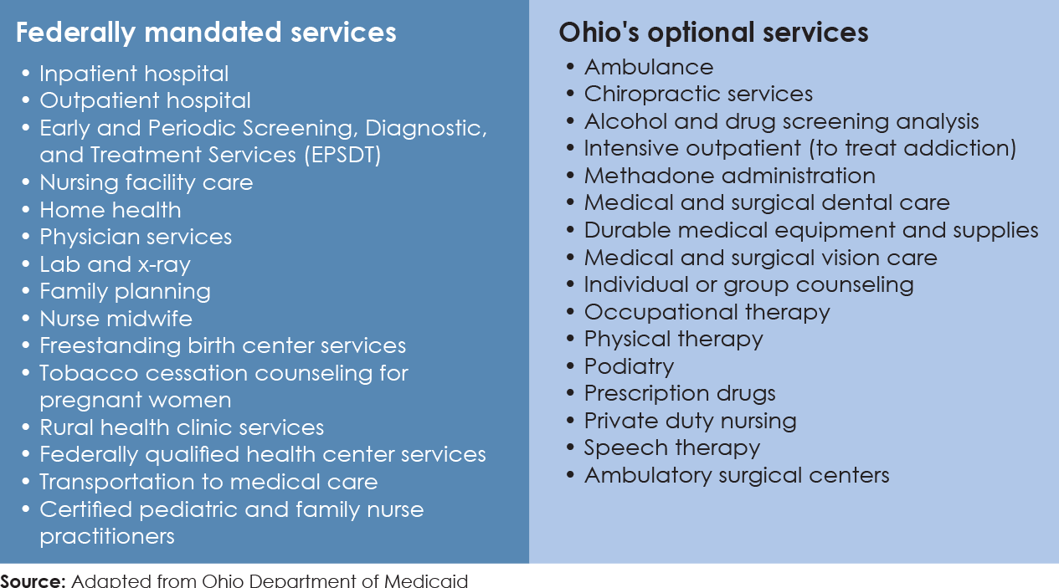
Ohio Medicaid Covered Services
Note: For more information and a complete list of Ohio covered services, visit medicaid.ohio.gov
Source: Adapted from Ohio Department of Medicaid
Copyright © 2019 Health Policy Institute of Ohio. All rights reserved.

Slide 12
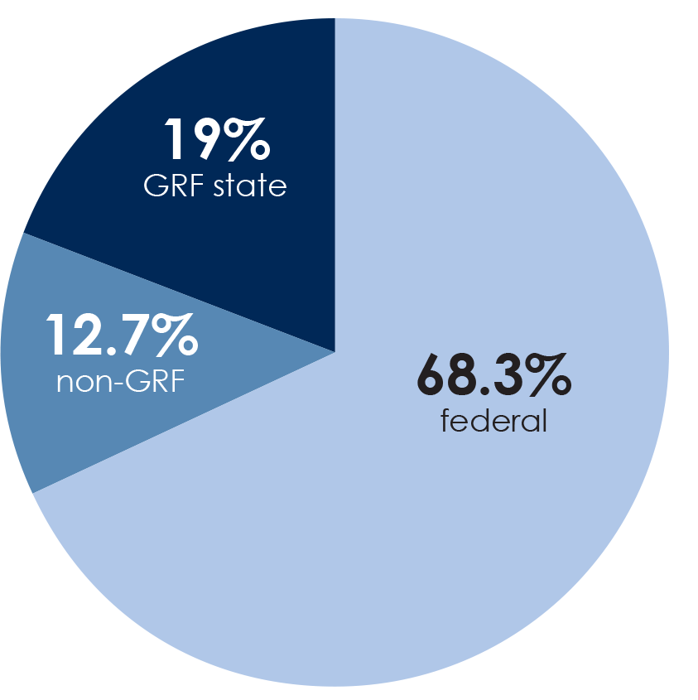
Ohio Medicaid spending, by source, SFY 2018
Source: Ohio Legislative Service Commission
Copyright © 2019 Health Policy Institute of Ohio. All rights reserved.

Slide 13
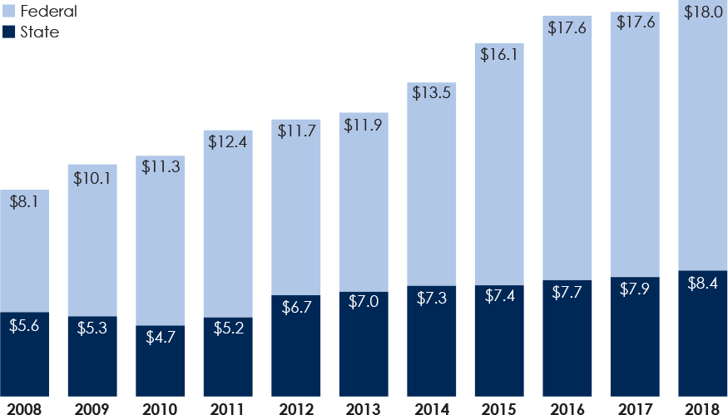
Ohio Medicaid spending, in billions,
SFY 2008 – SFY 2018
Source: Ohio Department of Medicaid (via Ohio Legislative Service Commission)
Copyright © 2019 Health Policy Institute of Ohio. All rights reserved.

Slide 14
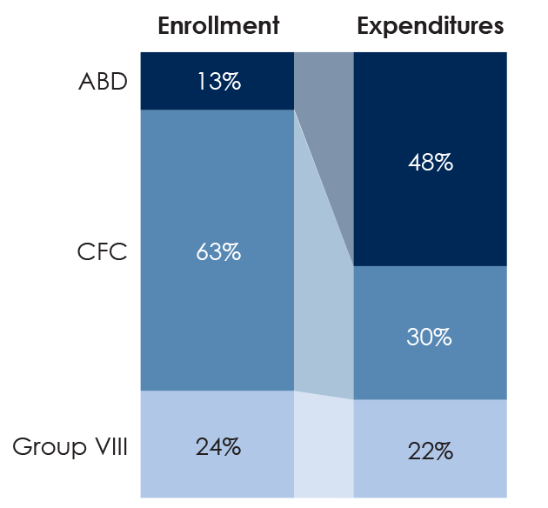
Enrollment and expenditures by Medicaid eligibility category, SFY 2016
Source: Ohio Department of Medicaid (via Ohio Legislative Service Commission)
Copyright © 2019 Health Policy Institute of Ohio. All rights reserved.

Slide 15
Download the complete “Ohio Medicaid Basics 2019” policy brief at https://bit.ly/2w1EO30
Copyright © 2019 Health Policy Institute of Ohio. All rights reserved.

