Slide 1
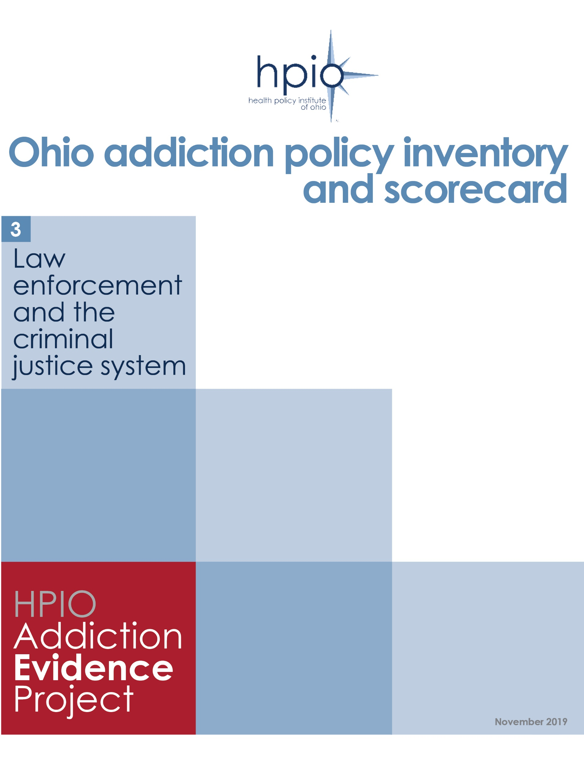
Graphics from
Ohio addiction policy inventory and scorecard
Law enforcement and the criminal justice system
Copyright © 2019 Health Policy Institute of Ohio. All rights reserved.

Slide 2
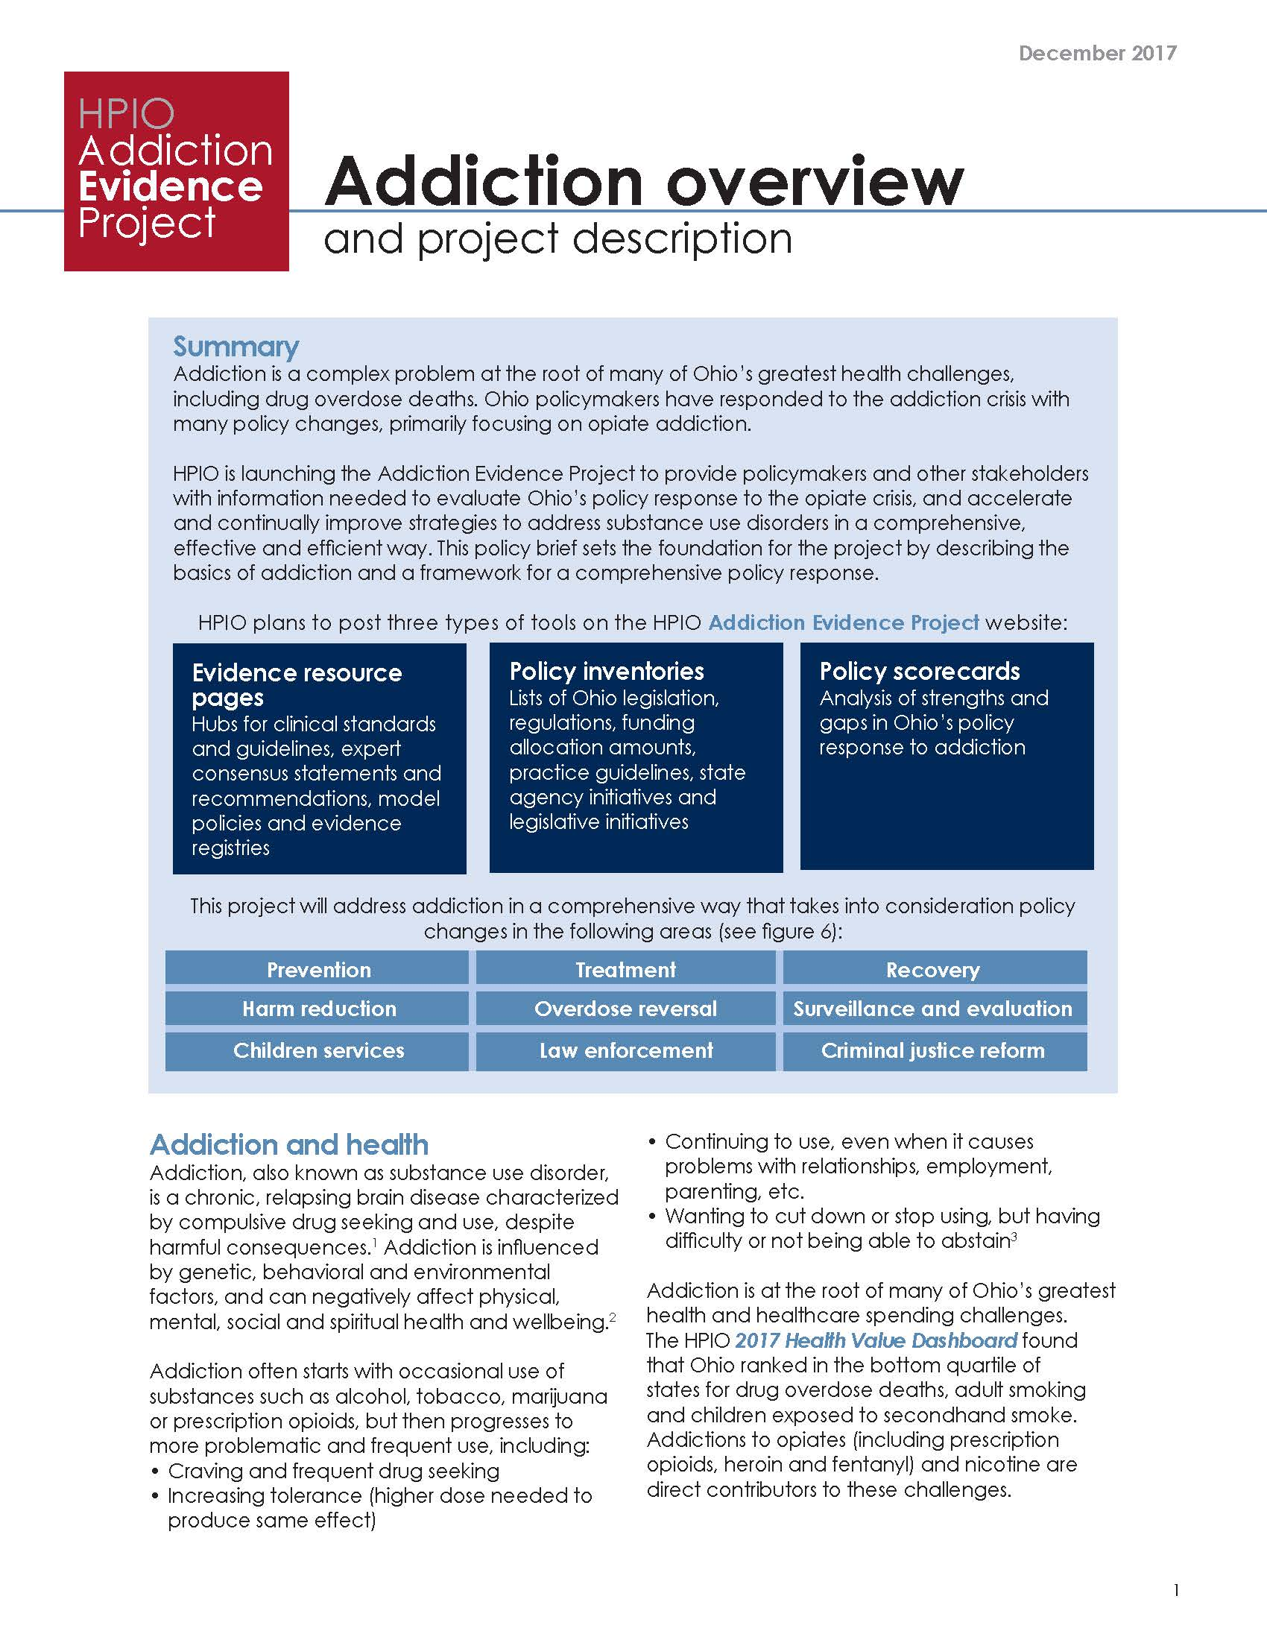
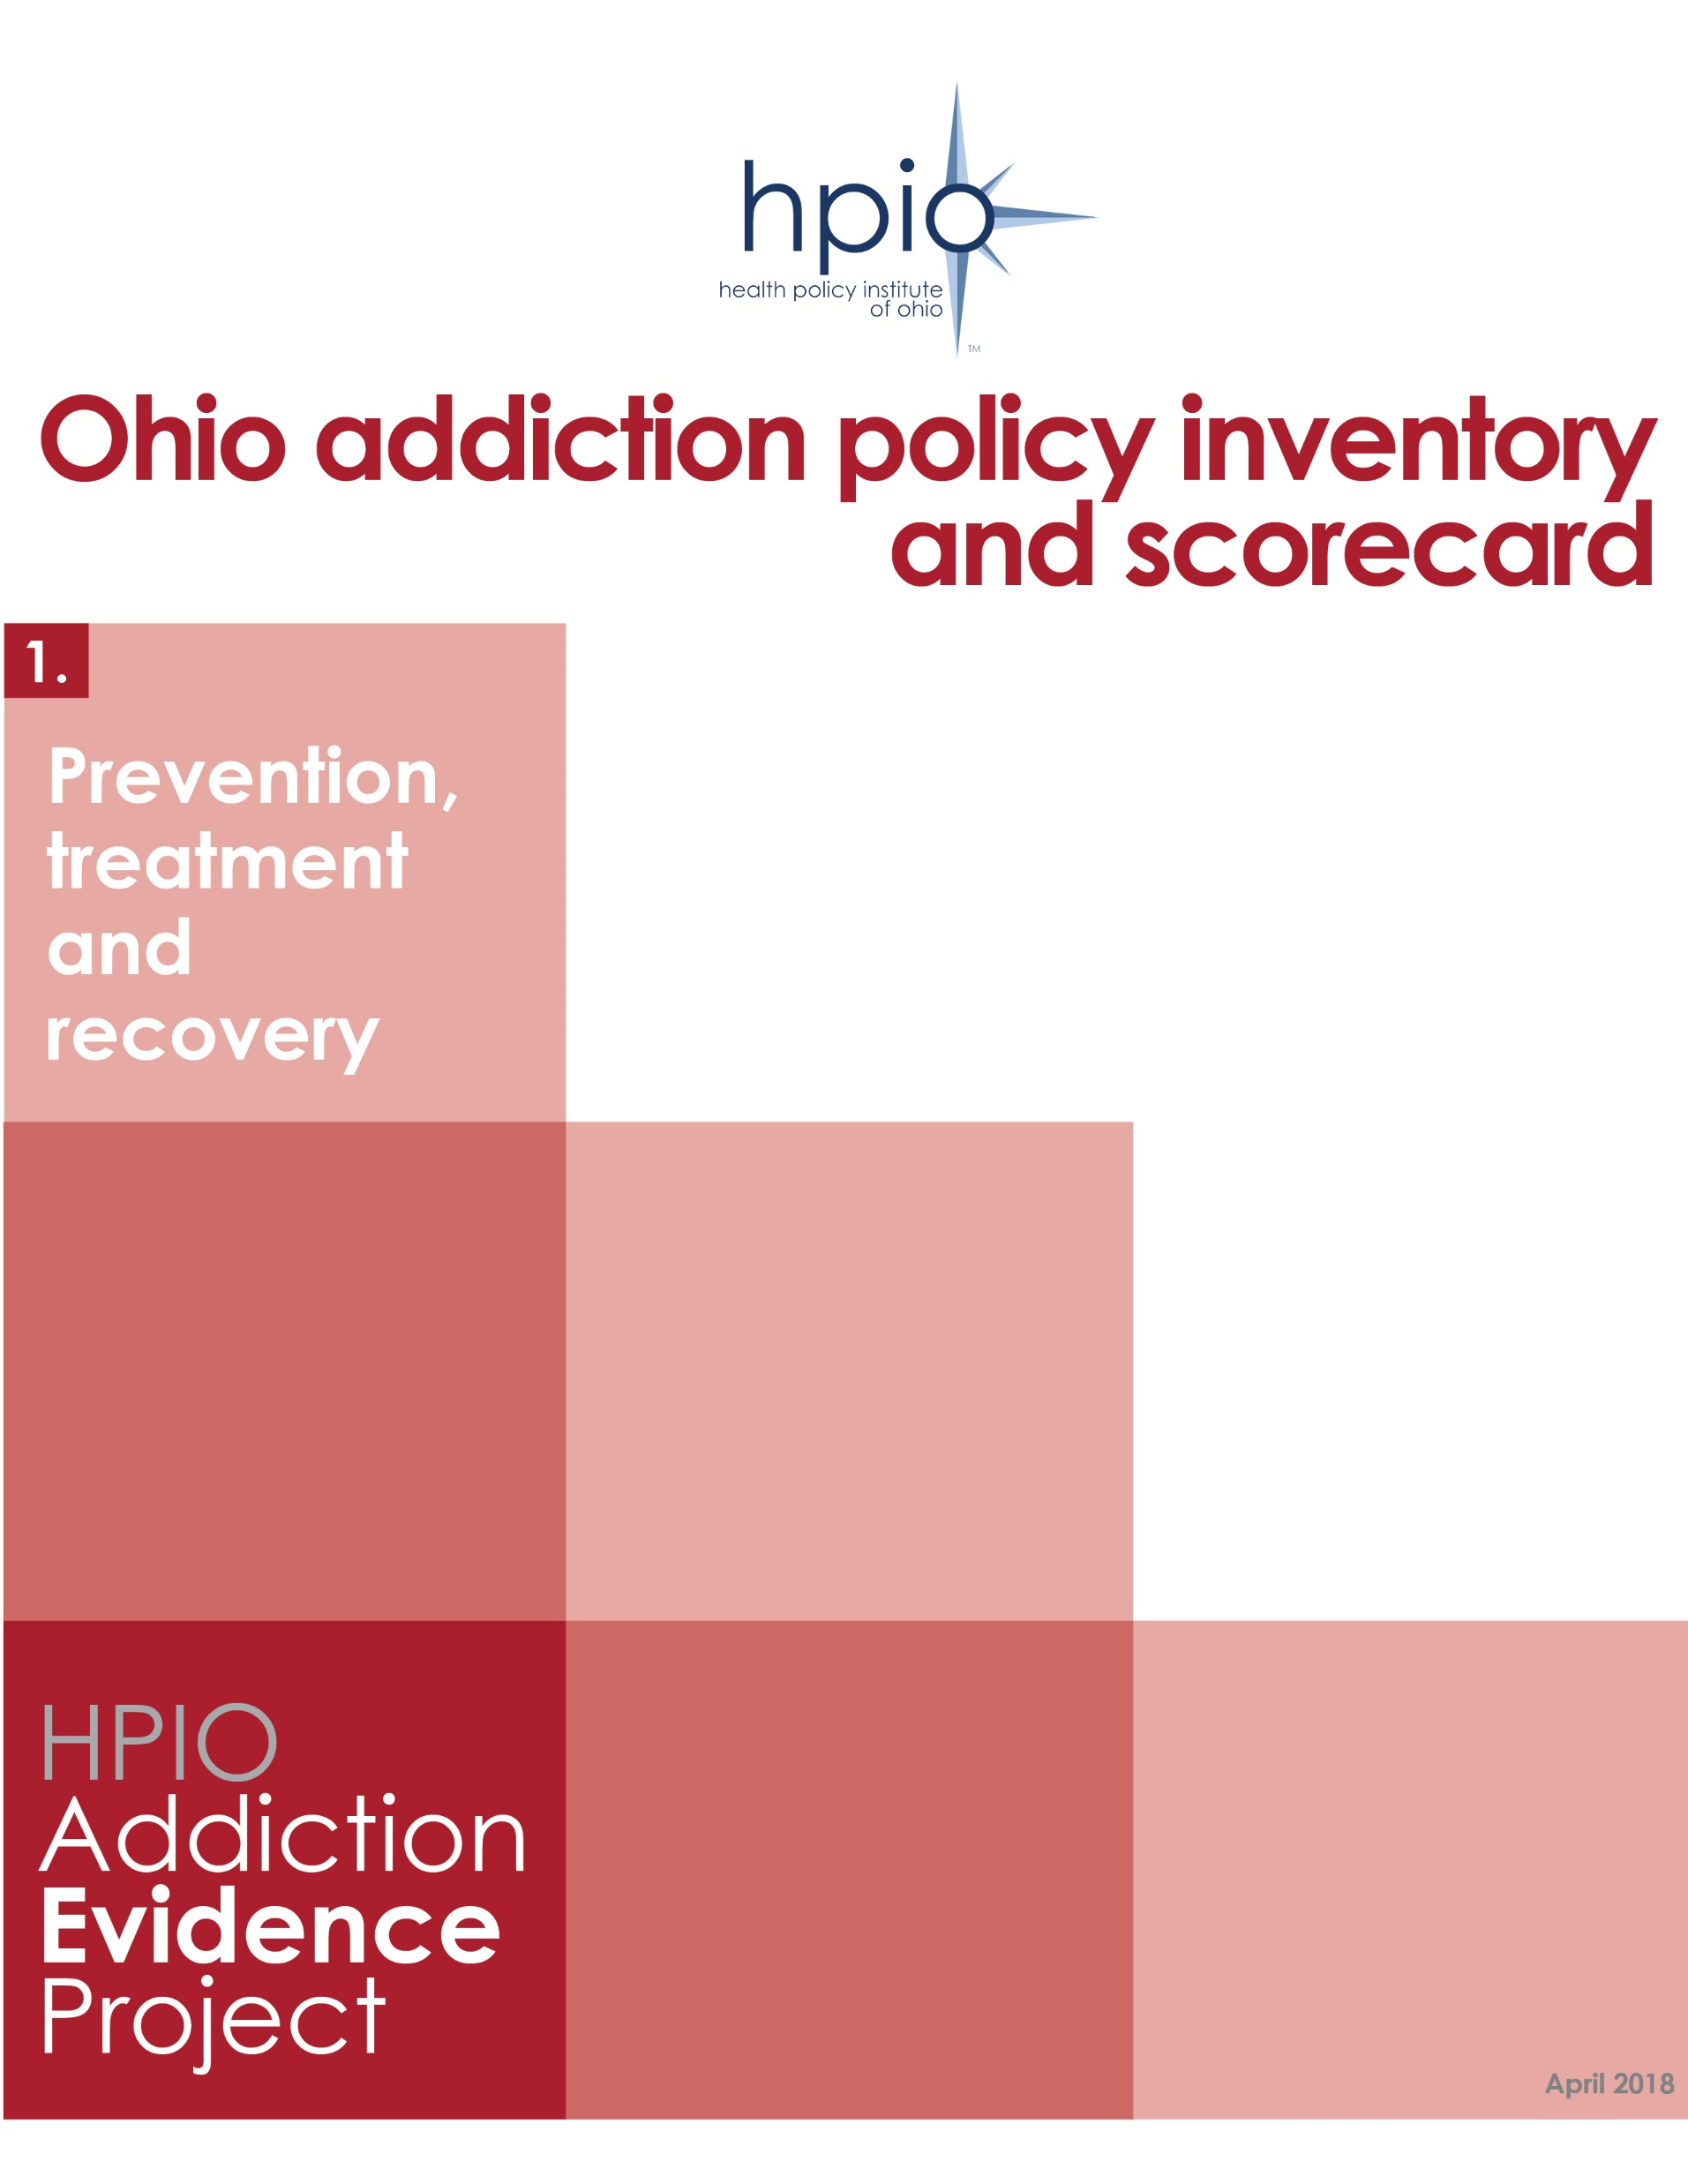
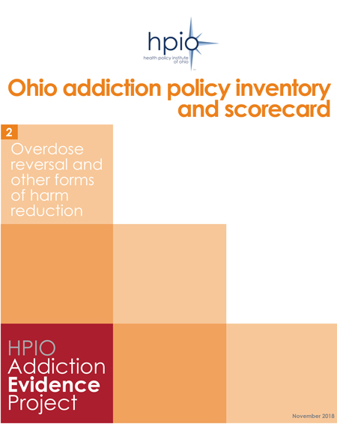
Copyright © 2019 Health Policy Institute of Ohio. All rights reserved.

Slide 3
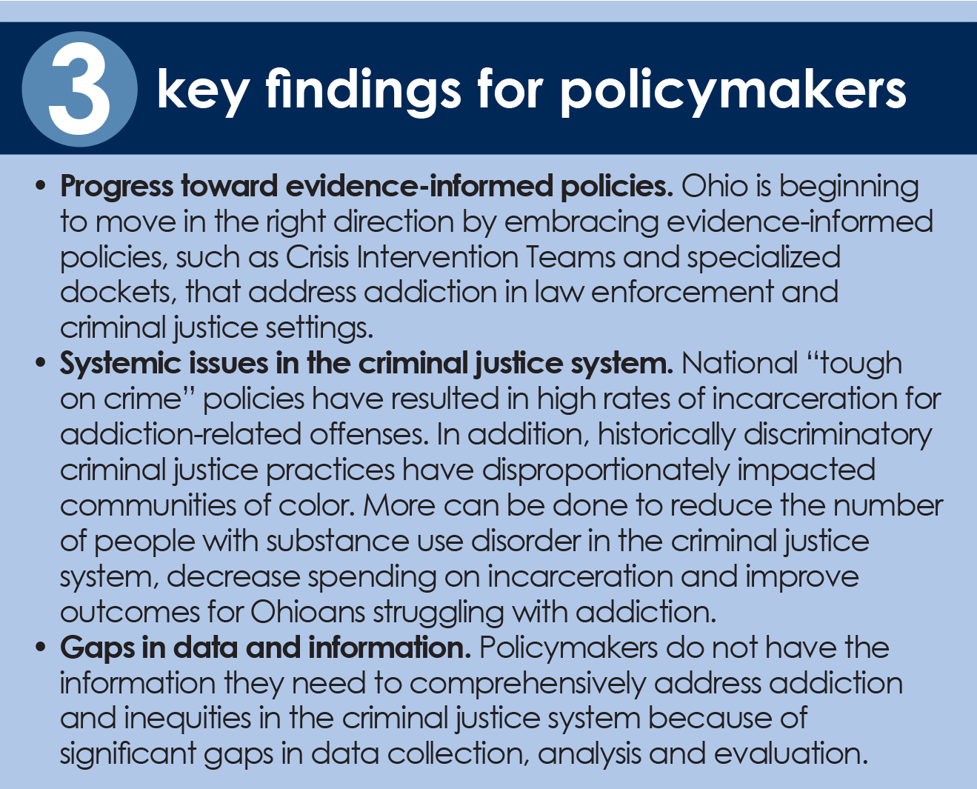
Copyright © 2019 Health Policy Institute of Ohio. All rights reserved.

Slide 4
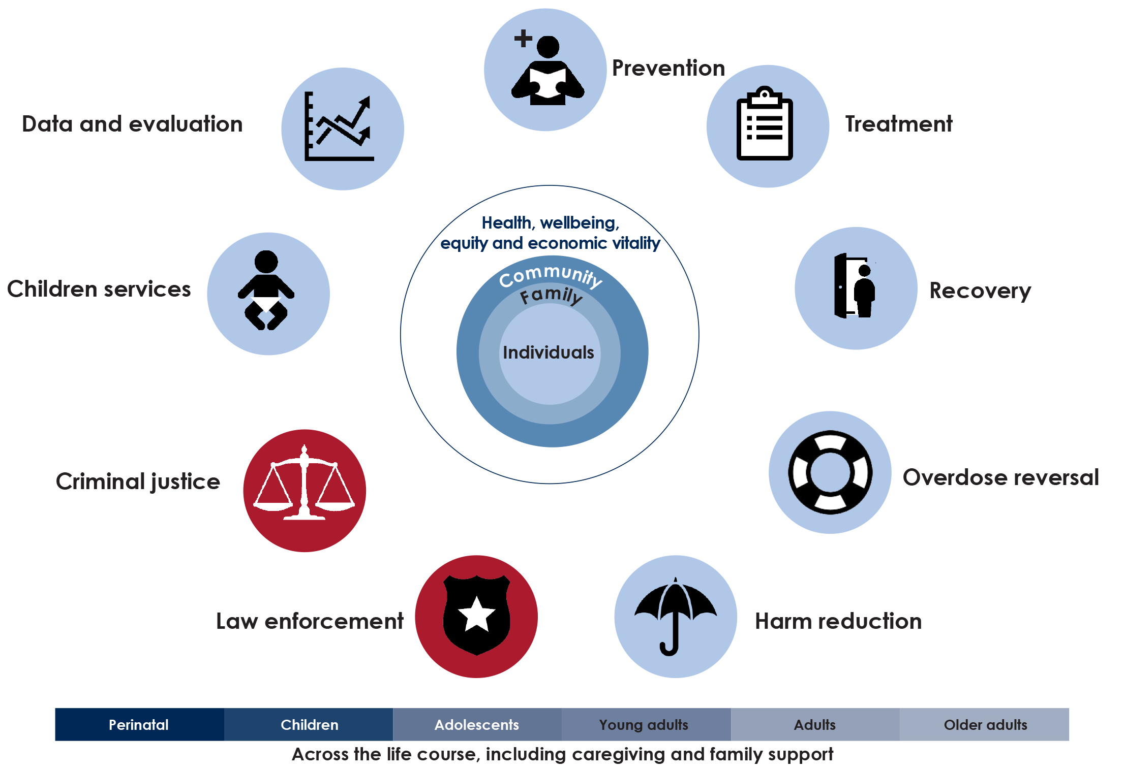
Key elements of a comprehensive policy response to addiction
Source: Health Policy Institute of Ohio adapted from Addiction Policy Forum (2017)
Copyright © 2019 Health Policy Institute of Ohio. All rights reserved.
Copyright © 2019 Health Policy Institute of Ohio. All rights reserved.

Slide 5
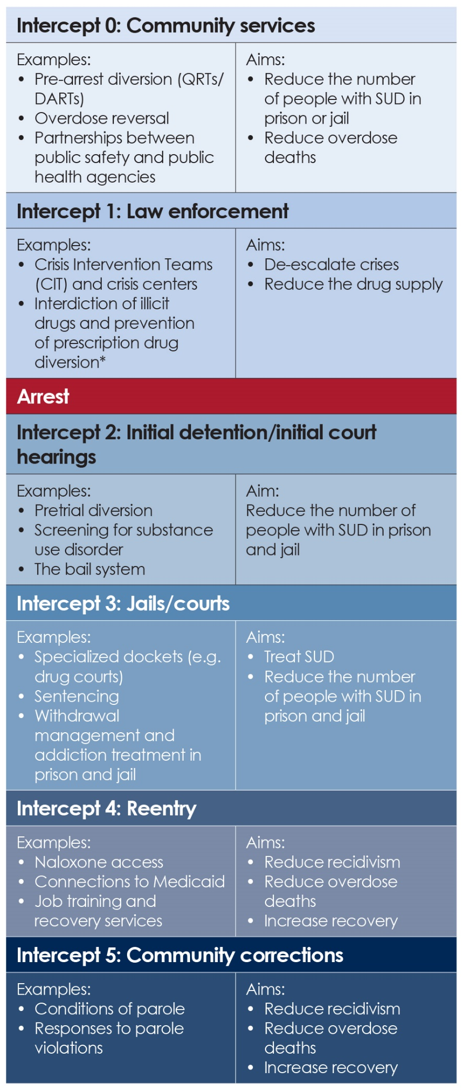
Aims of the criminal justice system related to addiction
*Not typically included in the Sequential Intercept Model
Note: This framework is based on the Sequential Intercept Model
Source: HPIO analysis and information from Policy Research Associates, 2018
Copyright © 2019 Health Policy Institute of Ohio. All rights reserved.

Slide 6
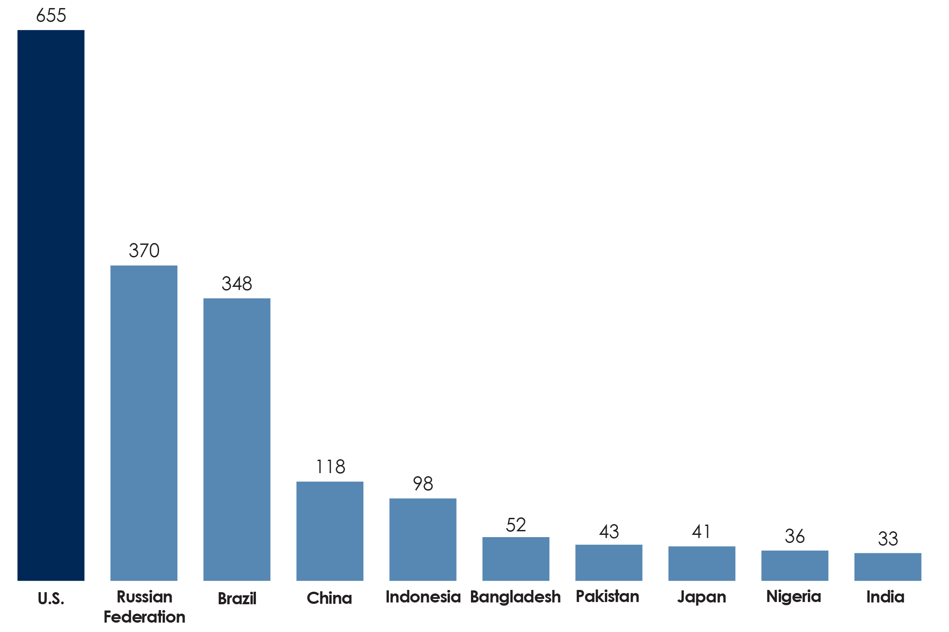
Incarceration rate of the most populous countries in the world, per 100,000 population, November 2018
Note: Incarceration rate includes incarceration in a variety of settings, including pretrial detainees. In the U.S., this includes federal and state prisons and local jails.
Source: World Prison Brief, Institute of Criminal Policy Research, University of London
Copyright © 2019 Health Policy Institute of Ohio. All rights reserved.

Slide 7
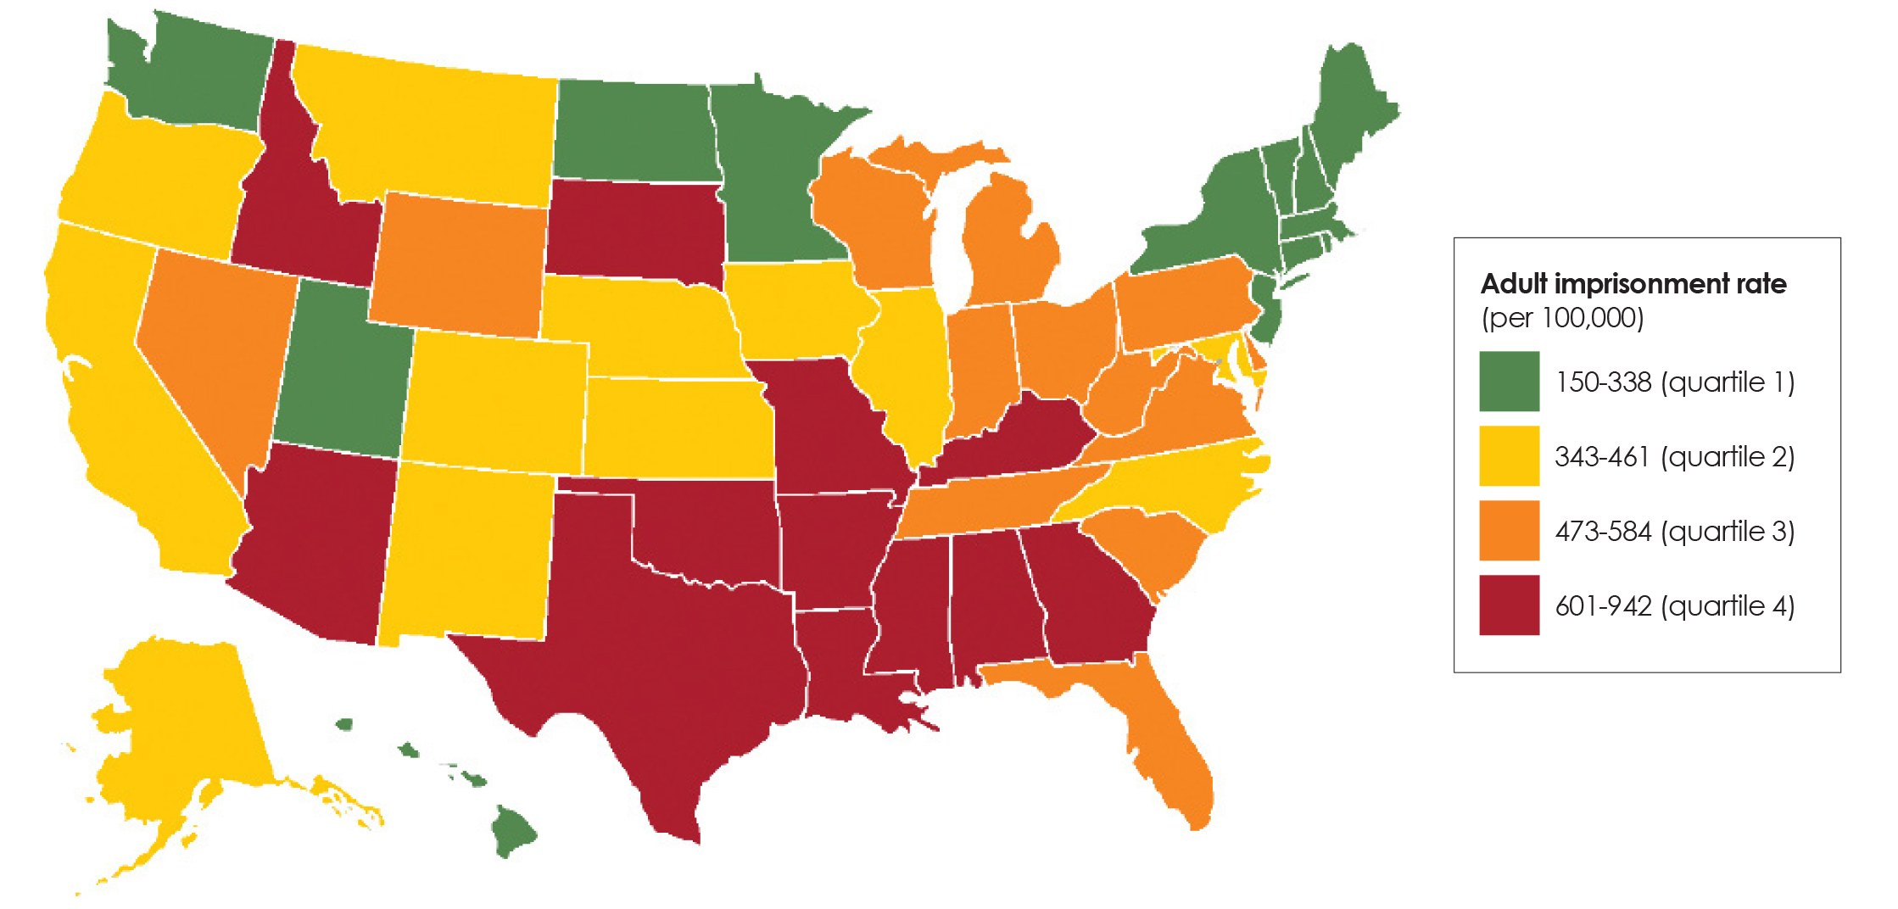
Adult imprisonment rates in state prisons per 100,000 population, 2017
Note: Incarceration rate includes incarceration in state prisons only. Federal prisons and local jails are not included.
Source: National Prisoner Statistics, Bureau of Justice Statistics
Copyright © 2019 Health Policy Institute of Ohio. All rights reserved.

Slide 8
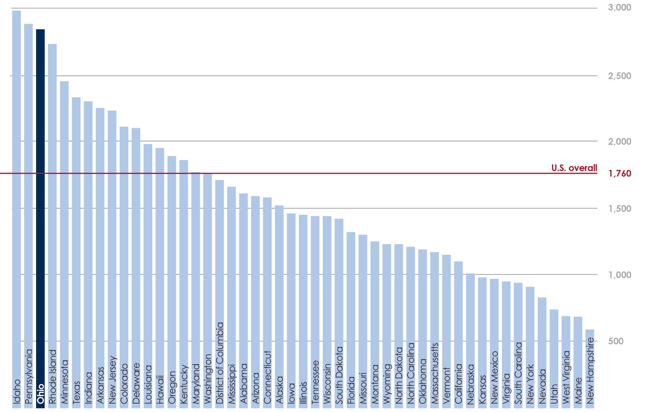
Adult community supervision rates per 100,000 population, 2016
Note: Counts are rounded to the nearest 100, and rates are rounded to the nearest 10, Rates are computed using estimates of the U.S. adult resident population of persons age 18 or older and persons of all ages on Jan. 1, 2017, within jurisdiction.
Source: National Prisoner Statistics, Bureau of Justice Statistics
Copyright © 2019 Health Policy Institute of Ohio. All rights reserved.

Slide 9
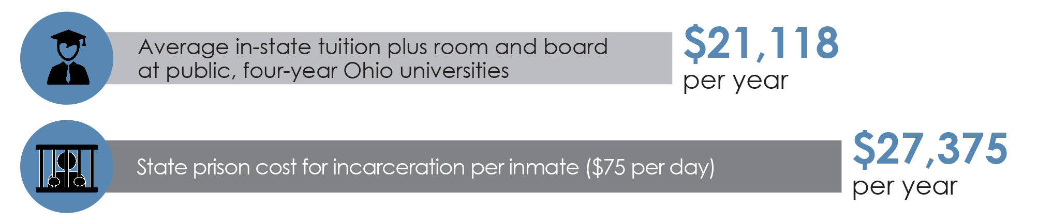
University and incarceration costs Ohio, 2019
Incarceration source: Ohio Department of Rehabilitation and Correction, 2019
University source: HPIO analysis of College Tuition Compare, 2019
Copyright © 2019 Health Policy Institute of Ohio. All rights reserved.

Slide 10
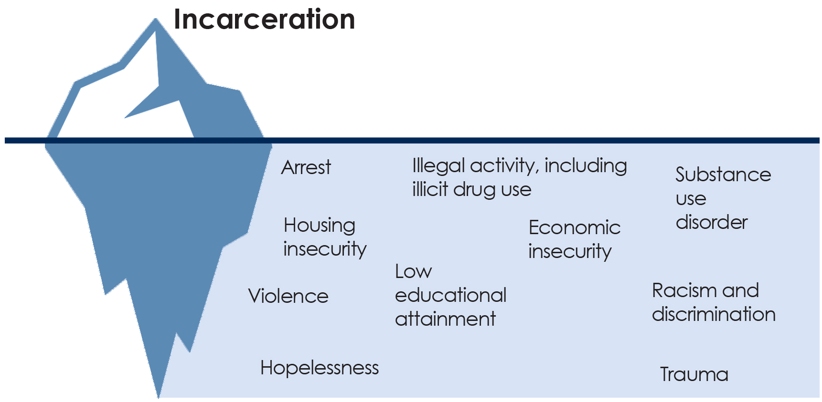
Determinants of incarceration
Copyright © 2019 Health Policy Institute of Ohio. All rights reserved.

Slide 11
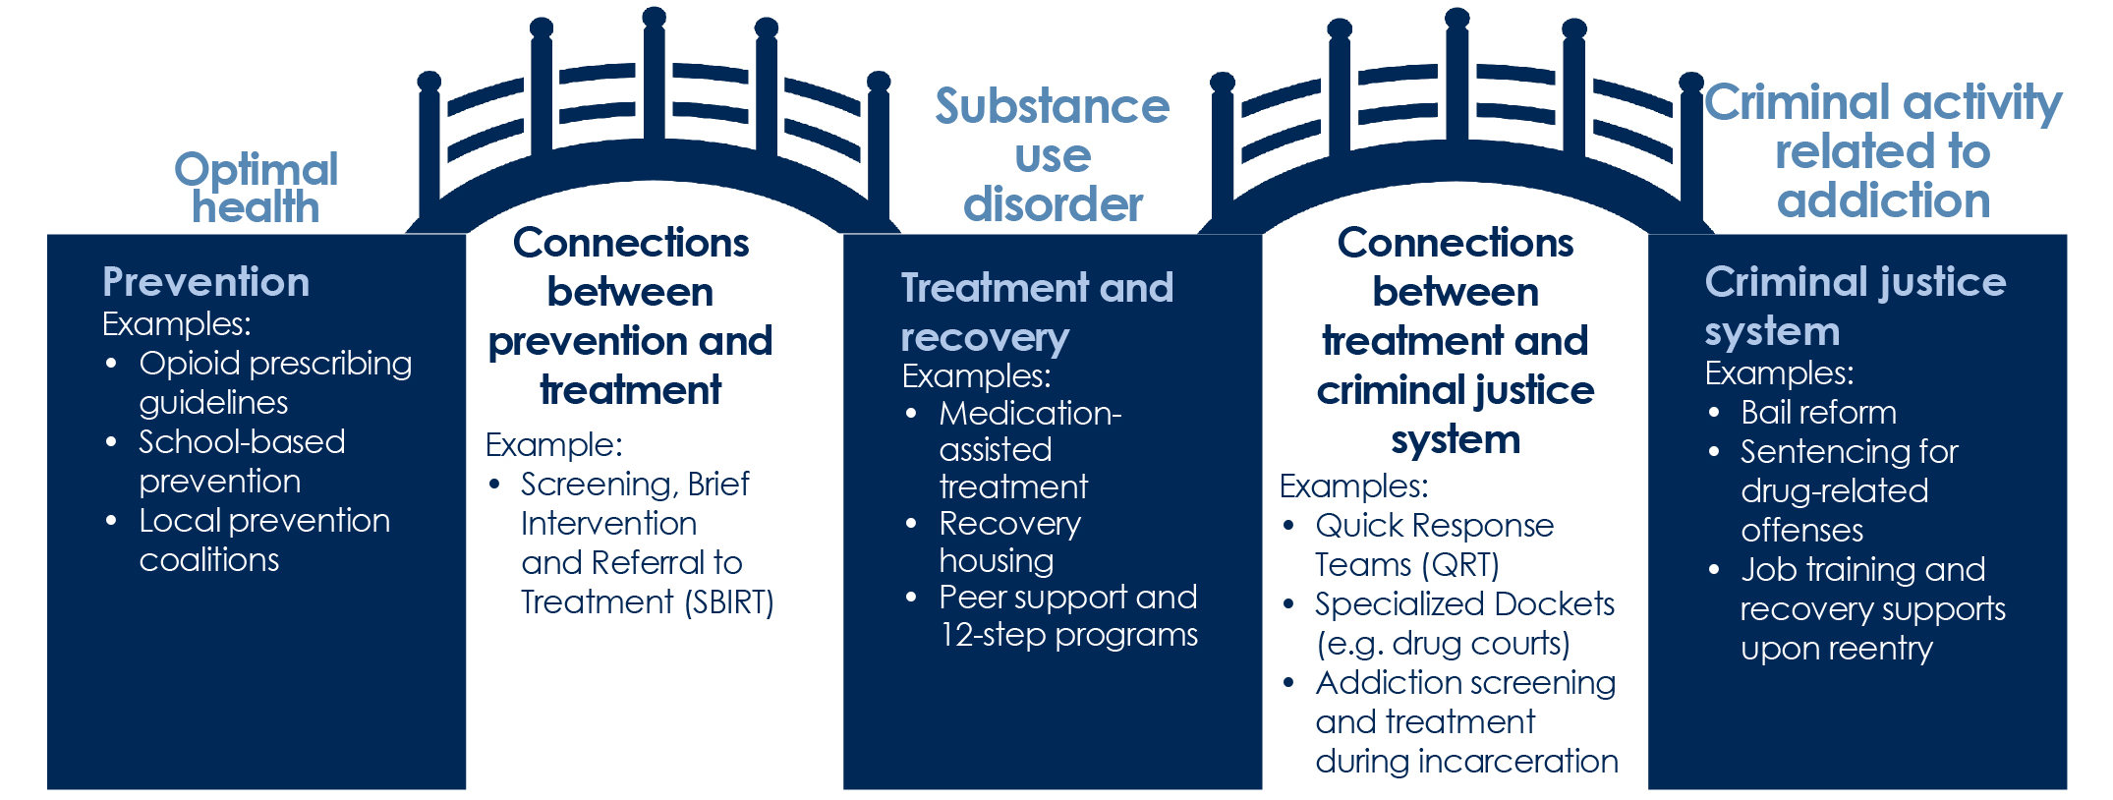
Role of the criminal justice system in a comprehensive approach to addiction
Copyright © 2019 Health Policy Institute of Ohio. All rights reserved.

Slide 12
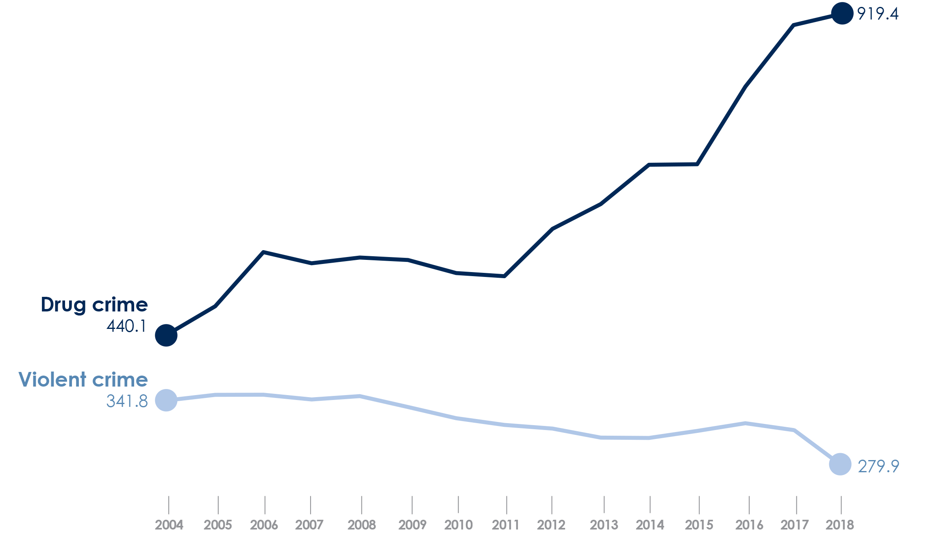
Rate of drug crime and violent crime in Ohio, per 100,000 population, 2004-2018
Note: Participation in OIBRS has increased from 383 law enforcement agencies (covering 64.7% of the population) in 2004 to 539 agencies (covering approximately 72.7% of the Ohio population) in 2014. Ohio Department of Reabilitation and Correction, 2016.
Source: Ohio Department of Rehabilitation and Correction, 2019
Copyright © 2019 Health Policy Institute of Ohio. All rights reserved.

Slide 13
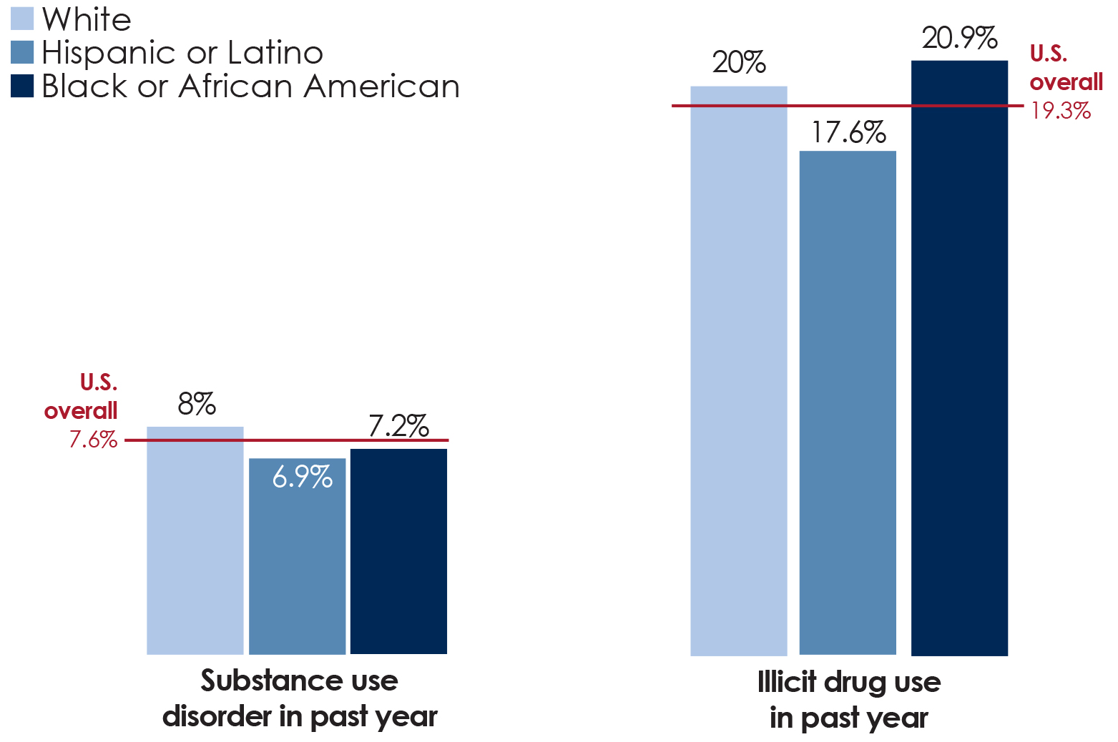
U.S. substance use disorder and illicit drug use in the past year age 18 and older, by race, 2017
Note: Illicit drug use includes use of marijuana, cocaine (including crack), heroin, hallucinogens, inhalants and methamphetamine, as well as the misuse of prescription pain relievers, tranquilizers, stimulants and sedatives
Source: National Survey on Drug Use and Health, 2017
Copyright © 2019 Health Policy Institute of Ohio. All rights reserved.

Slide 14
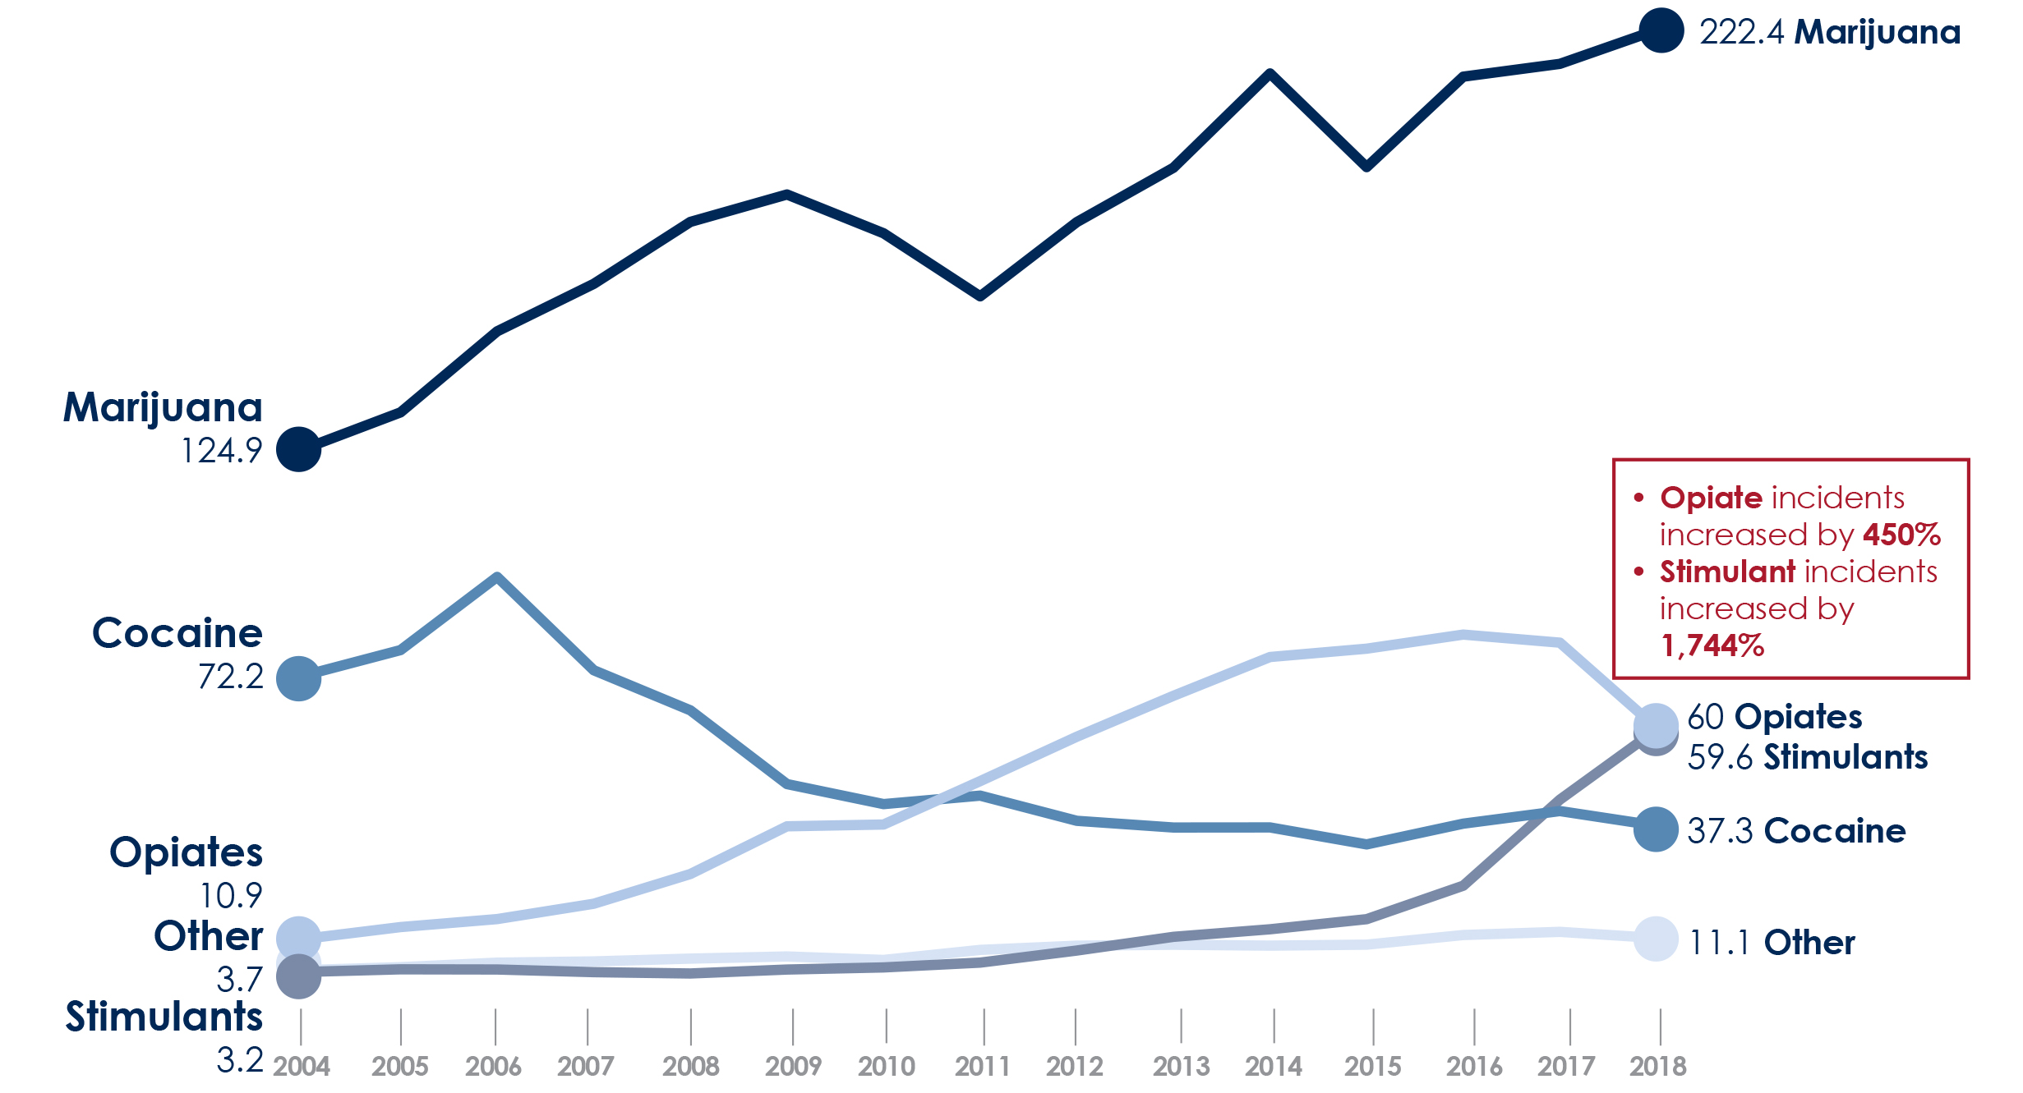
Ohio’s incident rate per 100,000 population, by drug type, 2004-2018
Note: Drug categories are based on OIBRS classification codes. “Opiates” includes heroin and other illicit opioids. “Stimulants” includes methamphetamine and other stimulant drugs (except cocaine) “Other” includes depressants, hallucinogens, prescription drugs and harmful intoxicants.
Source: Ohio Department of Rehabilitation and Correction, 2019
Copyright © 2019 Health Policy Institute of Ohio. All rights reserved.

Slide 15
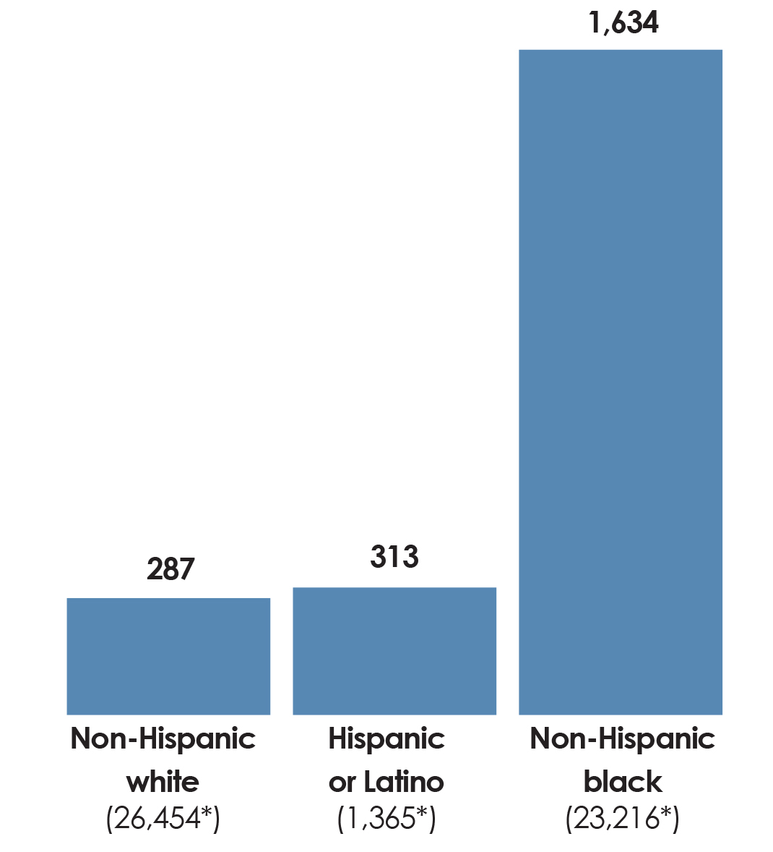
Ohio’s incarceration rate per 100,000 population, by race, 2017
*Number of people incarcerated
Source: HPIO analysis of data from the Bureau of Justice Statistics and the U.S. Census Bureau, Population Division
Copyright © 2019 Health Policy Institute of Ohio. All rights reserved.

Slide 16
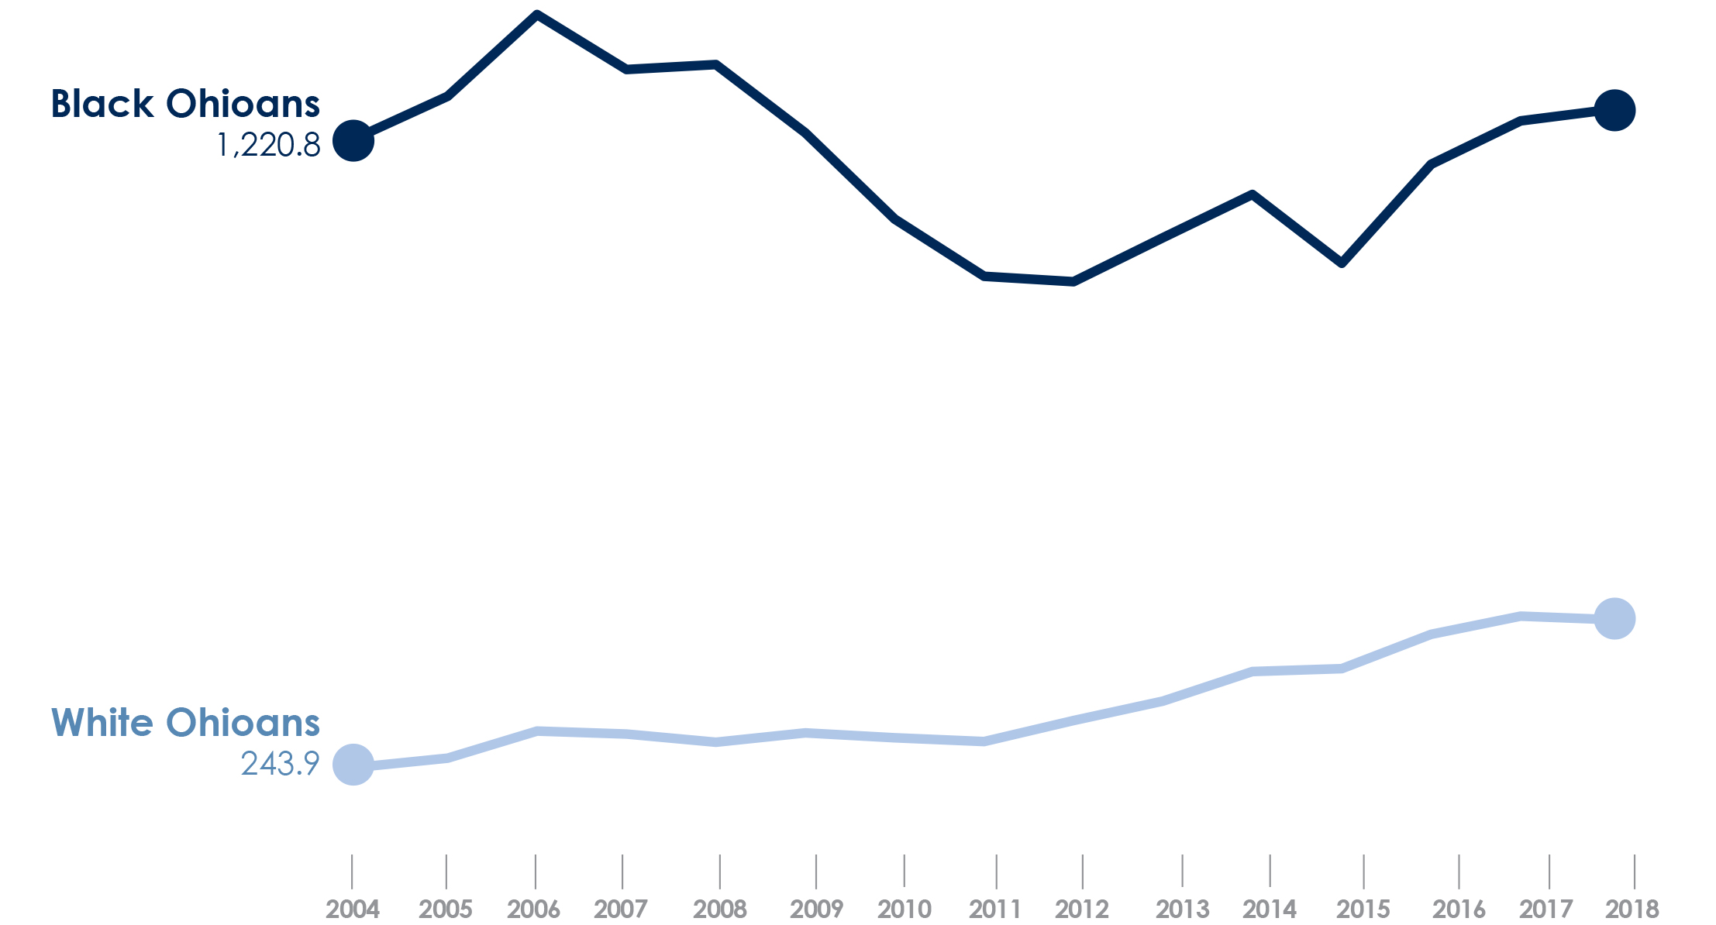
Ohio drug crime arrest rate per 100,000 population, by race, 2008-2018
Source: Ohio Department of Rehabilitation and Correction, 2019
Copyright © 2019 Health Policy Institute of Ohio. All rights reserved.

Slide 17
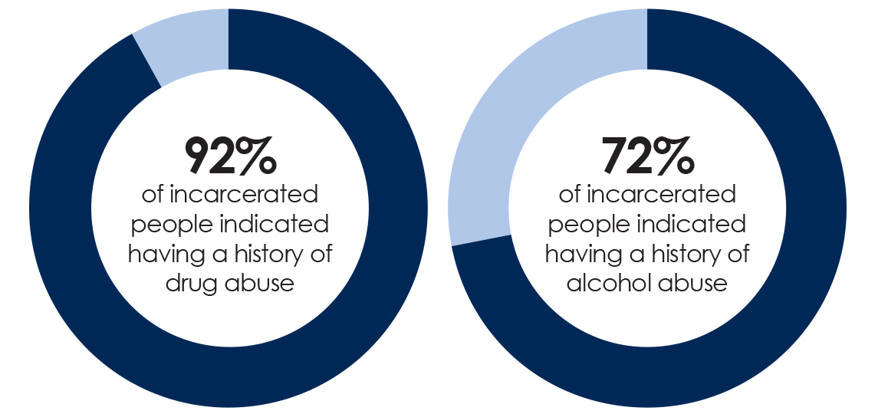
Drug and alcohol use among incarcerated people in Ohio 2015
Source: 2015 Intake Study, Ohio Department of Rehabilitation and Correction, 2016
Copyright © 2019 Health Policy Institute of Ohio. All rights reserved.

Slide 18
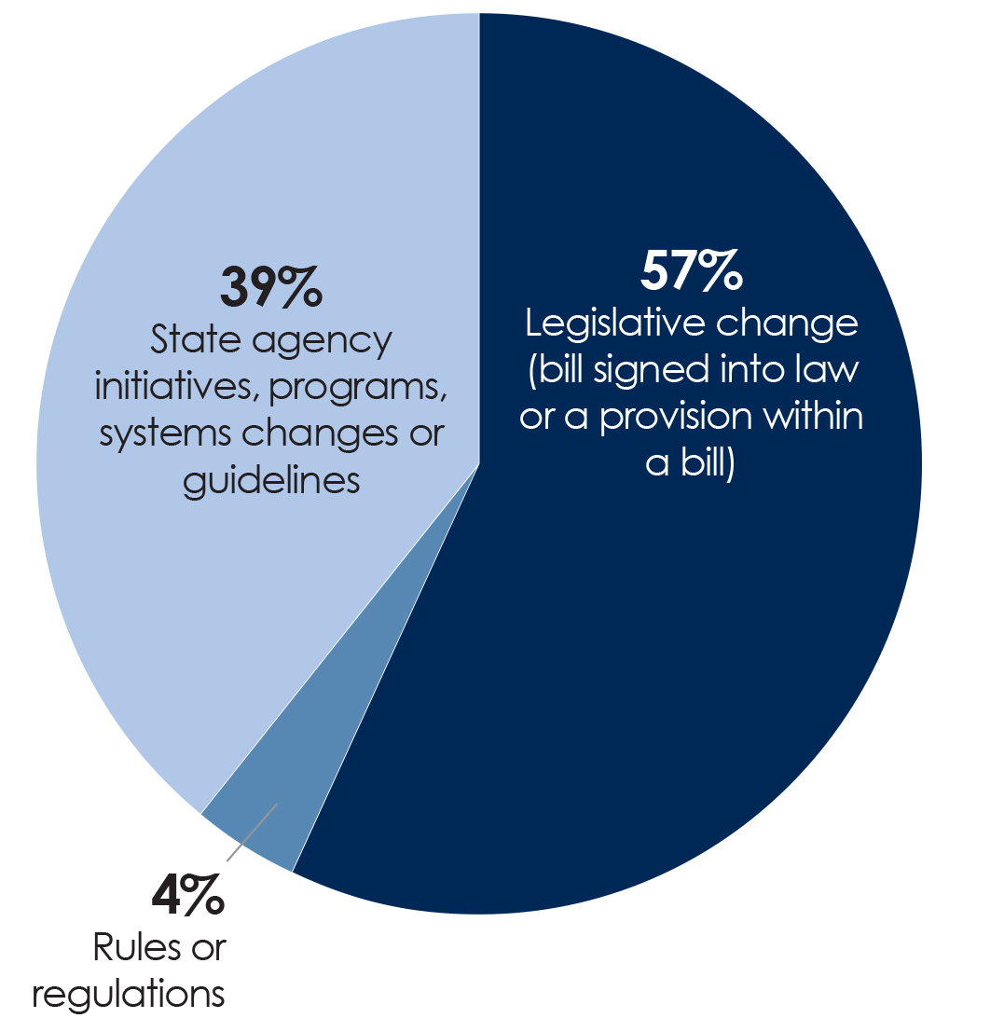
Number of addiction-related changes in law enforcement and criminal justice sectors in Ohio by type of policy change, 2013-2018
Source: HPIO review of Ohio legislation, regulations, Governor’s Cabinet Opiate Action Team timeline and other policy summaries
Copyright © 2019 Health Policy Institute of Ohio. All rights reserved.

Slide 19
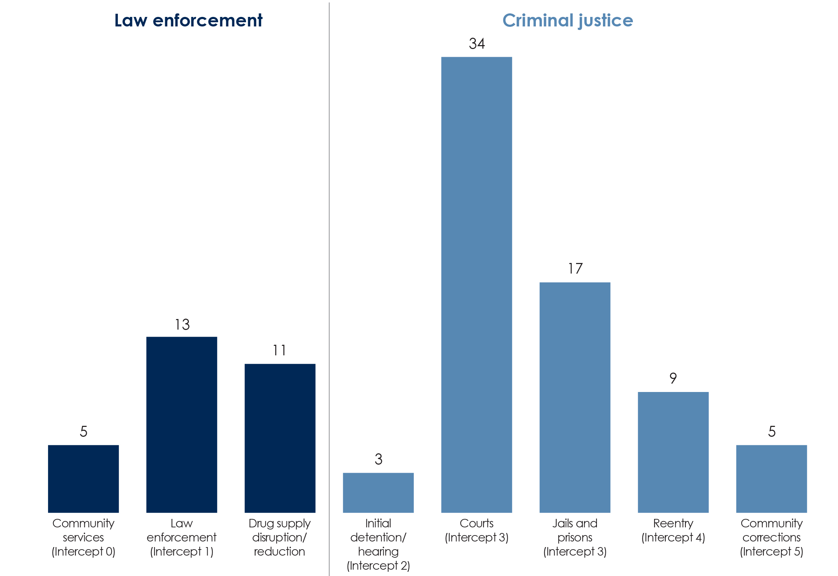
Number of addiction-related policy changes in Ohio by topic, 2015-2018
Source: HPIO review of Ohio legislation, regulations, Governor’s Cabinet Opiate Action Team timeline and other policy summaries
Copyright © 2019 Health Policy Institute of Ohio. All rights reserved.

Slide 20
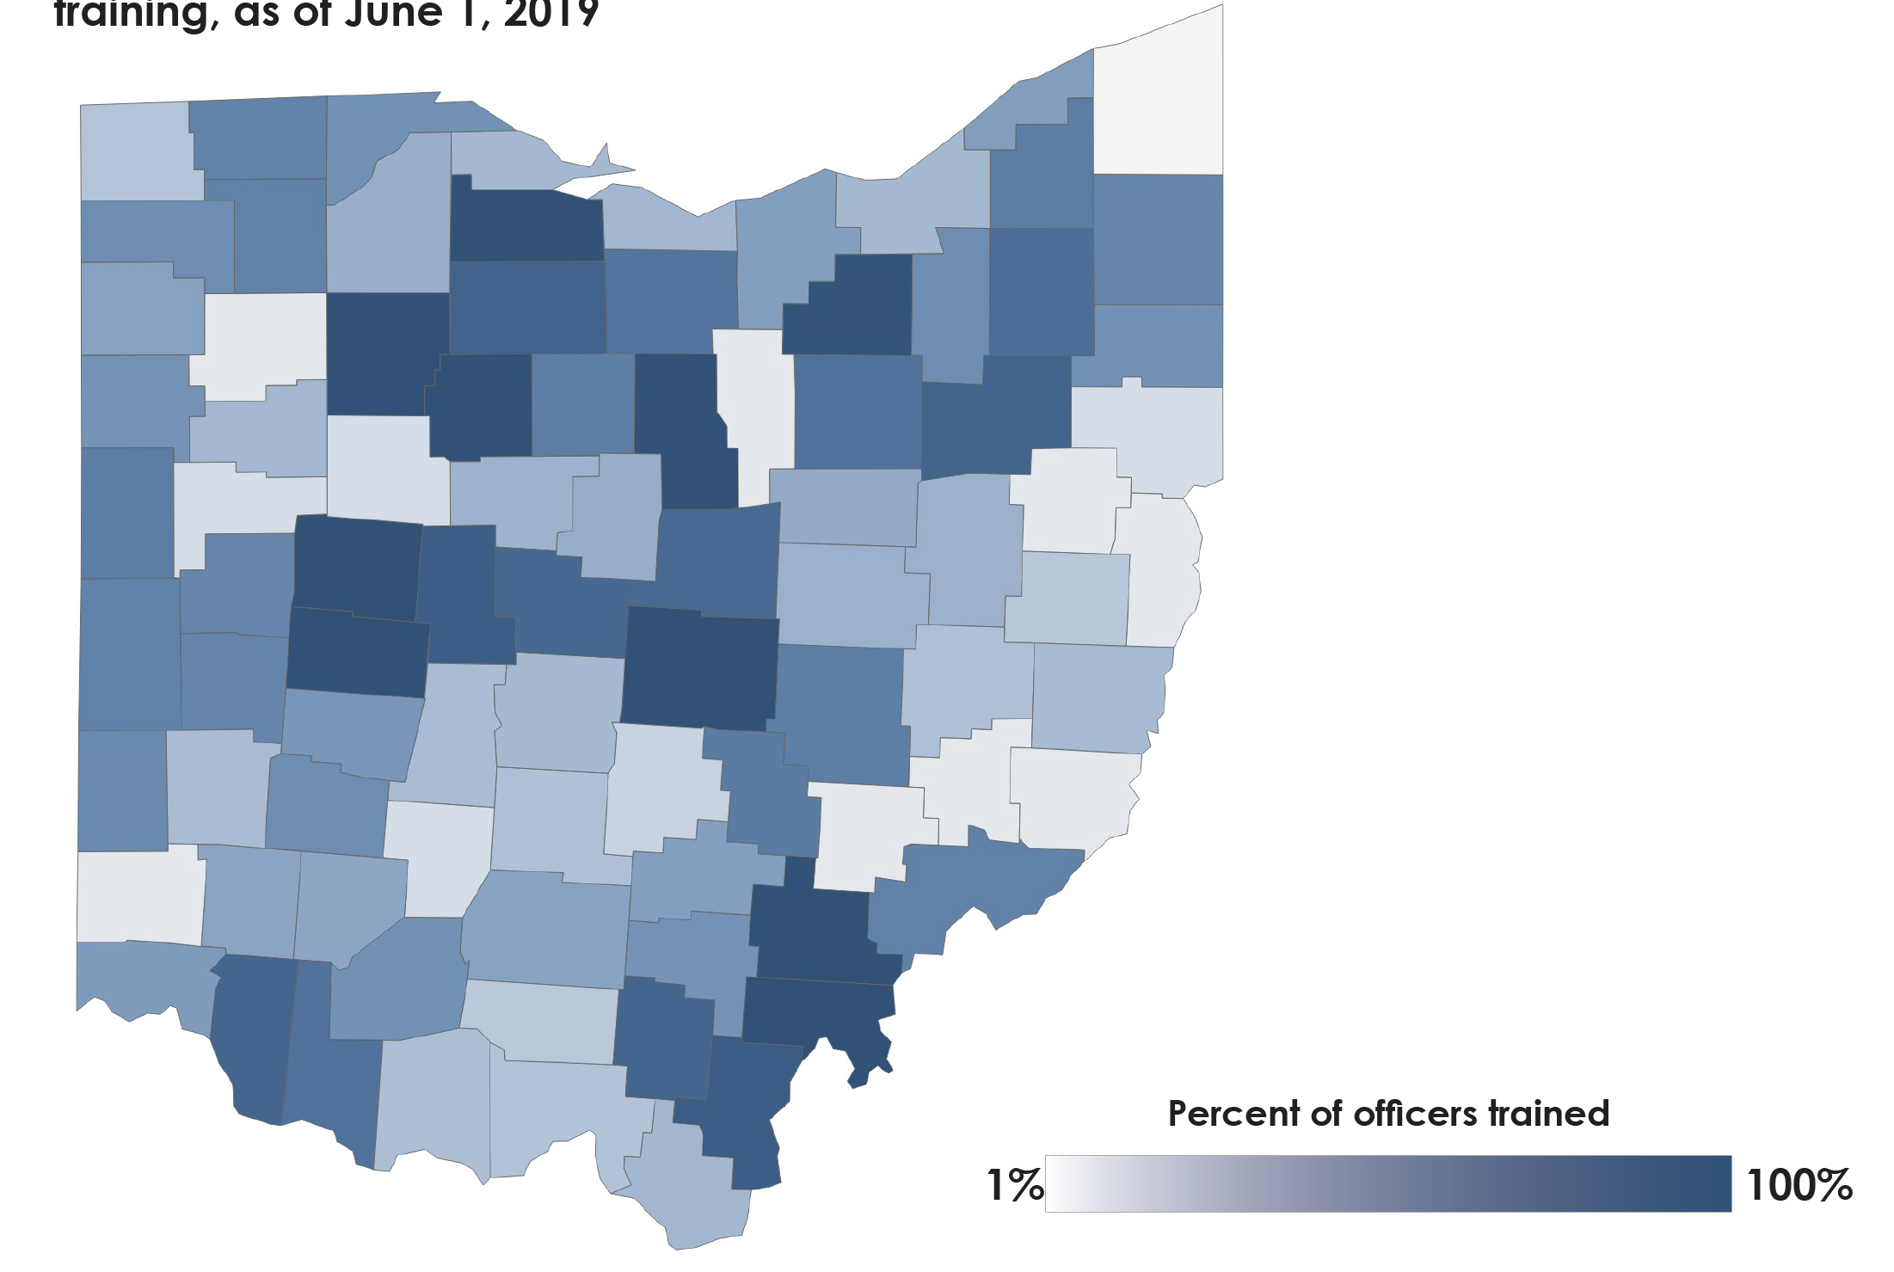
Percent of full-time law enforcement officers completing CIT training as of June 1, 2019
Source: Criminal Justice Coordinating Center of Excellence, Northeast Ohio Medical University
Copyright © 2019 Health Policy Institute of Ohio. All rights reserved.

Slide 21
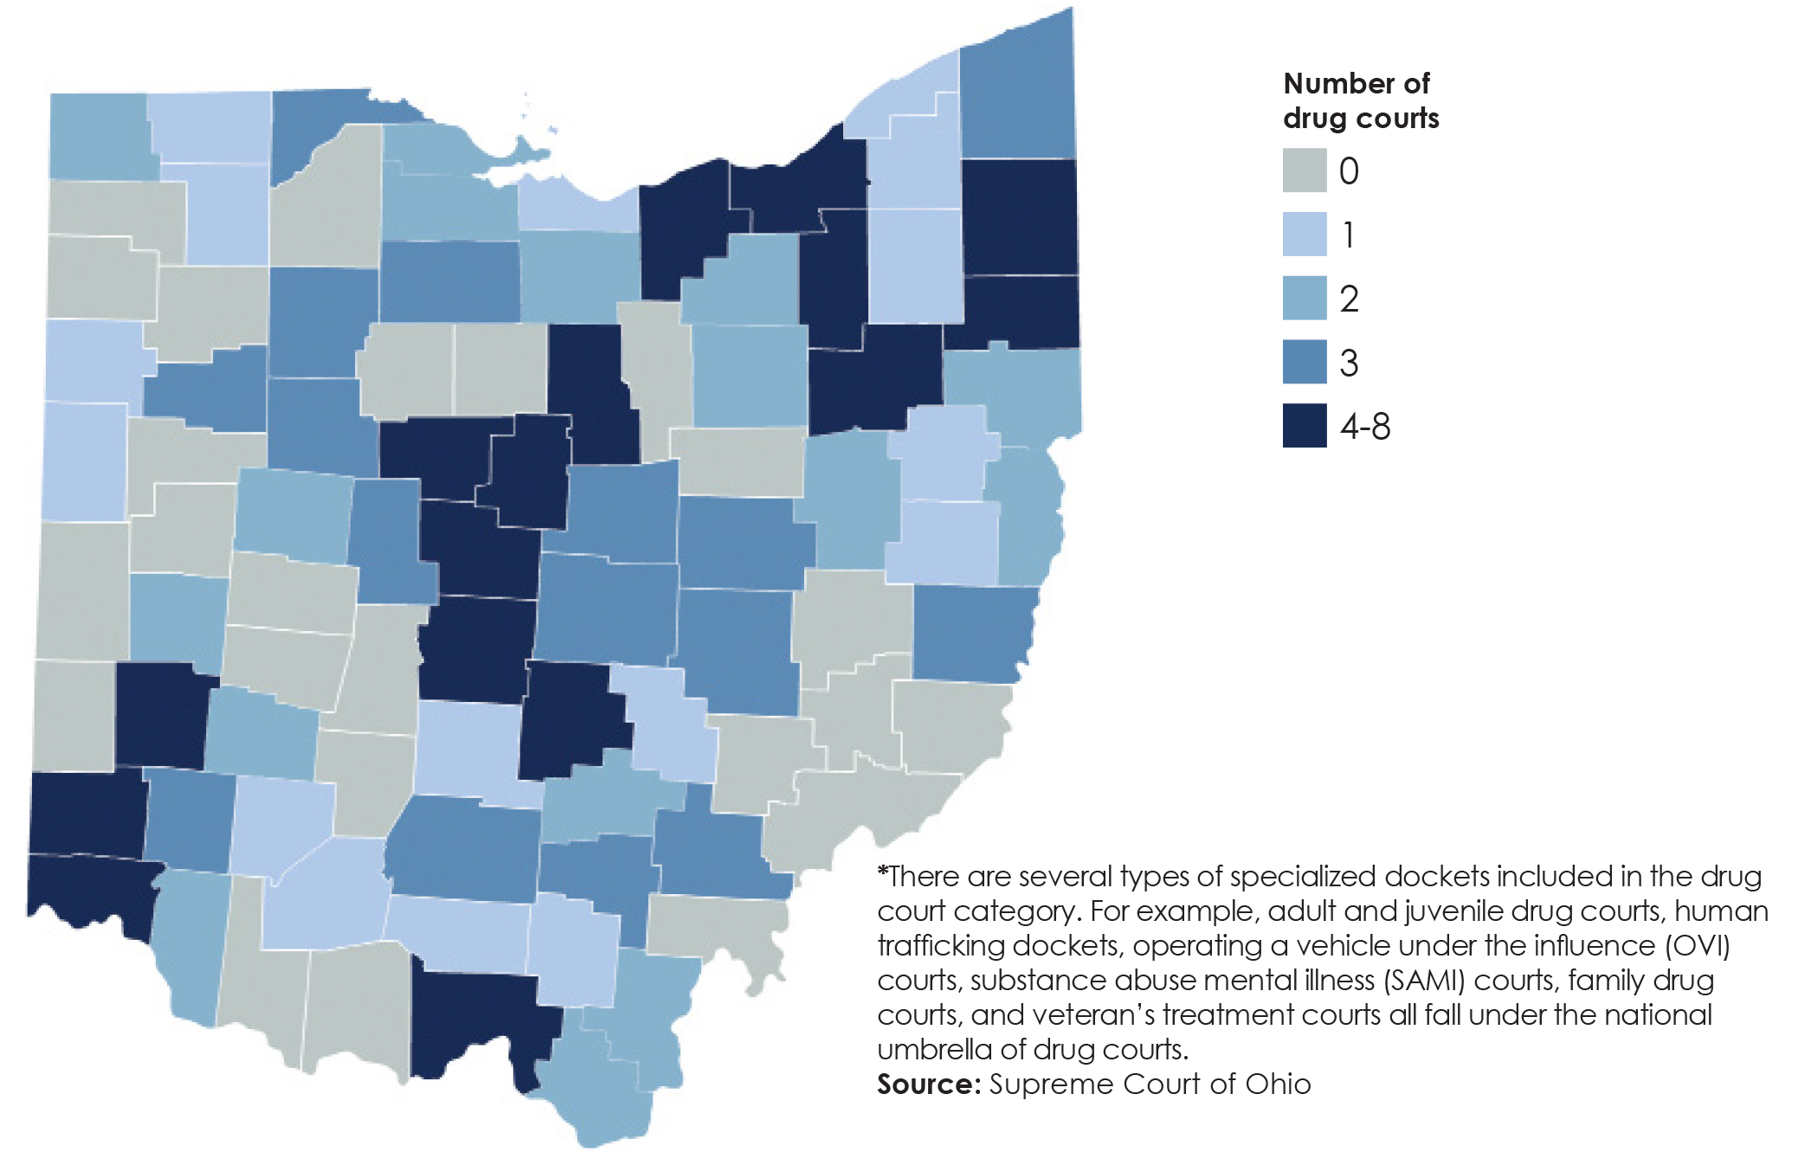
Drug courts* in Ohio October 2019
Copyright © 2019 Health Policy Institute of Ohio. All rights reserved.

Slide 22
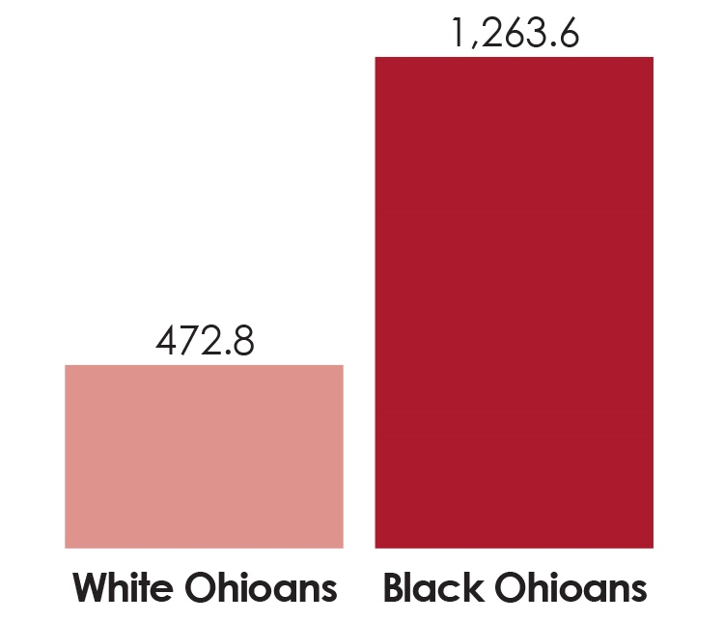
Ohio drug crime arrest rate by race, per 100,000 population, 2018
Source: Ohio Department of Rehabilitation and Correction, 2019
Copyright © 2019 Health Policy Institute of Ohio. All rights reserved.

