Slide 1
Economic Mobility Determines YOUR Health
David Lipsetz
Senior Fellow, Housing Assistance Council
July 27, 2017

Slide 2
Discuss the challenges related to economic mobility, as well as policy options for increasing mobility and thereby improving health outcomes for people living in poverty.

Slide 3
To Do
Economic Mobility
Social Determinants of Health

Slide 4
Economic mobility
The ability to move up and down the economic ladder in one’s lifetime, and across generations.

Slide 5
Economic mobility is correlated to:
residential integration
income equality
primary school quality
social capital
family stability
- Chetty et al, 2014
https://cdn.theatlantic.com/assets/media/img/posts/2017/03/Figure_3/9dd685f7f.png

Slide 6
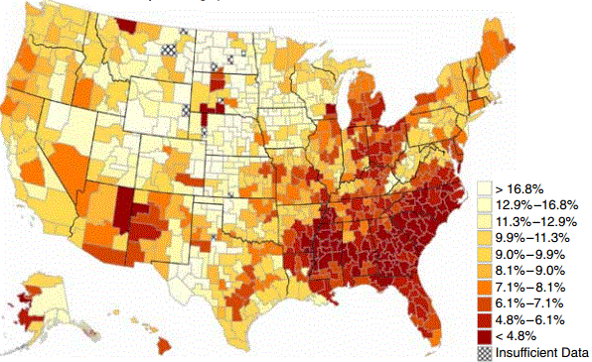
Economic Mobility varies by region
Map of the probability a child reaches an income in the top 20%
when born to parents earning an income in the bottom 20%
https://cdn.theatlantic.com/assets/media/img/posts/2017/03/Figure_3/9dd685f7f.png

Slide 7
AMERICAN DREAM varies by region
Prosperous and Mobile
Prosperous and Immobile
Distressed and Mobile
Distressed and Immobile Distressed
The Economic Innovation Group, 2017

Slide 8
Economic Mobility Project
- Pew Charitable Trusts
US Partnership for Mobility from Poverty
- Urban Institute
Center on Poverty and Inequality
- Stanford University
Economic Mobility solid sources

Slide 9
Social Determinants of HEALTH
Conditions under which people are born, grow, live, work and age that affect a wide range of health outcomes.

Slide 10
Social Determinants include:
education
employment
income
family & social support
community safety
housing

Slide 11
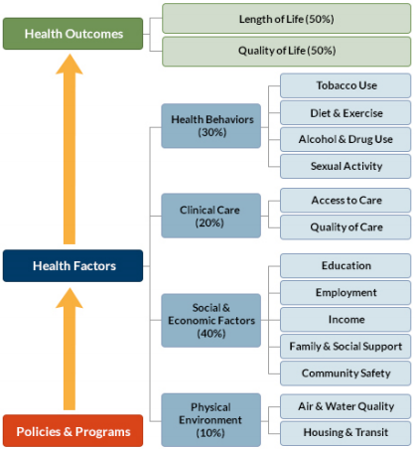
Social Determinants index:
University of Wisconsin Population Health Institute. County Health Rankings Key Findings 2017.

Slide 12
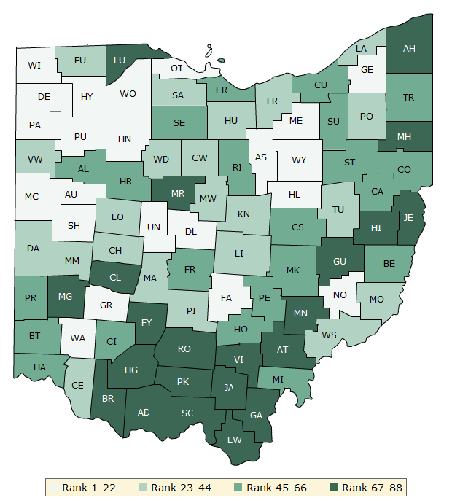
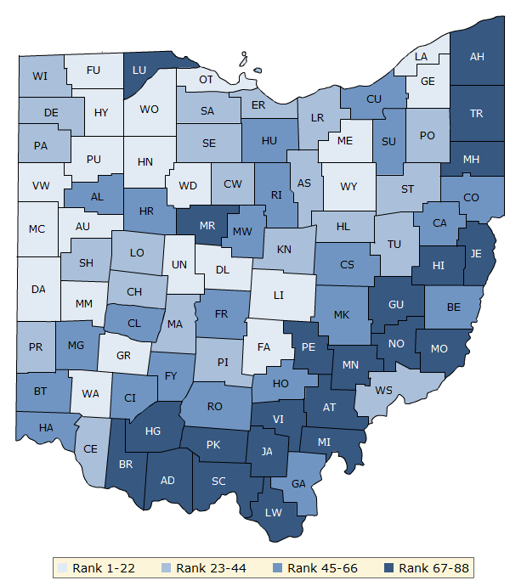
Social Determinants ranking Ohio health outcomes:
1. Delaware
2. Geauga
3. Putnam
4. Union
5. Medina
84. Jackson
85. Gallia
86. Scioto
87. Adams
88. Pike

Slide 13
Social Determinants solid sources
County Health Rankings & Roadmap
- Robert Wood Johnson / U of Wisconsin
Social Determinants of Health Interest Group
The Rand Corporations
Social Determinants of Health Programme
- World Health Organization
HealthyPeople.gov
- US Dept of Health and Human Services

Slide 14
To Do
Economic Mobility
Social Determinants of Health
Policy Options

Slide 15
ECONOMIC MOBILITY
SOCIAL DETERMINANTS OF HEALTH
residential integration
income equality
primary school quality
social capital
family stability
education
employment
income
family & social support
community safety
housing

Slide 16
Improve Health Outcomes by making sure more of the Population has:
Affordable and Hazard Free Housing
Broadband Access
Quality Education
Access to Nutritional Food
Economic Parity
Integrated Neighborhoods
Stable Families

Slide 17
Medicaid Waivers
States pilot projects to: expand eligibility; provide non-typical services; or use innovative service delivery systems to improve care and cut costs.
Social Impact Bonds
Repay investors from the savings generated by positive social outcomes.
Community Benefit and the 990(H)
Obligation of nonprofit hospitals to invest in community benefits now includes housing and economic development

Slide 18
A child’s course in life should not be determined by the ZIP code she’s born in but by the strength of her work ethic and the scope of her dreams.
Barack Obama, 2014

