Slide 1

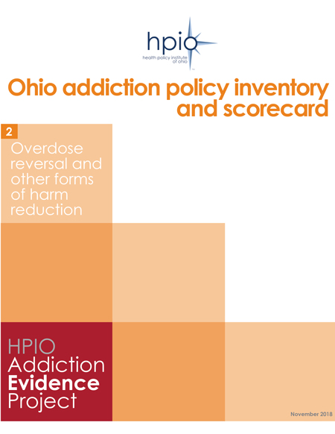
Graphics from
Ohio addiction policy inventory and scorecard
Overdose reversal and other forms of harm reduction
Copyright © 2018 Health Policy Institute of Ohio. All rights reserved.

Slide 2
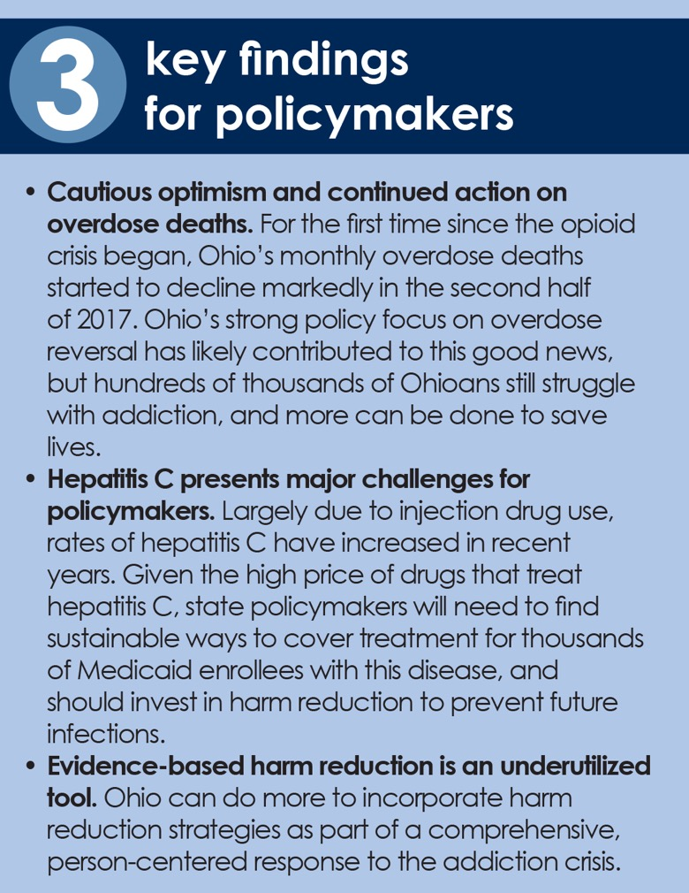
Source: Health Policy Institute of Ohio, ”Ohio Addiction Policy Inventory and Scorecard: Overdose Reversal and Other Forms of Harm Reduction,” November 2018.
Copyright © 2018 Health Policy Institute of Ohio. All rights reserved.

Slide 3
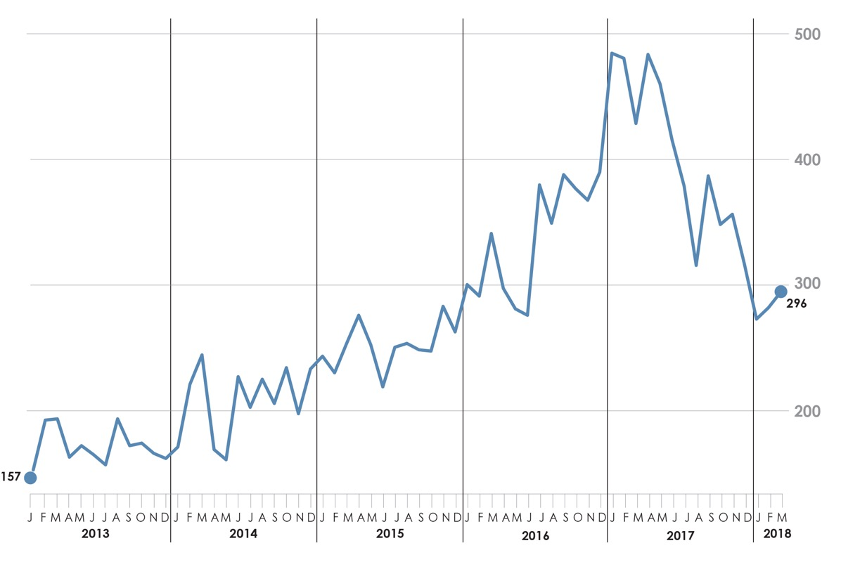

Number of unintentional drug overdose deaths, Ohio, Jan. 2013 - March. 2018
Note: 2018 data is provisional
Source: Health Policy Institute of Ohio, ”Ohio Addiction Policy Inventory and Scorecard: Overdose Reversal and Other Forms of Harm Reduction,” November 2018. Figure ES 1.
Data source: Ohio Public Health Data Warehouse, data accessed Nov. 5, 2018
Copyright © 2018 Health Policy Institute of Ohio. All rights reserved.

Slide 4
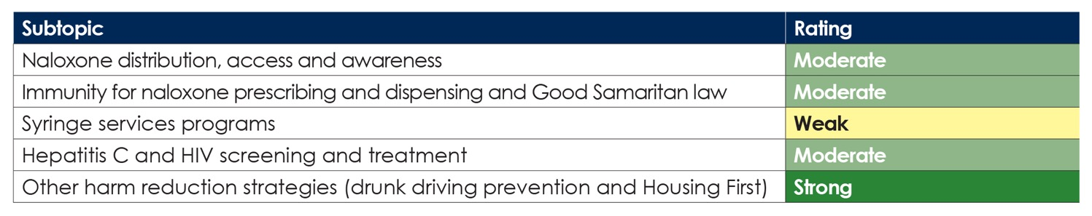
Summary scorecard rating
Extent to which Ohio policies and programs align with research evidence and reach Ohioans in need
Source: Health Policy Institute of Ohio, ”Ohio Addiction Policy Inventory and Scorecard: Overdose Reversal and Other Forms of Harm Reduction,” November 2018. Figure ES 2.
Data source: Ohio Public Health Data Warehouse, data accessed Nov. 5, 2018
Copyright © 2018 Health Policy Institute of Ohio. All rights reserved.

Slide 5
Key elements of a comprehensive policy response to addiction
Source: Health Policy Institute of Ohio, ”Ohio Addiction Policy Inventory and Scorecard: Overdose Reversal and Other Forms of Harm Reduction,” November 2018. Figure 1.
Copyright © 2018 Health Policy Institute of Ohio. All rights reserved.

Slide 6
HPIO Addiction Evidence Project: Overdose Reversal and Other Forms of Harm Reduction
Source: Health Policy Institute of Ohio, ”Ohio Addiction Policy Inventory and Scorecard: Overdose Reversal and Other Forms of Harm Reduction,” November 2018. Figure 2.
Copyright © 2018 Health Policy Institute of Ohio. All rights reserved.

Slide 7
Examples of addiction-related harms
Source: Health Policy Institute of Ohio, ”Ohio Addiction Policy Inventory and Scorecard: Overdose Reversal and Other Forms of Harm Reduction,” November 2018. Figure 3.
Copyright © 2018 Health Policy Institute of Ohio. All rights reserved.

Slide 8
Role of harm reduction in a comprehensive approach to addiction
Source: Health Policy Institute of Ohio, ”Ohio Addiction Policy Inventory and Scorecard: Overdose Reversal and Other Forms of Harm Reduction,” November 2018. Figure 4.
Copyright © 2018 Health Policy Institute of Ohio. All rights reserved.

Slide 9
County-level hepatitis C case rate per 100,000 population, 2016 and location of Syringe Services Programs
Source: Health Policy Institute of Ohio, ”Ohio Addiction Policy Inventory and Scorecard: Overdose Reversal and Other Forms of Harm Reduction,” November 2018. Figure 5.
Data source for SSP: 18 and counting: Another Ohio county starts syringe exchange, Harm Reduction Ohio; Syringe Exchanges in Ohio, Harm Reduction Ohio
Data source for hepatitis C: Vulnerable Counties and Jurisdictions Experiencing or At-Risk of Outbreaks, Centers for Disease Control and Prevention; Ohio Department of Health, Hepatitis Surveillance Program, data reported as of June 17, 2017.
Copyright © 2018 Health Policy Institute of Ohio. All rights reserved.

Slide 10
Ohio’s harm reduction “deserts”
Counties with insufficient access to overdose reversal or other harm reduction strategies
Note: Bolded counties appear in more than one category
Source: Health Policy Institute of Ohio, ”Ohio Addiction Policy Inventory and Scorecard: Overdose Reversal and Other Forms of Harm Reduction,” November 2018. Figure 6.
Copyright © 2018 Health Policy Institute of Ohio. All rights reserved.

Slide 11
Percent change in number of drug overdose deaths
by state, 12-month period ending in March 2017 to 12-month period ending in March 2018
Note: Based on provisional counts, which may not include all deaths that occurred during a given time period. Numbers are subject to change.
Source: Health Policy Institute of Ohio, ”Ohio Addiction Policy Inventory and Scorecard: Overdose Reversal and Other Forms of Harm Reduction,” November 2018. Figure 8.
Data source: National Center for Health Statistics, Vital Statistics Rapid Release, Provisional Drug Overdose Counts, as of Nov. 6, 2018
Copyright © 2018 Health Policy Institute of Ohio. All rights reserved.

Slide 12
Bystander present and naloxone administered by a lay person during overdose death, Ohio, 2016
Source: Health Policy Institute of Ohio, ”Ohio Addiction Policy Inventory and Scorecard: Overdose Reversal and Other Forms of Harm Reduction,” November 2018. Figure 9.
Data source: Enhanced State Opioid Overdose Surveillance (ESOOS) data, provided by the Ohio Department of Health, Oct. 11, 2018
Copyright © 2018 Health Policy Institute of Ohio. All rights reserved.

Slide 13
New hepatitis C cases* in Ohio
by number of cases, 2014-2017
*Includes all hepatitis C cases, both “acute” and “past or present” for 2013-2015 and both “acute” and “chronic” for 2016 and 2017.
Source: Health Policy Institute of Ohio, ”Ohio Addiction Policy Inventory and Scorecard: Overdose Reversal and Other Forms of Harm Reduction,” November 2018. Figure 10.
Data source: Ohio Department of Health, Hepatitis Surveillance Program Data. 2014-2017 data reported through June 25, 2018.
Copyright © 2018 Health Policy Institute of Ohio. All rights reserved.

Slide 14
Number of Ohio Medicaid enrollees diagnosed with and receiving treatment
for hepatitis C and HIV, 2015-2017*
* Calendar year
Note: Data includes fee-for-service and managed care enrollees of all ages
Source: Health Policy Institute of Ohio, ”Ohio Addiction Policy Inventory and Scorecard: Overdose Reversal and Other Forms of Harm Reduction,” November 2018. Figure 11.
Data source: Ohio Department of Medicaid, 2018
Copyright © 2018 Health Policy Institute of Ohio. All rights reserved.

Slide 15
Cost of hepatitis C prevention and treatment for people who use injection drugs
Source: Health Policy Institute of Ohio, ”Ohio Addiction Policy Inventory and Scorecard: Overdose Reversal and Other Forms of Harm Reduction,” November 2018. Figure 11. (see publication for data sources)
Copyright © 2018 Health Policy Institute of Ohio. All rights reserved.

Slide 16
New diagnoses of HIV infection in Ohio, 2013-2017
* Exposure categories for people who use Injection drugs include injection drug use only; male-to-male sex and injection drug use; injection drug use and heterosexual contact; and male-to-male sex, injection drug use and heterosexual contact.
Source: Health Policy Institute of Ohio, ”Ohio Addiction Policy Inventory and Scorecard: Overdose Reversal and Other Forms of Harm Reduction,” November 2018. Figure 13.
Data source: Ohio Department of Health, HIV/AIDS Surveillance Program. Data reported through June 30, 2018.
Copyright © 2018 Health Policy Institute of Ohio. All rights reserved.

Slide 17
Ohio hospital encounters for patients with endocarditis, by age group, 2008 and 2017
Source: Health Policy Institute of Ohio, ”Ohio Addiction Policy Inventory and Scorecard: Overdose Reversal and Other Forms of Harm Reduction,” November 2018. Figure 14.
Data source: Ohio Hospital Association
Copyright © 2018 Health Policy Institute of Ohio. All rights reserved.

Slide 18
Alcohol-related motor vehicle crashes resulting in injury and fatality, Ohio 2011-2017
Alcohol-related motor vehicle crashes resulting in injury and fatality, Ohio 2011-201
Source: Health Policy Institute of Ohio, ”Ohio Addiction Policy Inventory and Scorecard: Overdose Reversal and Other Forms of Harm Reduction,” November 2018. Figure 15.
Data source: Ohio Department of Public Safety
Copyright © 2018 Health Policy Institute of Ohio. All rights reserved.

Slide 19
Number of policy changes related to overdose reversal and other forms of harm reduction in Ohio, by type of policy change, Jan. 2013 – May 2018
Source: Health Policy Institute of Ohio, ”Ohio Addiction Policy Inventory and Scorecard: Overdose Reversal and Other Forms of Harm Reduction,” November 2018. Figure 16.
Data source: HPIO review of Ohio legislation, regulations, Governor’s Cabinet Opiate Action Team timeline and other policy summaries
Copyright © 2018 Health Policy Institute of Ohio. All rights reserved.

Slide 20
Number of addiction-related policy changes in Ohio, by topic, January 2013 to May 2018*
* Overdose reversal and other harm reduction policies were identified through May 2018, while prevention, treatment and recovery policies were identified through December 2017.
** Percents exceed 100 percent because some policies were counted in more than one category.
Source: Health Policy Institute of Ohio, ”Ohio Addiction Policy Inventory and Scorecard: Overdose Reversal and Other Forms of Harm Reduction,” November 2018. Figure 17.
Data source: HPIO review of Ohio legislation, regulations, Governor’s Cabinet Opiate Action Team timeline and other policy summaries
Copyright © 2018 Health Policy Institute of Ohio. All rights reserved.

Slide 21
Rate of naloxone administered by Ohio EMS Providers and unintentional overdose death rate, by county, 2017
Note: Twenty five counties are not included due to low overdose death rates (ODH suppresses the rate when there are fewer than 10 total deaths per year in a county). Clark and Fayette counties are outliers (very high naloxone administration rates) and have been removed from this analysis. Naloxone administration and overdose death rates are per 100,000 population.
Source: Health Policy Institute of Ohio, ”Ohio Addiction Policy Inventory and Scorecard: Overdose Reversal and Other Forms of Harm Reduction,” November 2018. Figure 20.
Data source for overdoses: Ohio Public Health Data Warehouse, Ohio Department of Health, accessed Sept. 26, 2018
Data source for naloxone rate: Naloxone Administration by Ohio EMS Providers by County, Ohio, 2017, Ohio Department of Public Safety, EMS data received as of Nov. 5, 2018.
Copyright © 2018 Health Policy Institute of Ohio. All rights reserved.

Slide 22
Overdose death rate, by county, 2012-2017 and Project DAWN sites
Note: Includes Ohio residents who died due to unintentional drug poisoning (underlying cause of death ICD-10 codes X40-X44). Rate suppressed if less than 10 total deaths for 2012-2017.
Source: Health Policy Institute of Ohio, ”Ohio Addiction Policy Inventory and Scorecard: Overdose Reversal and Other Forms of Harm Reduction,” November 2018. Figure 21.
Data source for overdoses: Adapted from “2017 Ohio Drug Overdose Data: General Findings.” Ohio Department of Health. Data source is Ohio Department of Health, Bureau of Vital Statistics; Analysis by ODH Injury Prevention Program; U.S. Census Bureau (Vintage 2016 population estimates)
Data source for Project DAWN sites: Project DAWN, Ohio Naloxone Distribution and Training Sites, Ohio Department of Health, as of Oct. 24, 2018.
Copyright © 2018 Health Policy Institute of Ohio. All rights reserved.

Slide 23
Download the complete “Ohio Addiction Policy Inventory
and Scorecard: Overdose Reversal and Other Forms of Harm Reduction” at
http://bit.ly/2RWMHjo
Copyright © 2018 Health Policy Institute of Ohio. All rights reserved.

